Slide 1
THE REAL MEANING OF PEACE
Notes:
Notes for Teacher - < Information for further reference or explanation >
Suggestions: <Ideas/ Images/ Animations / Others – To make better representation of the content >
Source of Multimedia Objects (Image/audio/ Video/Animation) used in this slide -
1. <Short Description> - <SOURCE URL>

Slide 2
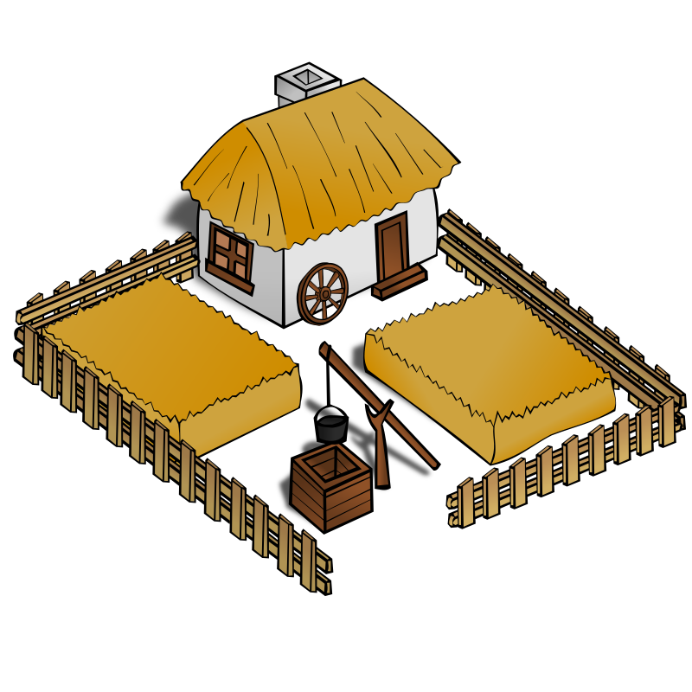
Perimeter / Area - Protection
A fencing/wall serves as protection of our property.
Notes:
Notes for Teacher –
We have just learnt that Perimeter is the distance covered along the boundary forming a closed figure when you go round the figure once.
Perimeter plays a great role when we need to put up a fencing/wall for the protection of our property. When you build a fence or wall around a place that forms the perimeter, the place becomes a safe place. No one can intrude inside.
In life, this fencing is nothing but peace and calm. When we protect ourselves with the fence of peace and inner calm, nothing can upset us. We are not affected by whatever happens around us.
Images-
Fenced property- https://openclipart.org/detail/11443/rpg-map-symbols-farm

Slide 3
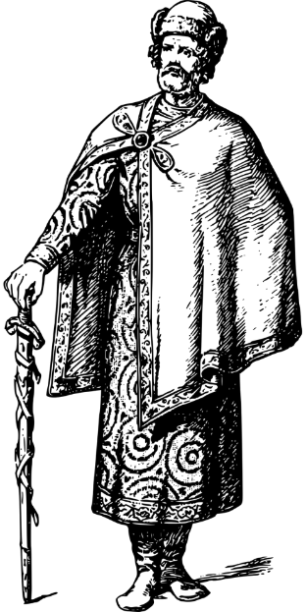


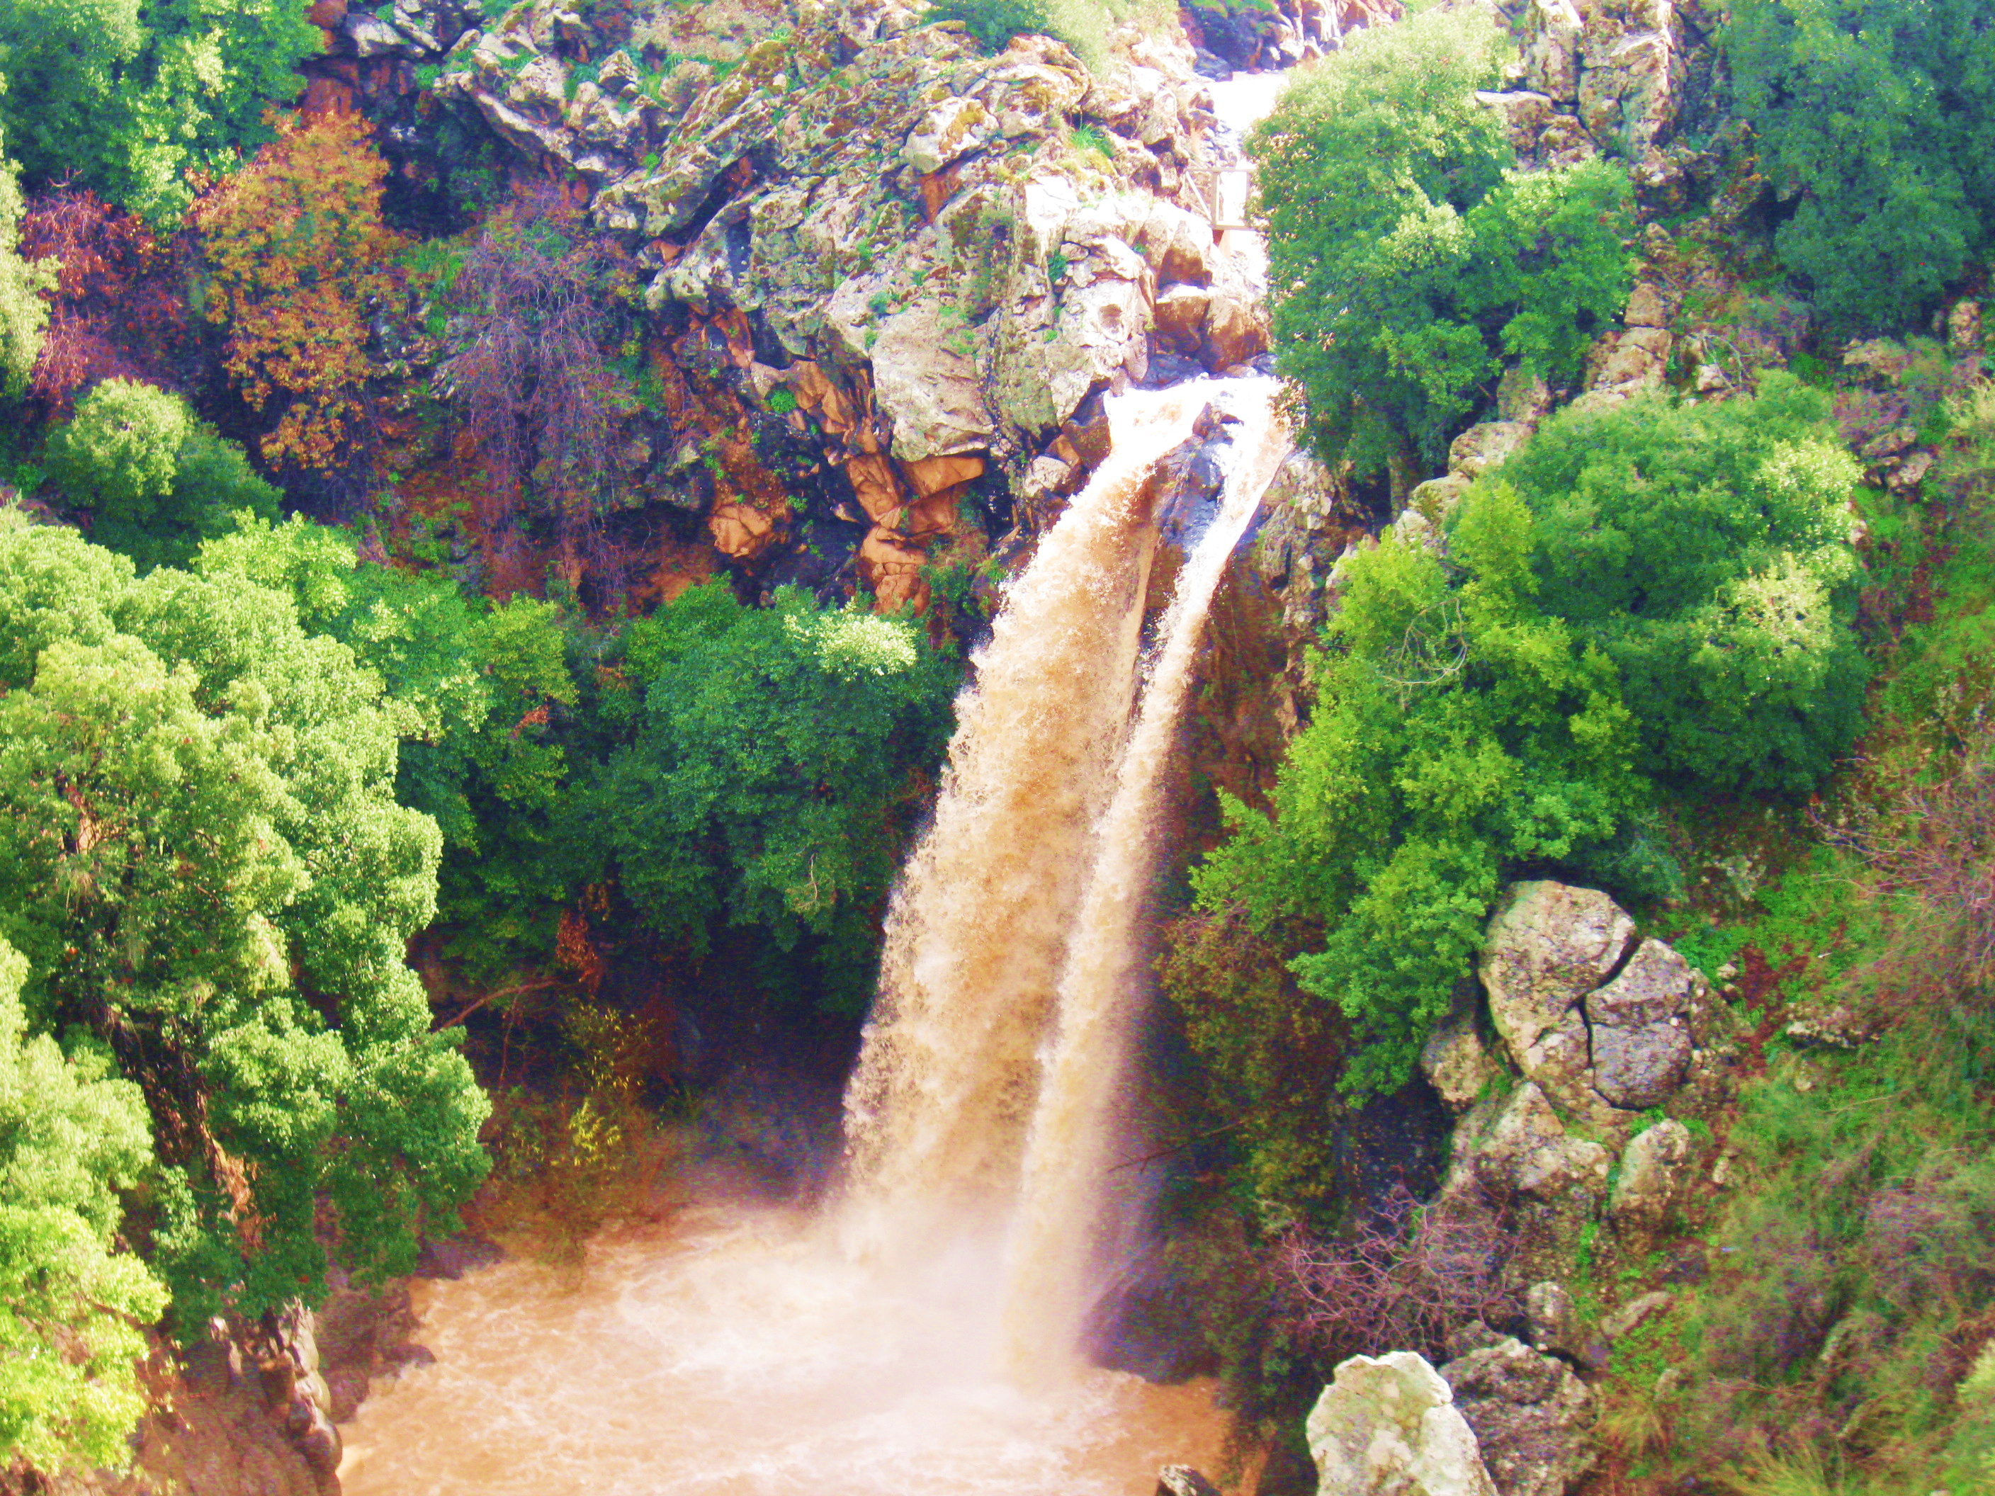

Best Picture of Peace
Notes:
Notes for Teacher –
Once a king announced a prize to the artist who would paint the best picture of peace. Many artists sent their pictures to the king. The king looked at all the pictures and liked only two. So he decided to choose between them.
One picture was of a calm lake. The sky was calm and blue with fluffy white clouds. Everyone found it to be a perfect picture of peace.
The other picture was not looking peaceful at all.
Children! Which picture would you choose if you were the King?
Images:
Calm - https://pixabay.com/illustrations/landscape-water-lake-rio-sky-3603564/
Turbulent- https://commons.wikimedia.org/wiki/File:PikiWiki_Israel_11912_Saar_waterfall.JPG

Slide 4
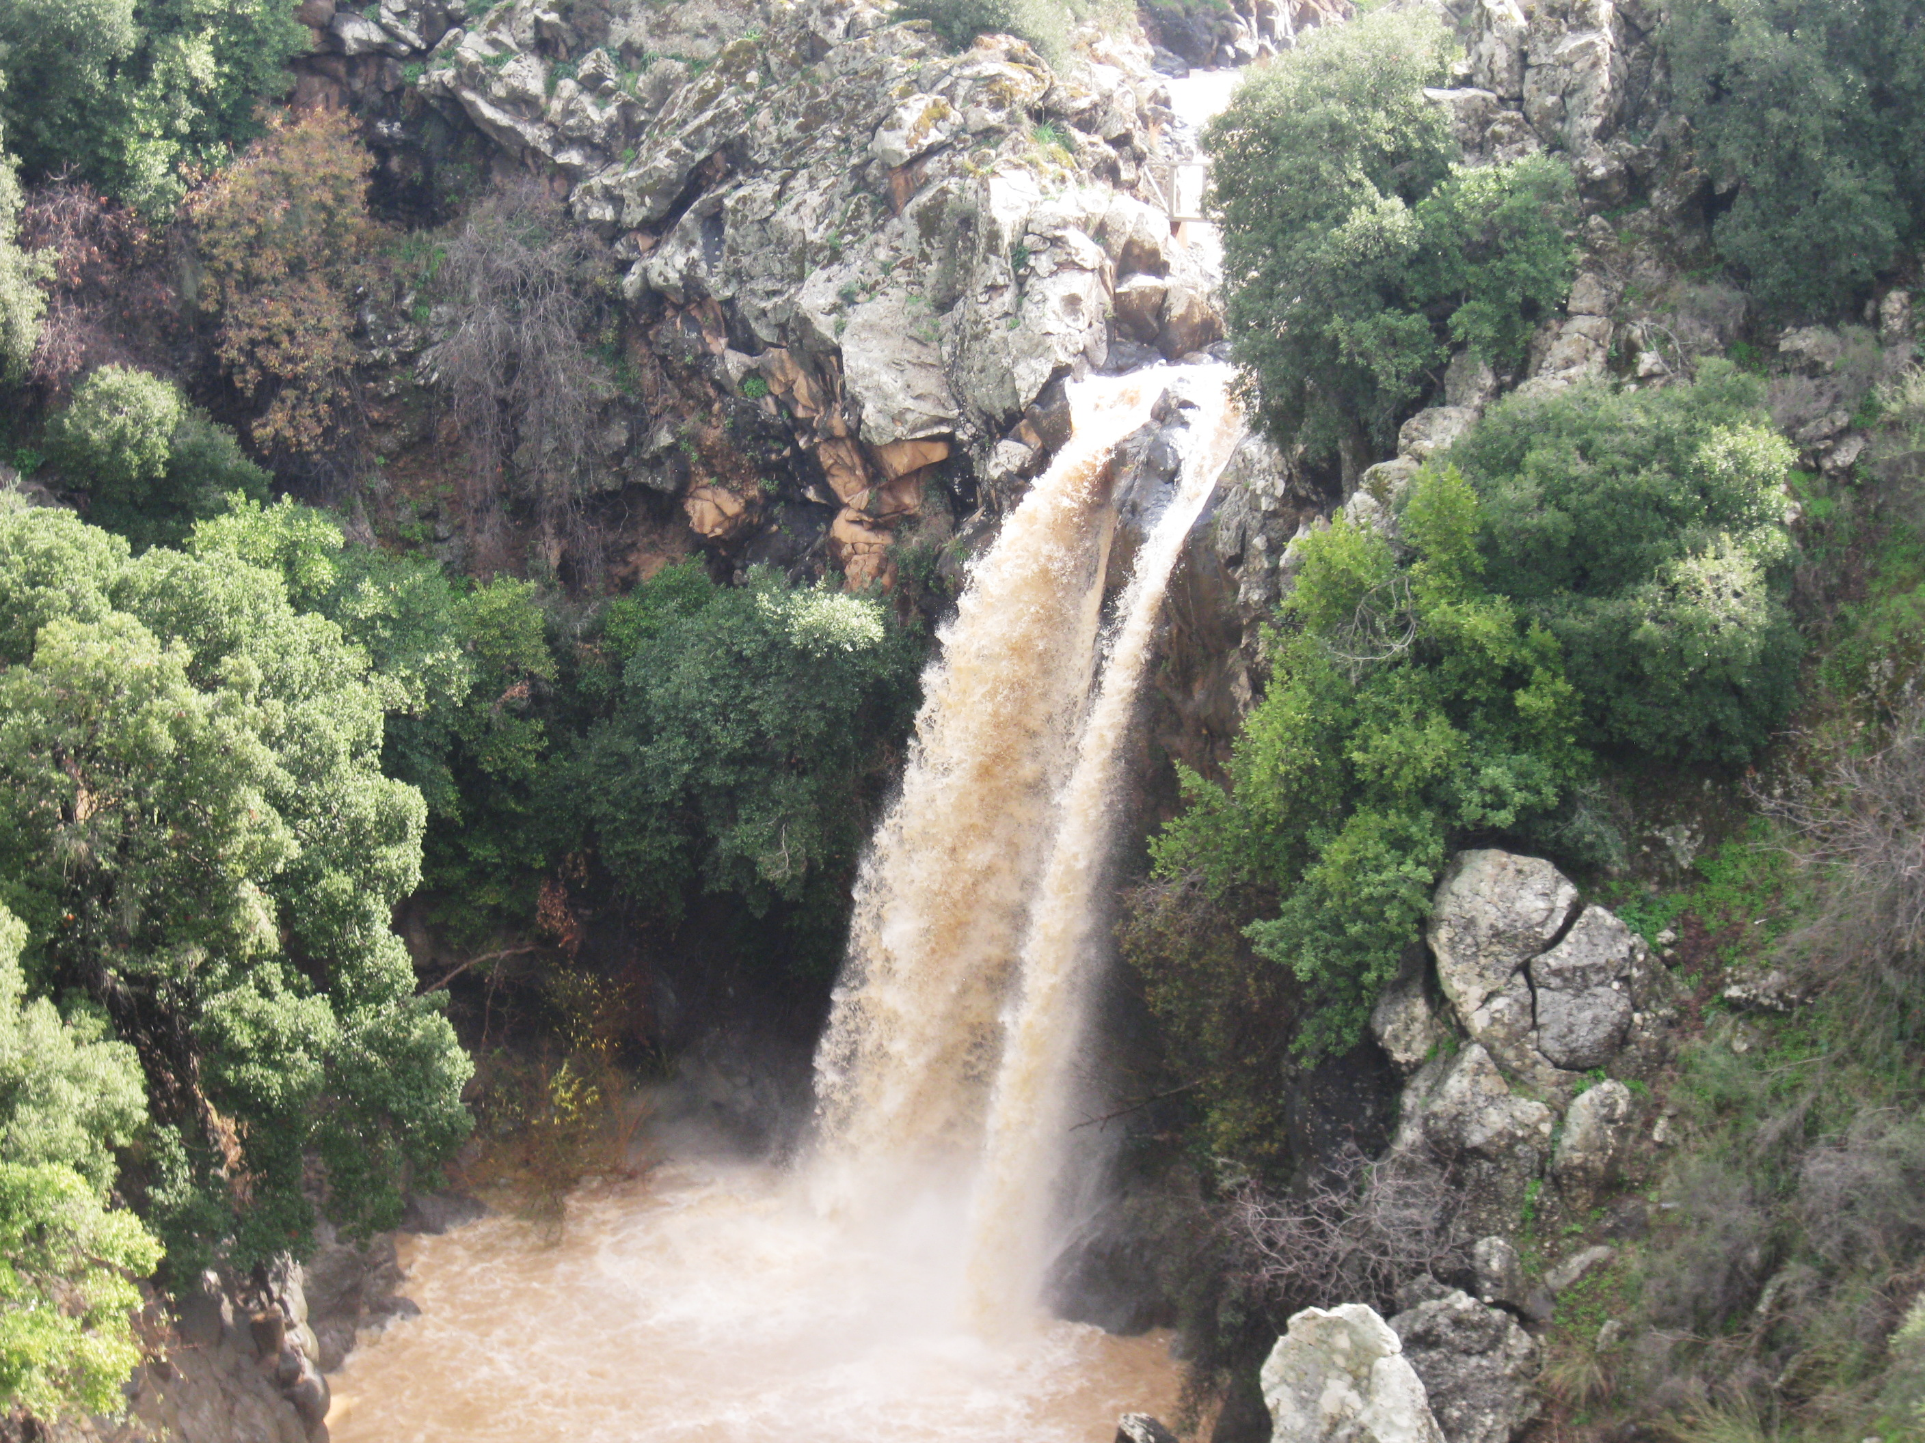
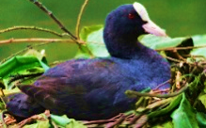
Best Picture of Peace
Notes:
Notes for Teacher –
The king chose the second picture. Do you know why?
When the king looked closely, he saw among the hurricane, A bird had built her nest in the bush. and the mother bird sat on her nest - in perfect peace.
Explained the king, "peace does not mean to be in a place where there is no noise, trouble, or hard work. Peace means to be in the midst of all those things and still be calm in your heart. That is the real meaning of peace."
Image
https://commons.wikimedia.org/wiki/File:PikiWiki_Israel_11912_Saar_waterfall.JPG

Slide 5
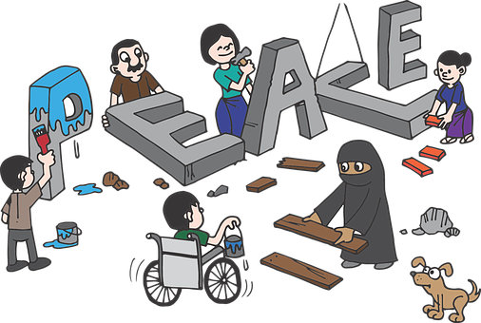
Learnings for Life
Life is full of trials and tribulations
We must surround ourselves with peace and calm
Then ups and downs of life will not bother us
Notes:
Notes for Teacher –
Peace- https://pixabay.com/illustrations/peace-peacebuild-peacebuilding-2288954/

Slide 6


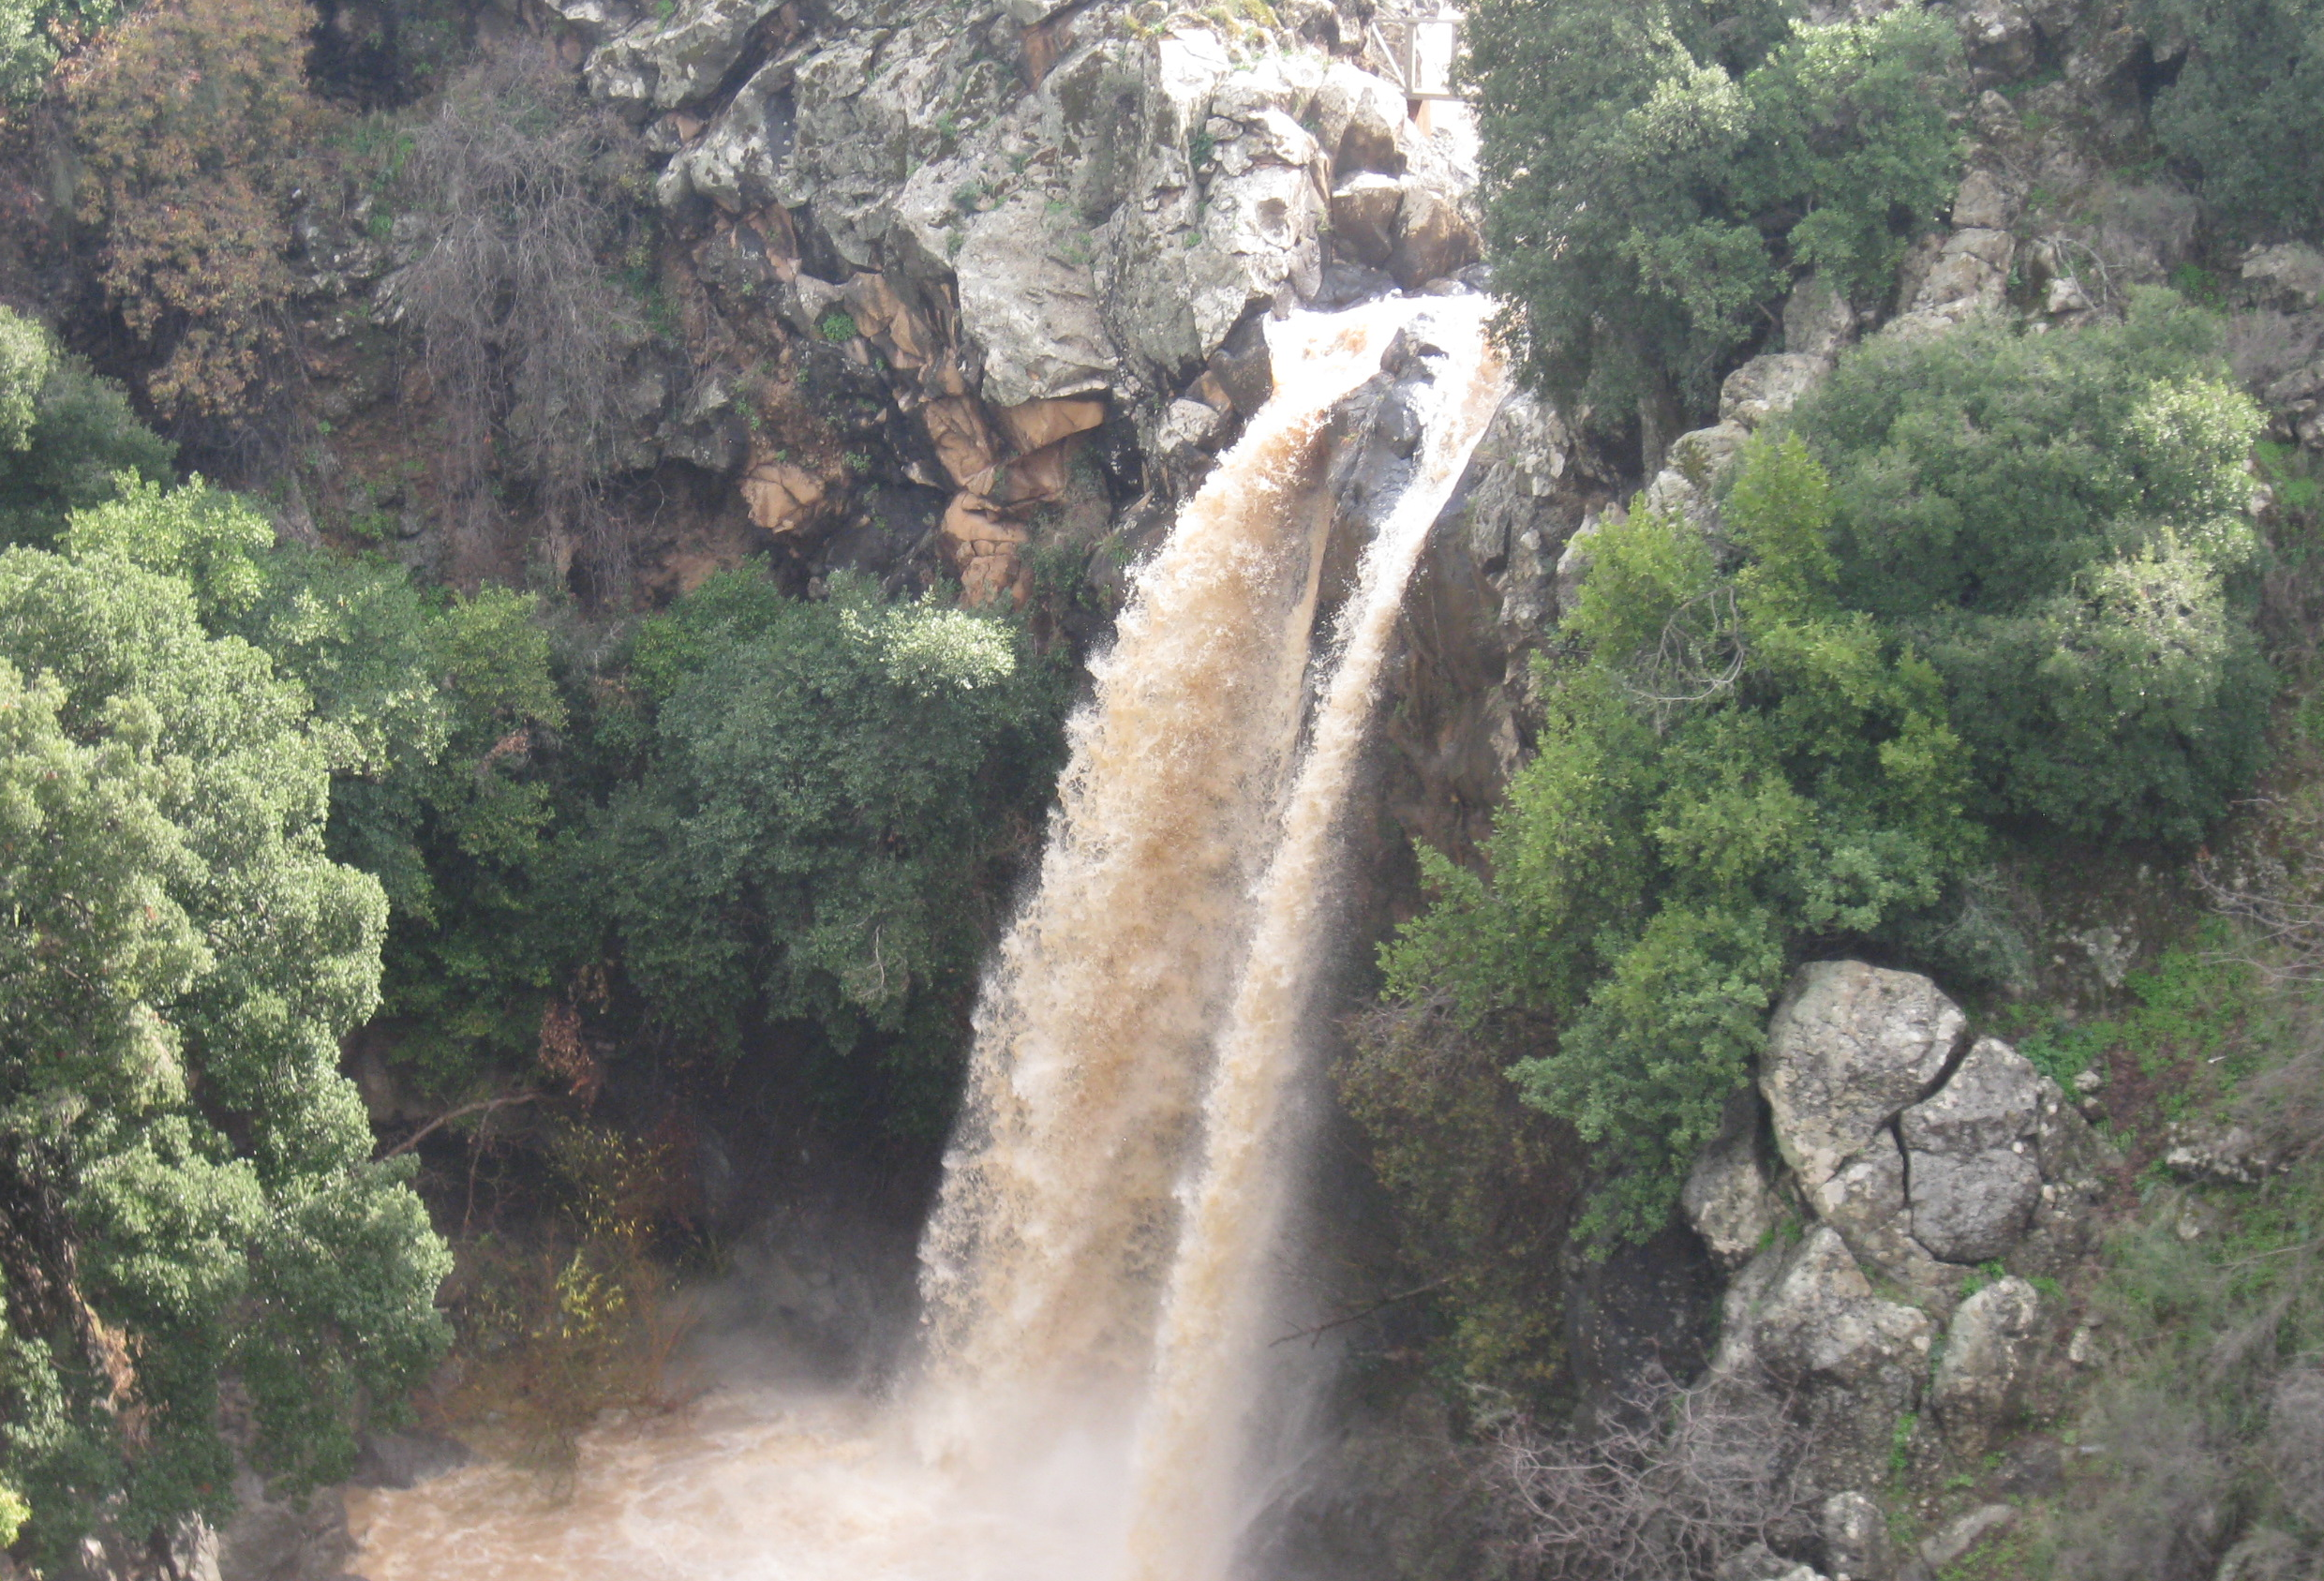




MM Index
Slide# | Thumbnail | Source and Attribution
2 |  | Fenced property- https://openclipart.org/detail/11443/rpg-map-symbols-farm
3 |  | Calm - https://pixabay.com/illustrations/landscape-water-lake-rio-sky-3603564/
3 |  | https://commons.wikimedia.org/wiki/File:PikiWiki_Israel_11912_Saar_waterfall.JPG
3 |  | https://pixabay.com/vectors/monarchy-people-prince-royal-1297783/
3 |  | https://pixabay.com/illustrations/cup-champion-nr1-winner-award-1614530/
3,4 |  | https://pixabay.com/photos/coot-water-bird-animal-nest-4276266/
5 |  | https://pixabay.com/illustrations/peace-peacebuild-peacebuilding-2288954/

