Slide 1
Construction of Angles

Slide 2
Construction of Angle
Angle:
An angle is formed when two lines are joined at a single point and the point they meet is called as Vertex.
Z
Angle
Y
X
Where, Y = Vertex
Here, angle is named as angle XYZ and is shown as ∠XYZ
Notes:
Slide Explanation:
There should step by step explanation, by mouse click or by arrow click on keyboard.

Slide 3
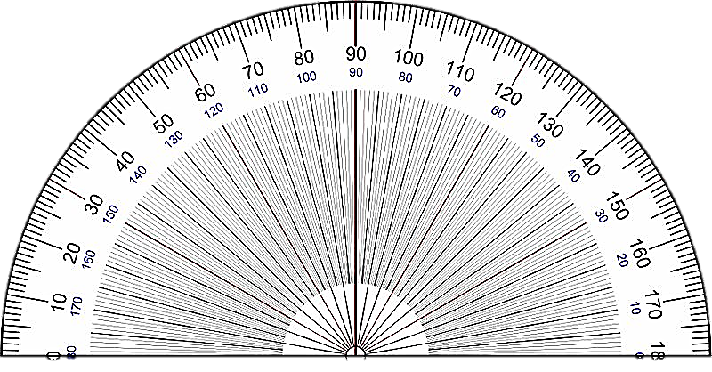
Construction of Angle
Example 1:
Construct an Angle of 60°
Step 1:
Using ruler draw a straight line and name it XY.
Step 2:
Place the center of protractor at point X of the line segment XY.
X
Y
Notes:
Image Source:
Protractor – CCO - https://commons.wikimedia.org/wiki/File:Protractor_Rapporteur_Degrees_V3.jpg

Slide 4
Construction of Angle
Step 3:
Starting from 0° on protractor move up to 60° and mark point at 60° name it as Z.
Step 4:
Remove the protractor and draw a line from point X to Z using ruler.
Z
60°
X
Y
Notes:
Image Source:
Protractor – CCO - https://commons.wikimedia.org/wiki/File:Protractor_Rapporteur_Degrees_V3.jpg

Slide 5
Construction of Angle
Example 2:
Construct an Angle of 140°
Step 1:
Using ruler draw a straight line and name it XY.
Step 2:
Place the center of protractor at point X of the line segment XY
X
Y
Notes:
Image Source:
Protractor – CCO - https://commons.wikimedia.org/wiki/File:Protractor_Rapporteur_Degrees_V3.jpg

Slide 6
Construction of Angle
Step 3:
Starting from 0° on protractor move up to 140° and mark point at 140° name it as Z.
Step 4:
Remove the protractor and draw a line from point X to Z using ruler.
Z
140°
X
Y
Notes:
Image Source:
Protractor – CCO - https://commons.wikimedia.org/wiki/File:Protractor_Rapporteur_Degrees_V3.jpg

Slide 7
Reflex angle
An angle that is greater than 180° and less than 360°
is called Reflex angle
Reflex angle
c
A
B
Notes:
Slide Explanation:
There should step by step explanation, by mouse click or by arrow click on keyboard.

Slide 8
Construct a Reflex angle
Example 3:
Construct an Angle of 240°
Firstly, we need to subtract the reflex angle of 240° from 360° and then draw the angle. (360° - 240° = 120°)
Step 1:
Using ruler draw a straight line and name it PQ.
Step 2:
Place the protractor upside down with its center at point P of the line segment PQ
P
Q
Notes:
Image Source:
Protractor – CCO - https://commons.wikimedia.org/wiki/File:Protractor_Rapporteur_Degrees_V3.jpg

Slide 9
Construct a Reflex angle
Step 3:
Initially we subtracted 240° from 360°, the resulting angle is 120°. So starting from 0° on protractor move up to 120° and mark point at 120° name it as R.
Step 4:
Remove the protractor and draw a line from point P to R using ruler.
240°
P
Q
R
Notes:
Image Source:
Protractor – CCO - https://commons.wikimedia.org/wiki/File:Protractor_Rapporteur_Degrees_V3.jpg

Slide 10
Constructing an Angle Equal in measure to an angle with unknown measure
Example 4:
Step 1:
Draw an angle with any measure. ∠CBA.
Step 2:
Draw another line XY.
C
B
A
X
Y
Notes:
Notes for teacher: For this exercise compass and ruler is required.
Construction of an angle equal in measure to a given angle of unknown measure
Since we do not know the measure of the given angle and we only have the figure,we cannot draw it using the protractor. Hence we will be using the ruler and the compass to construct this.
Steps of Construction

Slide 11
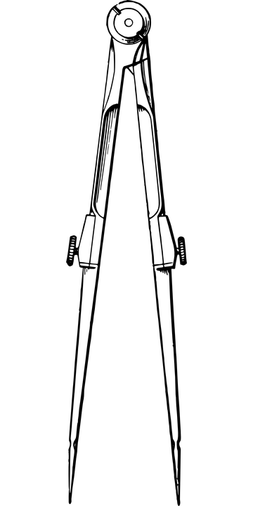
Constructing an Angle Equal in measure to an angle with unknown measure
Step 3:
Place the compass at the point B and draw an arc which cuts the arms BA and BC.
Step 4:
With the same measurement keep the compass at X and draw an arc. Name the arc which intersect the line XY as M.
C
B
A
X
M
Y
Notes:
Notes for teacher: For this exercise compass and ruler is required.
Construction of an angle equal in measure to a given angle of unknown measure
Since we do not know the measure of the given angle and we only have the figure,we cannot draw it using the protractor. Hence we will be using the ruler and the compass to construct this.
Image Source:
Compass: https://pixabay.com/vectors/dividers-compasses-circle-tool-37921/

Slide 12
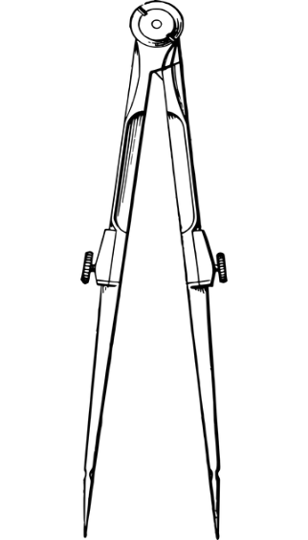
Constructing an Angle Equal in measure to an angle with unknown measure
Step 5:
Measure the arc length of figure CAB with the compass.
Step 6:
With the same radius keep the compass at M on XY and draw an arc. Name the intersected arc as N
C
N
B
A
X
M
Y
Notes:
Notes for teacher: For this exercise compass and ruler is required.
Construction of an angle equal in measure to a given angle of unknown measure
Since we do not know the measure of the given angle and we only have the figure,we cannot draw it using the protractor. Hence we will be using the ruler and the compass to construct this.
Image Source:
Compass: https://pixabay.com/vectors/dividers-compasses-circle-tool-37921/

Slide 13
Constructing an Angle Equal in measure to an angle with unknown measure
Step 7:
Join XN.
Now measure the angle ∠NXY and ∠CBA. Both should be equal.
C
N
B
A
X
M
Y
Notes:
Notes for teacher: For this exercise compass and ruler is required.
Construction of an angle equal in measure to a given angle of unknown measure
Since we do not know the measure of the given angle and we only have the figure,we cannot draw it using the protractor. Hence we will be using the ruler and the compass to construct this.
Image Source:
Compass: https://pixabay.com/vectors/dividers-compasses-circle-tool-37921/

Slide 14

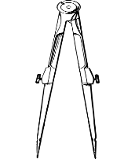
MM Index
Slide# | Thumbnail | Source and Attribution
3, 4, 5, 6, 8, 9 |  | Protractor – CCO - https://commons.wikimedia.org/wiki/File:Protractor_Rapporteur_Degrees_V3.jpg
11, 12 |  | https://pixabay.com/vectors/dividers-compasses-circle-tool-37921/

