Slide 1
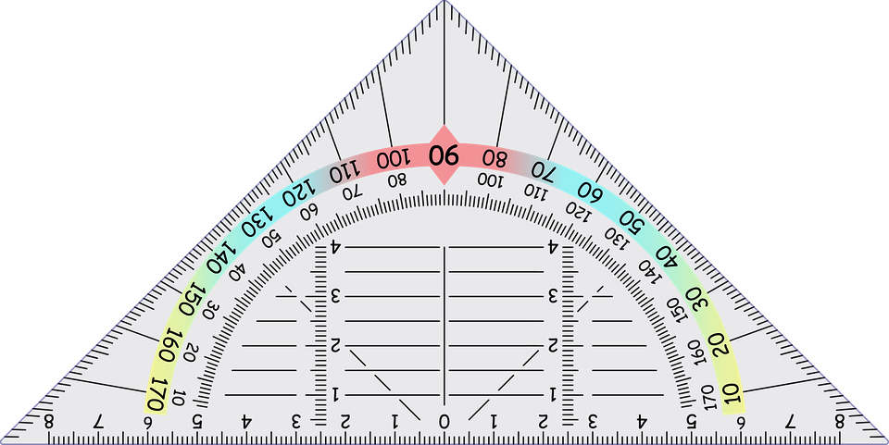
Test your skills
Notes:
Notes for Teacher - N/A
Suggestions: N/A
Source of Multimedia Objects (Image) used in this slide -
https://pixabay.com/vectors/angle-college-fixed-improved-2024916/

Slide 2


Bisectors of an angle
Fill in the Blanks
An angular bisector divides the angle into
_____________.
two equal parts
90°
A perpendicular to a line make __ with the line.
angle
An _____ is the space between two intersecting lines.
A perpendicular bisector makes ___ with the line and ______ into two.
90°
bisects
Answer
Notes:
Notes for Teacher - N/A
Suggestions: N/A
Source of Multimedia Objects (Image) used in this slide - N/A

Slide 3
Bisectors of an angle
Draw an obtuse angle of any measure say 110° and draw the copy of the angle
Z
110°
X
Y

Slide 4
Bisectors of an angle
Construction of 110°
Step: 2
Draw a line and name two points at both ends as P,Q
P
Q
Notes:
Notes for Teacher - N/A
Suggestions: N/A
Source of Multimedia Objects (Image) used in this slide - N/A

Slide 5
Bisectors of an angle
Construction of 110°
Step: 3
Keep the compass at X (fig of step a) and draw an arc. With the same radius keep the compass at P and draw an arc which cuts the line PQ at O
O'
P
O
Q
Notes:
Notes for Teacher - N/A
Suggestions: N/A
Source of Multimedia Objects (Image) used in this slide - N/A

Slide 6
Bisectors of an angle
Construction of 110°
Step: 4
Keep the compass at O and with the same radius cut the arc. The intersected point is O'. Join P and O'.
O’
P
O
Q
Notes:
Notes for Teacher - N/A
Suggestions: N/A
Source of Multimedia Objects (Image) used in this slide - N/A

Slide 7
Bisectors of an angle
Construction of the perpendicular at a point
Step: 1
Draw a big line and mark a point A approximately in the middle of the line and name the other end of the line as B.
A
B

Slide 8
Bisectors of an angle
Construction of the perpendicular at a point
Step: 2
With any convenient radius draw arcs with the help of compass on both sides of A.
P
A
Q
B

Slide 9
Bisectors of an angle
Construction of the perpendicular at a point
Step: 2
Keeping the compass and taking more than the length of PA, draw an arc above the line. With the the same measurement keep the compass at Q and draw the arc which intersects the arc. Name it as C.
C
P
Q
B
A

Slide 10
Bisectors of an angle
Construction of the perpendicular at a point
Step: 3
Join the points A and C which is the perpendicular line.
C
P
Q
B
A

Slide 11
Bisectors of an angle
Keep the compass at A and with any convenient radius draw an arc which cuts the line AP and AC at X and Y respectively.
(ii) Bisect the angle 90° to the left of A
Step: 3
C
Y
X
P
Q
B
A

Slide 12
Bisectors of an angle
(ii) Bisect the angle 90° to the left of A
Step: 4
Keep the compass at X and taking more than half of length XY draw an arc. With the same measurement keep the compass at Y and draw an arc which intersects the before arc. Name the point as D. Now join the points A and D which is the required angle ∠﻿ DAB = 135﻿°﻿
D
C
Y
X
P
A
Q
B

Slide 13
Bisectors of an angle
Angular bisector of 108°
Step: 1
Construct an ∠﻿ QRS = 108﻿°﻿ with the help of the protractor
Q
108°
R'
R
S
Notes:
Notes for Teacher - N/A
Suggestions: N/A
Source of Multimedia Objects (Image) used in this slide - N/A

Slide 14
Bisectors of an angle
Angular bisector of 108°
Step: 2
Keep the compass at R and draw an arc with convenient radius. The arcs intersects the lines RS and RQ at P and O respectively.
Q
O
R'
R
P
S
Notes:
Notes for Teacher - N/A
Suggestions: N/A
Source of Multimedia Objects (Image) used in this slide - N/A

Slide 15
Bisectors of an angle
Angular bisector of 108°
Step: 3
Keep the compass at P and taking more than half of the length of OP draw an arc. With the same measurement keep the compass at O and draw an arc.
Q
T
O
R'
R
P
S
Notes:
Notes for Teacher - N/A
Suggestions: N/A
Source of Multimedia Objects (Image) used in this slide - N/A

Slide 16
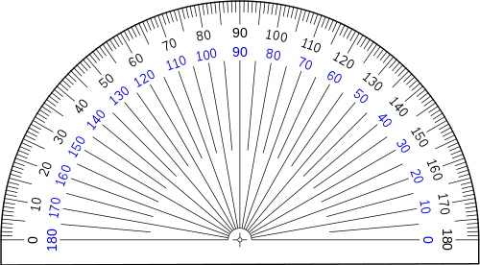
Bisectors of an angle
Angular bisector of 108°
Step: 4
The arcs drawn will intersect and name the point as T. Hence ﻿∠﻿ ORT = ﻿∠﻿ TRP = 54﻿°﻿
Q
T
54°
O
54°
R'
R
P
S
Notes:
Notes for Teacher - N/A
Suggestions: N/A
Source of Multimedia Objects (Image) used in this slide - N/A

Slide 17

MM Index
Slide# | Thumbnail | Source and Attribution
1 |  | https://pixabay.com/vectors/angle-college-fixed-improved-2024916/
7 |  | https://commons.wikimedia.org/wiki/File:Rapporteur_180deg.svg

