Slide 1
CONSTRUCTION OF
PARALLEL LINES
n
m
Notes:
Notes for Teacher - < Information for further reference or explanation >
Suggestions: <Ideas/ Images/ Animations / Others – To make better representation of the content >
Source of Multimedia Objects (Image/audio/ Video/Animation) used in this slide -
1. <Short Description> - <SOURCE URL>

Slide 2
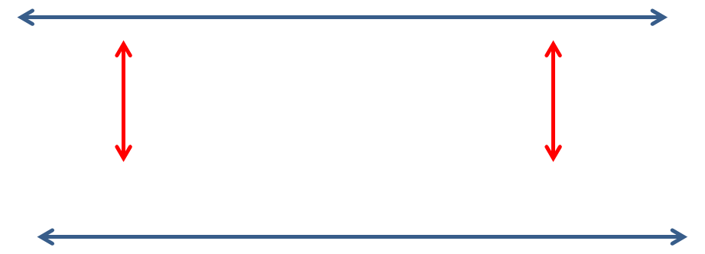
What Are Parallel Lines???
These are lines when extended in both directions, never meet each other.
Notes:
Notes for Teacher - < Information for further reference or explanation >
Suggestions: <Ideas/ Images/ Animations / Others – To make better representation of the content >
Source of Multimedia Objects (Image/audio/ Video/Animation) used in this slide -
1. <Short Description> - <SOURCE URL>

Slide 3
Constructing Parallel Lines……
Based on Alternate interior angle property
The theorem says that when two lines are parallel, then the Alternate Interior Angles are equal.
1
n
2
m
If two lines(m & n) are cut by a transversal (l) so that the alternate interior angles( 1 &2 ) are equal, then these lines are parallel.

Slide 4
Constructing Parallel Lines
Step 1 : Draw a straight line m and mark a point X outside the line. Then mark any point Y on it.
x
y
m
Step 2 : Join X and Y.

Slide 5

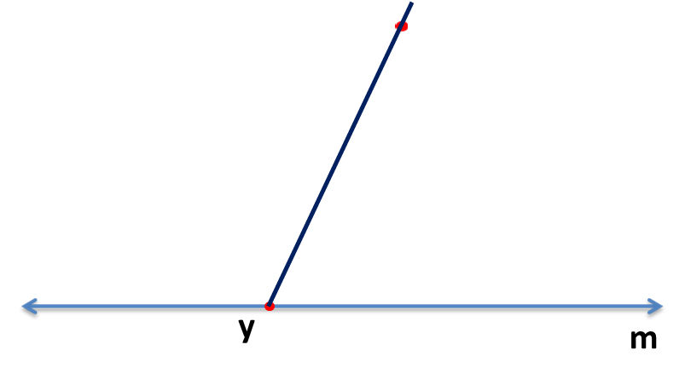

Constructing Parallel Lines
Step 3 : Draw an arc CD at Y on the right hand side of the transversal.
E
X
G
F
D
C
Step 4 : With the same radius draw an arc EF at point X on the left hand side of the transversal cutting XY at G.

Slide 6
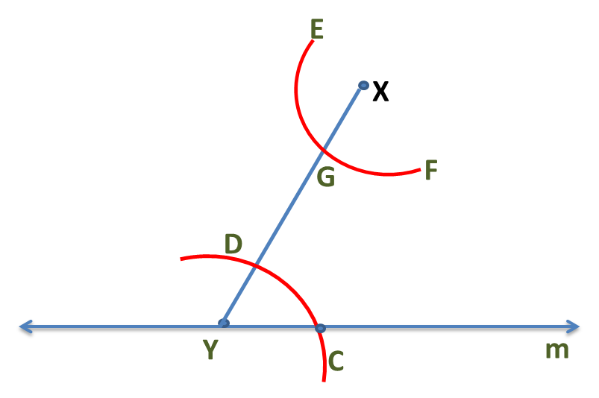
Constructing Parallel Lines……
Step 5 : Measure arc CD with a compass
J
Step 6: Make the same measurement on arc EF with G as center and mark the intersection as J.

Slide 7
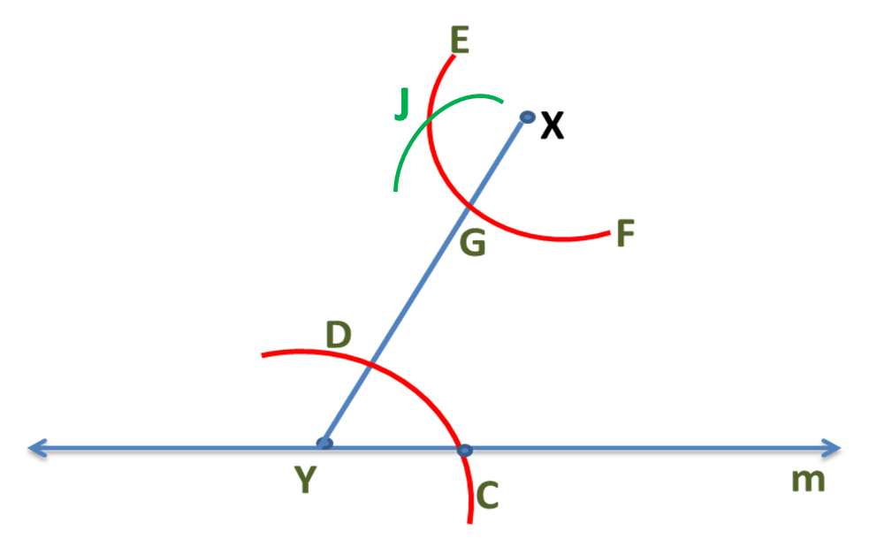
Constructing Parallel Lines……
Step 7 :Join J and X and draw a line n.

Slide 8
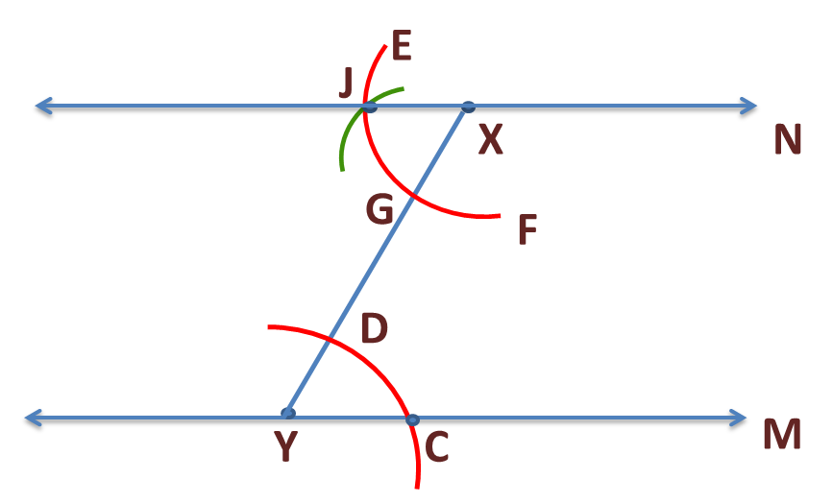
Constructing Parallel Lines……
⦟YXJ =⦟XYC are alternate interior angles
We have constructed line n parallel to m using alternate interior angles property.

Slide 9
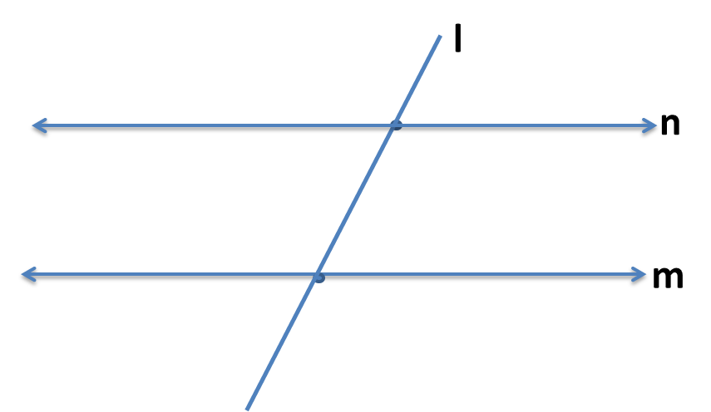



Constructing Parallel Lines??
Based on corresponding angle property theorem
When the lines are parallel, then the corresponding angles are equal.
1
2
If two lines(m & n) are cut by a transversal (l) such that the corresponding angles ( 1 &2 ) are equal, then these lines are parallel.

Slide 10
Constructing Parallel Lines
Step 1 : Draw a straight line m and mark a point X outside the line. Then mark any point Y on it.
x
y
m
Step 2 : Join X and Y.

Slide 11
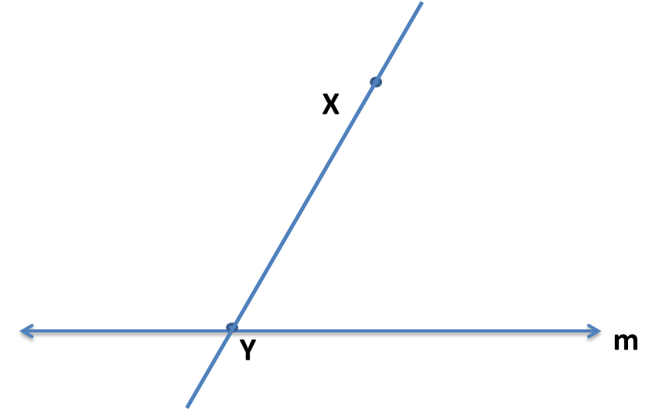
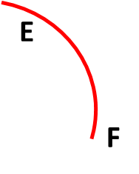
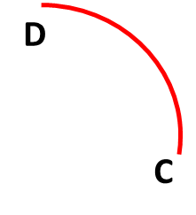
Constructing Parallel Lines
Step 3 : Draw an arc CD at point Y on the right hand side of the transversal.
G
D
z
C
Step 4 : With X as centre and the same radius, draw an arc EF cutting XY at G.

Slide 12

Constructing Parallel Lines
Step 5 : Measure arc CD with a compass
G
J
D
z
C
Step 6 :Make the same measurement on arc EF with E as center and mark the intersection as J.

Slide 13
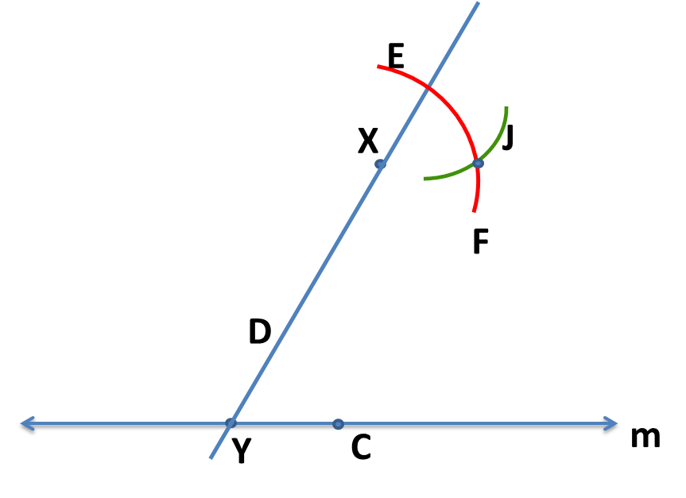
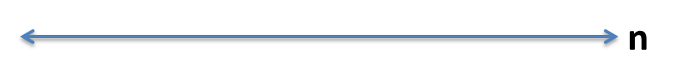
Constructing Parallel Lines
Step 7 : Join X and J and draw line n.
G
C
Step 8: Observe that ⦟EXJ=⦟XYC (corresponding angles)

Slide 14
Constructing Parallel Lines
E
G
X
J
n
F
D
Y
C
m
Therefore, based on Corresponding Interior Angles Property, we have constructed n parallel to m.
Notes:
All original creations by surekhapsarathy@gmail.com

Slide 15
MM Index
Slide# | Thumbnail | Source and Attribution

