Slide 1


THINK AND ANSWER
Notes:
Images- SSSVV Gallery (Clipart)

Slide 2
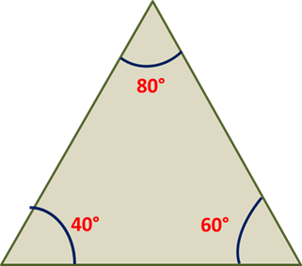
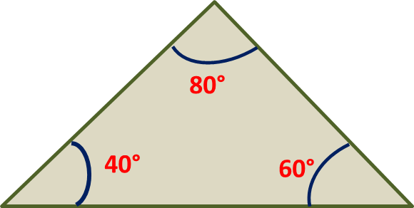
Answer the following
1. Is it possible to draw a unique triangle if the three angles are known?
Yes, but they will not be unique.
These triangles will have the same shape but differ in size as shown below.
80°
40°
60°
Notes:
https://pixabay.com/vectors/protractor-angle-geometry-46461/

Slide 3
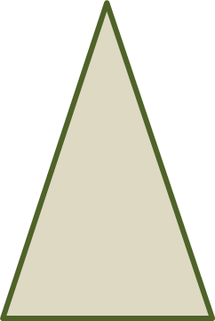
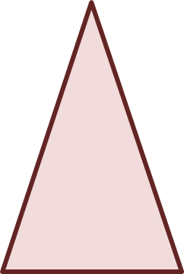
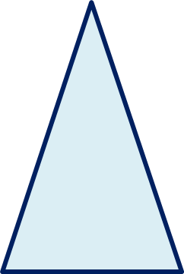
Answer the following
2. Is it possible to draw a unique triangle if the three sides are known?
      Yes, by SSS criteria.
      Each of the triangles shown below has the same size and shape.
5 cm
6 cm
5 cm
6 cm
5 cm
6 cm
4 cm
4 cm
4 cm
Notes:
Notes for Teacher - < Information for further reference or explanation >
Suggestions: <Ideas/ Images/ Animations / Others – To make better representation of the content >
Source of Multimedia Objects (Image/audio/ Video/Animation) used in this slide -
1. <Short Description> - <SOURCE URL>

Slide 4
Answer the following
3. Construct an isosceles right triangle whose one angle is 45° and one side is 5cm. State the criteria used for construction.
Steps of construction :
R
1. Draw a rough diagram
90°
45°
P
Q

Slide 5
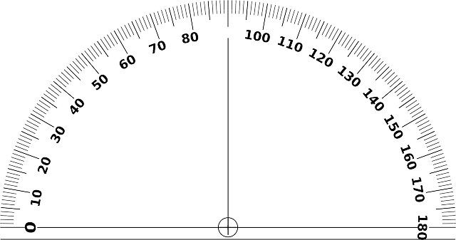

Answer the following
Steps of construction :
2. Draw a line segment PQ = 5 cm.
P
5 cm
Q
3. Using the protractor draw an angle 90° at point P.
5 cm
Q

Slide 6
Answer the following
Steps of construction :
4. Using the protractor draw an angle 45° at point Q.
5. Produce the angular lines to meet at R.
R
90°
45°
5 cm
Q

Slide 7
Answer the following
RPQ is an isosceles right triangle.
ASA Criteria is used for construction.
R
90°
45°
5 cm
Q

Slide 8
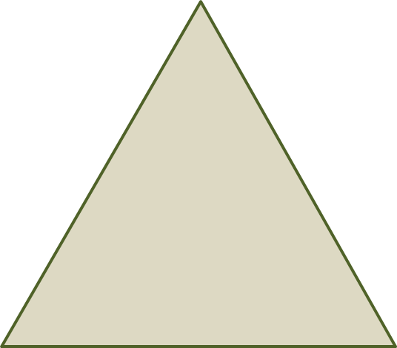
Answer the following
4. Construct an isosceles triangle XYZ in which one of the equal sides is 5.8cm and vertex angle is 50°. State the criteria used for construction. Measure the other two angles.
Z
Steps of construction :
65°
1. Draw a rough diagram with the measurements.
5.8 cm
50°
65°
X
5.8 cm
Y

Slide 9
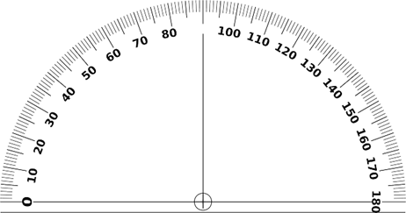
Answer the following
Steps of construction :
2. Draw a line segment XY of length 5.8 cm.
3. With X as centre draw an angle of 50°.
X
5.8 cm
Y

Slide 10
Answer the following
Steps of construction :
4. With X as centre and a radius of 5.8 cm draw an arc cutting the angular line at Z.
5. Join ZY.
Z
65°
5.8 cm
50°
65°
X
Y
5.8 cm

Slide 11
Answer the following
∆ XYZ is the triangle by SAS criteria.
The other two angles LY and LZ measure 65° each.
Z
65°
5.8 cm
50°
65°
X
Y
5.8 cm

Slide 12

MM Index
Slide# | Thumbnail | Source and Attribution
5 |  | https://pixabay.com/vectors/protractor-angle-geometry-46461/

