Slide 1
TRIANGLES
AROUND US

Slide 2
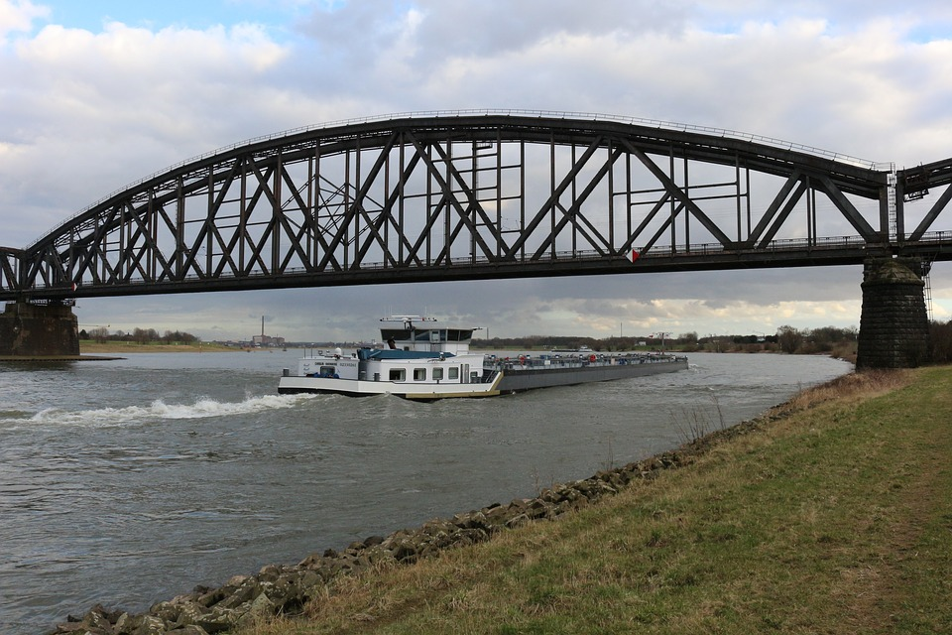
Triangles Around Us
Bridges
We often observe that the metallic bridges over railway tracks or flyovers are designed using triangles.
Notes:
Truss_of railway Bridge
( labeled for reuse and modification )
https://pixabay.com/en/railway-bridge-truss-bridge-bridge-1594192/

Slide 3
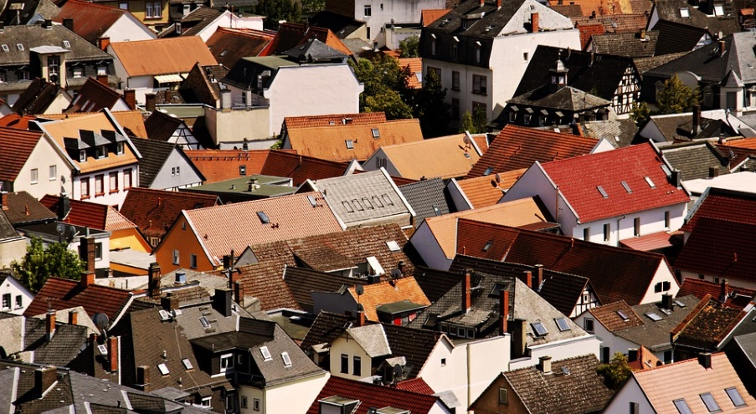
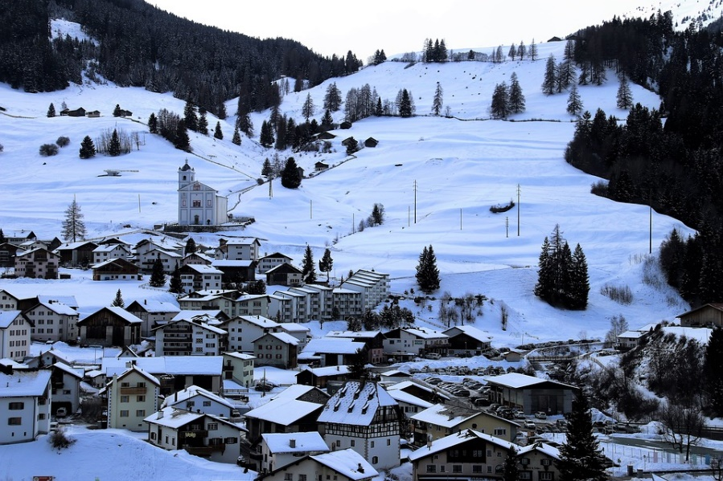
Triangles Around Us
Rooftops
The rooftops of buildings are often made triangular so that rain water or snow falls off the building easily.
Notes:
rooftops of buildings ,<( labeled for and reuse and modification )
https://pixabay.com/en/city-roofs-house-roofs-architecture-3632286/
2. https://pixabay.com/en/snow-winter-mountains-the-alps-3137271/

Slide 4

Triangles Around Us
Billiard ball racks
On a billiard table, the pool balls are arranged in the shape of equilateral triangle using the Billiard ball racks.
Notes:
Billiard ball racks
( labeled for non commercial purpose and reuse)
https://pixabay.com/en/billiards-game-3d-balls-play-1167221/

Slide 5
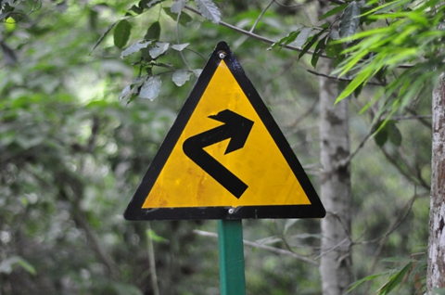
Triangles Around Us
Road signs
We find road signs are often triangular in shape. These are warning signs indicated to the driver about the possible hazard ahead on the road.
Notes:
Road signs
( labeled for non commercial purpose and reuse)
https://pixabay.com/en/signs-turn-right-road-signs-2761122/

Slide 6
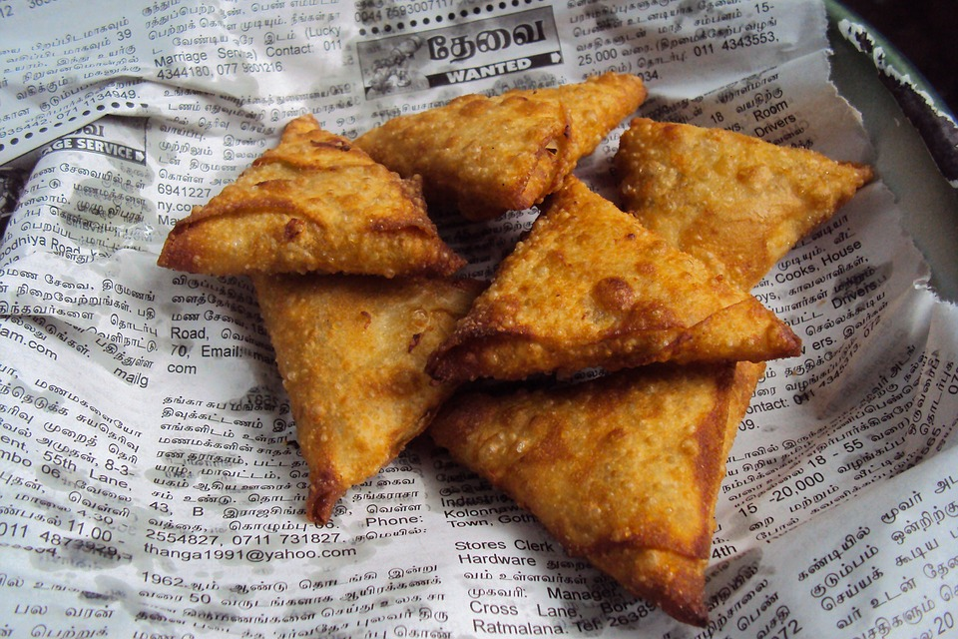
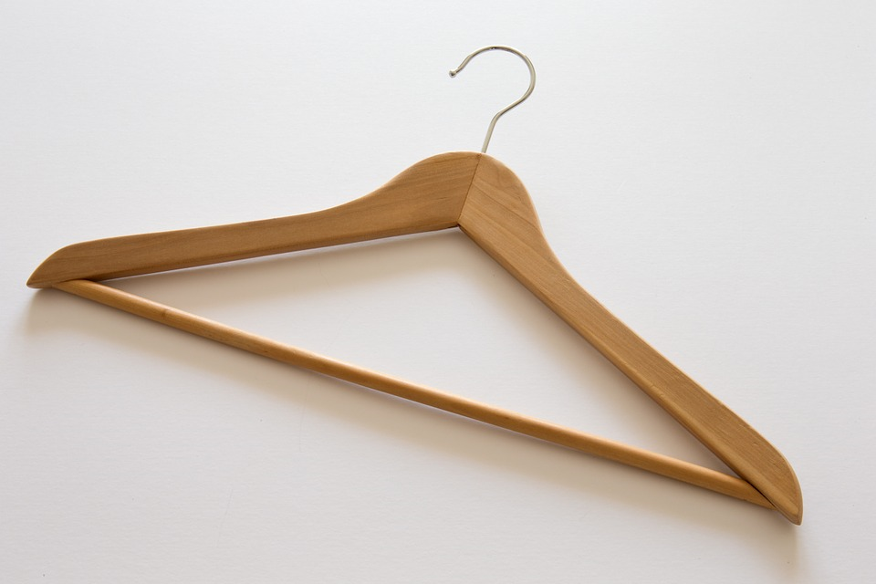
Triangles Around Us
Design of articles
Many products are designed in triangular shape for aesthetics.
Notes:
Samosas , Clothes Hangers
( labeled for reuse with modification)
https://pixabay.com/en/samosa-fast-food-sri-lanka-indian-165850/
https://pixabay.com/en/clothes-hanger-traditional-429279/

Slide 7


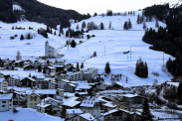




MM Index
Slide# | Thumbnail | Source and Attribution
2 |  | https://pixabay.com/en/railway-bridge-truss-bridge-bridge-1594192/
3 |  | https://pixabay.com/en/city-roofs-house-roofs-architecture-3632286/
3 |  | https://pixabay.com/en/snow-winter-mountains-the-alps-3137271/
4 |  | https://pixabay.com/en/signs-turn-right-road-signs-2761122/
5 |  | https://pixabay.com/en/billiards-game-3d-balls-play-1167221/
6 |  | https://pixabay.com/en/samosa-fast-food-sri-lanka-indian-165850/
6 |  | https://pixabay.com/en/clothes-hanger-traditional-429279/

