Slide 1
Construction of Triangles-SSS Criterion
Notes:
Notes for Teacher – N/A
Suggestions: N/A
Source of Multimedia Objects (Image/audio/ Video/Animation) used in this slide - N/A

Slide 2
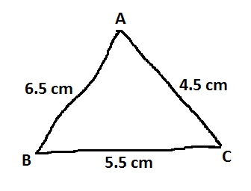
Construction of Triangle
Construction of a triangle when all its sides are known.
Construct a ∆ ABC given its sides BC= 5.5 cm; AC = 4.5cm and AB = 6.5cm.
Step - 1: Draw a rough figure of the ∆ ABC and mark the given measurements on it.
Notes:
Notes for Teacher – 1 click only.
Suggestions: N/A
Source of Multimedia Objects (Image/audio/ Video/Animation) used in this slide - N/A

Slide 3
Construction of Triangle
Step - 2: Draw a line BC= 5.5 cm using a ruler.
B
5.5 cm
C
Notes:
Notes for Teacher – 1 click only.
Suggestions: N/A
Source of Multimedia Objects (Image/audio/ Video/Animation) used in this slide - N/A

Slide 4
Construction of Triangle
Step - 3: With B as centre and radius 6.5cm draw an arc.
B
5.5 cm
C
Notes:
Notes for Teacher – 1 click only.
Suggestions: N/A
Source of Multimedia Objects (Image/audio/ Video/Animation) used in this slide - N/A

Slide 5
Construction of Triangle
Step - 4: With C as centre and radius 4.5cm draw an arc cutting the previous one at the point A.
A
B
5.5 cm
C
Notes:
Notes for Teacher – 1 click only.
Suggestions: N/A
Source of Multimedia Objects (Image/audio/ Video/Animation) used in this slide - N/A

Slide 6
Construction of Triangle
Step - 5: Join AB and AC.
A
6.5 cm
4.5 cm
B
5.5 cm
C
The required triangle ABC is constructed.
Notes:
Notes for Teacher – 1 click only.
Suggestions: N/A
Source of Multimedia Objects (Image/audio/ Video/Animation) used in this slide - N/A

Slide 7
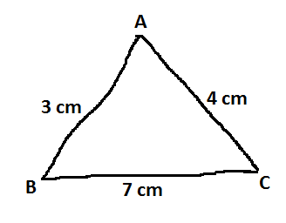
Construction of Triangle
Special case:
Construct a triangle ∆ ABC given its sides
BC= 7cm; AC = 4cm and AB = 3cm.
Step - 1: Draw a rough figure of the ∆ ABC and mark the given measurements on it.
Notes:
Notes for Teacher – 1 click only.
Suggestions: N/A
Source of Multimedia Objects (Image/audio/ Video/Animation) used in this slide - N/A

Slide 8
Construction of Triangle
Step - 2: Draw a line BC= 7 cm using a ruler.
B
7 cm
C
Notes:
Notes for Teacher – 1 click only.
Suggestions: N/A
Source of Multimedia Objects (Image/audio/ Video/Animation) used in this slide - N/A

Slide 9
Construction of Triangle
Step - 3: With B as centre and radius 3 cm draw an arc.
B
7 cm
C
Notes:
Notes for Teacher – 1 click only.
Suggestions: N/A
Source of Multimedia Objects (Image/audio/ Video/Animation) used in this slide - N/A

Slide 10
Construction of Triangle
Step - 4: With C as centre and radius 4 cm draw an arc cutting the previous arc.
B
7 cm
C
The two arcs do not intersect. Hence the triangle cannot be constructed.
Notes:
Notes for Teacher – 1 click only.
Suggestions: N/A
Source of Multimedia Objects (Image/audio/ Video/Animation) used in this slide - N/A

Slide 11
Construction of Triangle
Reason:
Consider the sum of the sides of the above triangle ABC.
The construction of a triangle is possible only if the sum of any two sides is always greater than the third side.
Sum of any two sides | Third Side | Sum of two sides > Third side (YES/NO)
AB + BC = 3 + 7 = 10 | AC = 4 | 10 > 4 Yes
BC + AC = 7 + 4 = 11 | AB = 3 | 11 > 3 Yes
AB + AC = 3 + 4 = 7 | BC = 7 | 7 = 7 NO
2. From the table it is evident that this condition is not satisfied. Hence the construction of the triangle is not possible.
Notes:
Notes for Teacher – 1 click only.
Suggestions: N/A
Source of Multimedia Objects (Image/audio/ Video/Animation) used in this slide - N/A

Slide 12
MM Index
Slide# | Thumbnail | Source and Attribution

