Slide 1
Construction of Triangles-
SAS Criterion
Notes:
Notes for Teacher – N/A
Suggestions: N/A
Source of Multimedia Objects (Image/audio/ Video/Animation) used in this slide - N/A

Slide 2
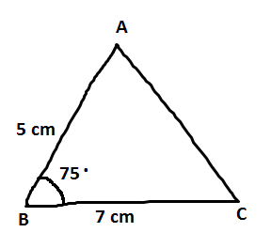
Construction of triangle
1. Construction of a triangle when two sides and an included angle are given.
Consider a ∆ ABC in which two sides AB = 5cm, BC = 7 cm and the included angle ∠ B = 75° are known.
Step - 1: Draw a rough diagram indicating the given measurements in it.
Notes:
Notes for Teacher – click is not required.
Suggestions: N/A
Source of Multimedia Objects (Image/audio/ Video/Animation) used in this slide - N/A

Slide 3
Construction of triangle
Step - 2: Draw a line segment BC of length 7 cm.
B
7 cm
C
Notes:
Notes for Teacher – only 1 click is required.
Suggestions: N/A
Source of Multimedia Objects (Image/audio/ Video/Animation) used in this slide - N/A

Slide 4
Construction of triangle
Step – 3: With B as centre draw a ray BX making an angle of 75° at B.
X
.
75
B
7 cm
C
Notes:
Notes for Teacher – only 1 click is required.
Suggestions: N/A
Source of Multimedia Objects (Image/audio/ Video/Animation) used in this slide - N/A

Slide 5
Construction of triangle
Step – 4: With B as centre and a radius of 5cm draw an arc cutting the ray BX at A and join AC.
X
A
5 cm
.
75
B
7 cm
C
The required triangle ABC is obtained.
Notes:
Notes for Teacher – only 1 click is required.
Suggestions: N/A
Source of Multimedia Objects (Image/audio/ Video/Animation) used in this slide - N/A

Slide 6
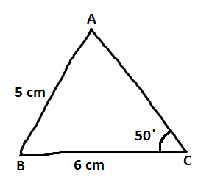
Construction of triangle
2. Special Case - Construction of triangle when two sides and an non-included angle are given.
Consider a ∆ ABC in which two sides AB = 5cm, BC = 6 cm and the non-included angle ∠ C = 50° are known.
Step – 1: Draw a rough diagram indicating the given measurements in it.
Notes:
Notes for Teacher – click is not required.
Suggestions: N/A
Source of Multimedia Objects (Image/audio/ Video/Animation) used in this slide - N/A

Slide 7
Construction of triangle
Step – 2: Draw a line segment BC of length 6 cm.
B
6 cm
C
Notes:
Notes for Teacher – only 1 click is required.
Suggestions: N/A
Source of Multimedia Objects (Image/audio/ Video/Animation) used in this slide - N/A

Slide 8
Construction of triangle
Step – 3: With C as centre draw a ray CX making an angle of 50° at C.
X
.
50
B
6 cm
C
Notes:
Notes for Teacher – only 1 click is required.
Suggestions: N/A
Source of Multimedia Objects (Image/audio/ Video/Animation) used in this slide - N/A

Slide 9
Construction of triangle
Step – 4: With B as centre and a radius of 5 cm draw an arc cutting the ray CX at A and join AB.
X
A
5 cm
.
50
B
6 cm
C
The required triangle ABC is obtained. But this triangle is not unique.
Notes:
Notes for Teacher – only 1 click is required.
Suggestions: N/A
Source of Multimedia Objects (Image/audio/ Video/Animation) used in this slide - N/A

Slide 10
Construction of triangle
Conclusion:
1. A unique triangle can be constructed only when two sides and an included angle are given.
X
A
5 cm
.
2. A unique triangle cannot be constructed when two sides and a non- included angle are given.
50
B
6 cm
C
Notes:
Notes for Teacher – only 1 click is required.
Suggestions: N/A
Source of Multimedia Objects (Image/audio/ Video/Animation) used in this slide - N/A

Slide 11
MM Index
Slide# | Thumbnail | Source and Attribution

