Slide 1
Construction of Triangles-ASA Criterion
Notes:
Notes for Teacher – N/A
Suggestions: N/A
Source of Multimedia Objects (Image/audio/ Video/Animation) used in this slide - N/A

Slide 2
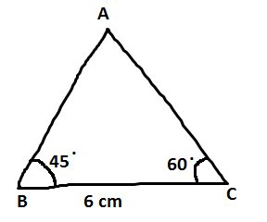
Construction of Triangle
Two angles and an included side of a triangle is known, then a unique triangle could be constructed.
Example: Construct ∆ ABC given two angles ∠B = 45° ,∠C = 60°and an included side BC = 6 cm.
Step - 1: Draw a rough diagram of the triangle indicating the given measurements.
Notes:
Notes for Teacher – N/A
Suggestions: N/A
Source of Multimedia Objects (Image/audio/ Video/Animation) used in this slide - N/A

Slide 3
Construction of Triangle
Step - 2: Draw a line segment BC = 6 cm.
B
6 cm
C
Notes:
Notes for Teacher – N/A
Suggestions: N/A
Source of Multimedia Objects (Image/audio/ Video/Animation) used in this slide - N/A

Slide 4
Construction of Triangle
Step - 3: Draw a ray BX making an angle of 45° at B.
X
.
45
B
6 cm
C
Notes:
Notes for Teacher – N/A
Suggestions: N/A
Source of Multimedia Objects (Image/audio/ Video/Animation) used in this slide - N/A

Slide 5
Construction of Triangle
Step - 5: Draw a ray CY making an angle of 60° at C in such a way BX and CY lines such that they intersect at A.
Y
X
A
.
.
45
60
B
6 cm
C
This is the required triangle ABC.
Notes:
Notes for Teacher – Conclusion-
An unique triangle can be drawn when two angles and an included side of a triangle are known.
Suggestions: N/A
Source of Multimedia Objects (Image/audio/ Video/Animation) used in this slide - N/A

Slide 6
MM Index
Slide# | Thumbnail | Source and Attribution

