Slide 1
Construction of Triangles-
RHS Criterion
Notes:
Notes for Teacher – N/A
Suggestions: N/A
Source of Multimedia Objects (Image/audio/ Video/Animation) used in this slide - N/A

Slide 2
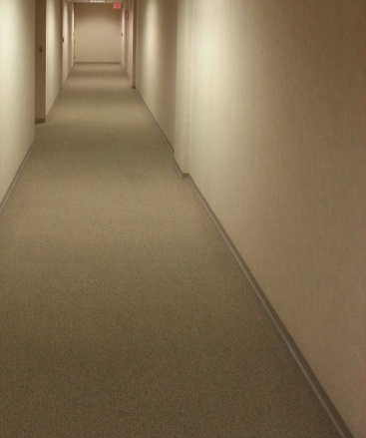
Right – Angle Triangles
Ladder forming a right angled triangle when placed against the wall.
Longest side of the triangle and is called the hypotenuse.
Notes:
Notes for Teacher - one click for slide.
Suggestions: N/A
Source of Multimedia Objects (Image/audio/ Video/Animation) used in this slide -
Wall: https://pixabay.com/photos/hallway-empty-office-quiet-95771/
Ladder – using PPT shapes

Slide 3
Construction of Triangles
Construct a right angled triangle XYZ such that
∠Y = 90˚, YZ = 4 cm and XZ = 4.5 cms.
Step-1: Draw a rough diagram of the triangle.
X
4.5 cm
90°
Y
4 cm
Z
Step-2: Draw line segment YZ = 4 cm.
Y
4 cm
Z
Notes:
Notes for Teacher - 1 click anywhere in the slide to work.
Suggestions: N/A
Source of Multimedia Objects (Image/audio/ Video/Animation) used in this slide - N/A

Slide 4
Construction of Triangles
Step – 2: Place the protractor on Y and draw ray YW so that ∠Y = 90˚
.
W
90°
Y
4 cm
Z
Notes:
Notes for Teacher - 1 click anywhere in the slide for steps to work.
Suggestions: N/A
Source of Multimedia Objects (Image/audio/ Video/Animation) used in this slide - N/A

Slide 5
Construction of Triangles
Step – 3: Place the compass at Z and with radius = hypotenuse (4.5 cm).
Draw an arc to cut ray YW at X.
Step – 4: Join points X and Z to get the ∆XYZ.
.
W
X
4.5 cm
90°
4 cm
Z
Y
Notes:
Notes for Teacher - 2 click anywhere in the slide to work.
Suggestions: N/A
Source of Multimedia Objects (Image/audio/ Video/Animation) used in this slide - N/A

Slide 6
MM Index
Slide# | Thumbnail | Source and Attribution
2 |  | https://pixabay.com/photos/hallway-empty-office-quiet-95771/

