Slide 1
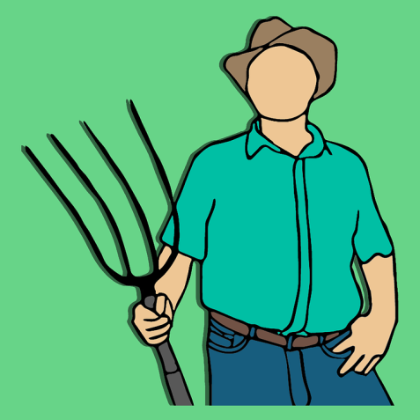
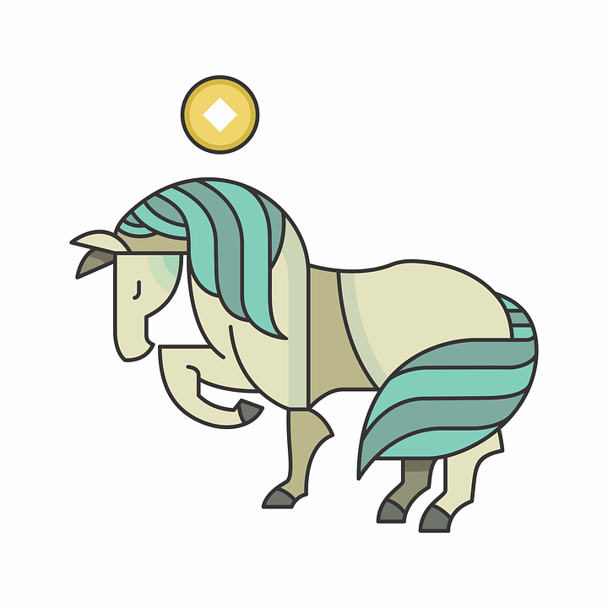
Maintaining a healthy balance in our attitude
Notes:
Students will also be able to appreciate the need to maintain a healthy balancein our attitude towards life.
Value – Peace
Sub Value – Inner silence
CBSE Sub value – Optimism, Patience poise and calmness

Slide 2

Strong mental base like a triangle
Triangles
Notes:
Value Content:
A triangle is basically the strongest construction with a strong base. Similarly, we need to have a strong mental base in life. We should not allow any event, good or bad in our lives, to upset our mental balance and peace.

Slide 3
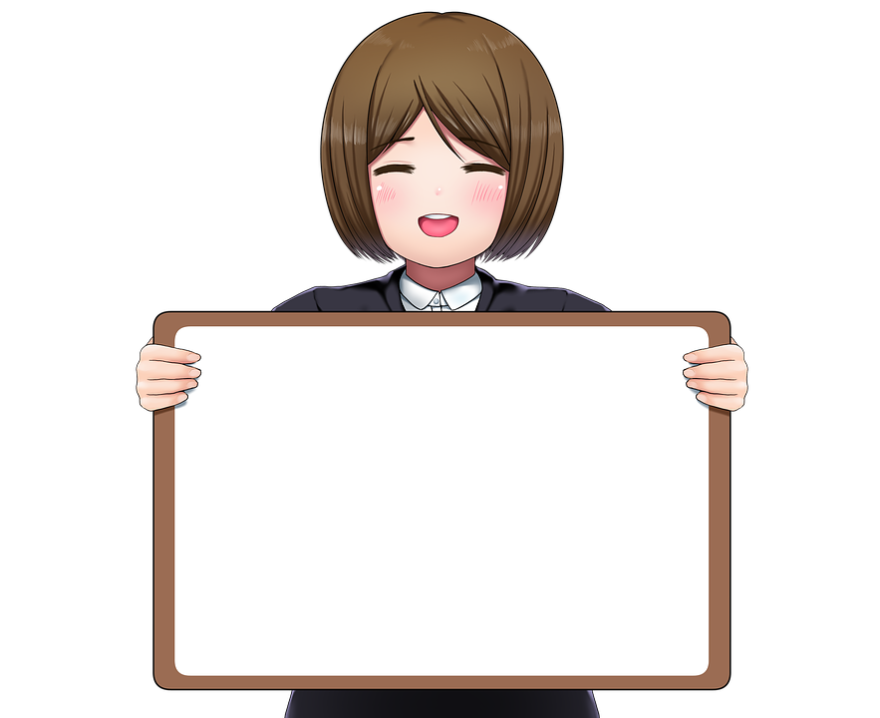
Strong mental base like a triangle
49
100
Notes:
The teacher gives a situation:
Your Maths teacher returns your test papers and you find that you have not fared well and got less grades. Maths is your favourite subject. You normally top the class. How would you feel?
Let children come out with their views.

Slide 4
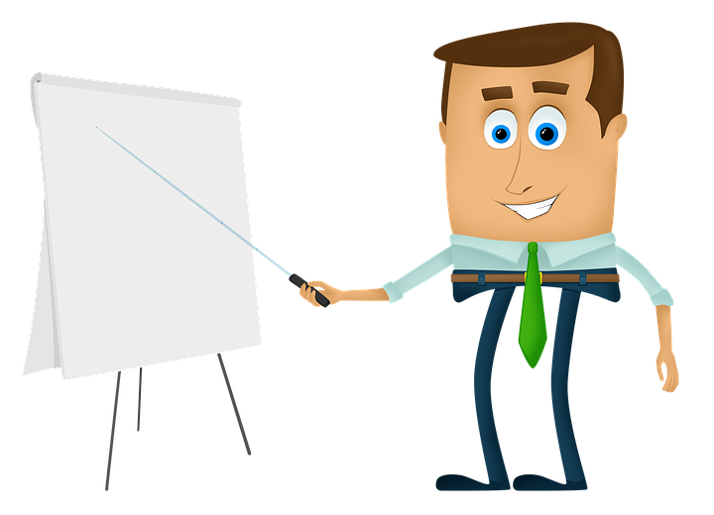
Strong mental base like a triangle
97
100
Notes:
The next day
Your Chemistry teacher returns your test paper. You have always had an aversion for Chemistry. Surprisingly, you find you have topped the class in this. How would you feel?
Let children come out with answers
The suggested answer:
It is quite natural to feel sad when you score less marks and delighted when you top the class. We all have 2 sides of us. A very happy side and a downhearted one. When we are not very overjoyed during happy moments and not very depressed during sad moments, we are said be in equanimity.

Slide 5

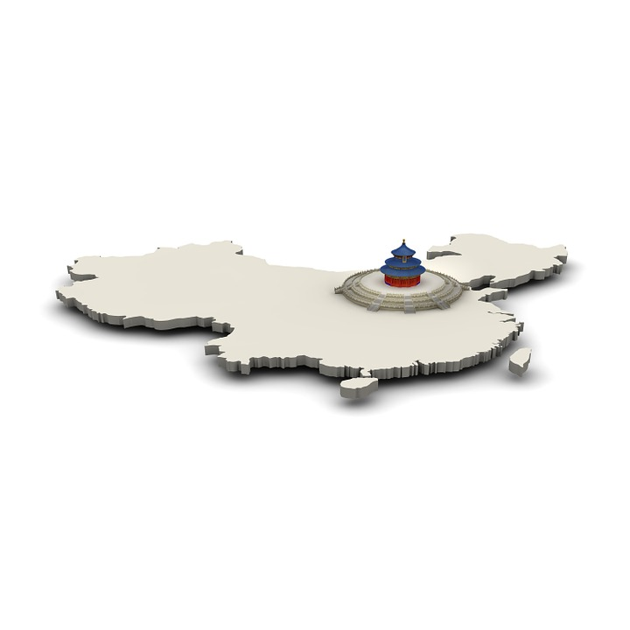
Strong mental base like a triangle
Notes:
Here is a story to prove this.
Once upon a time there was a farmer in a central region of China.

Slide 6
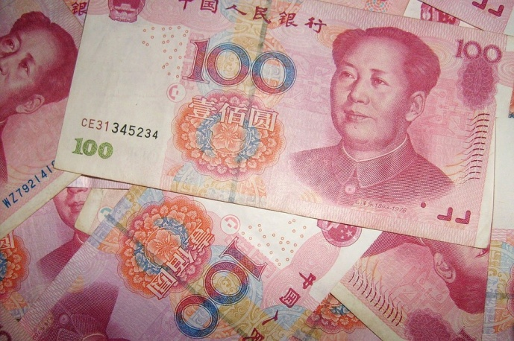
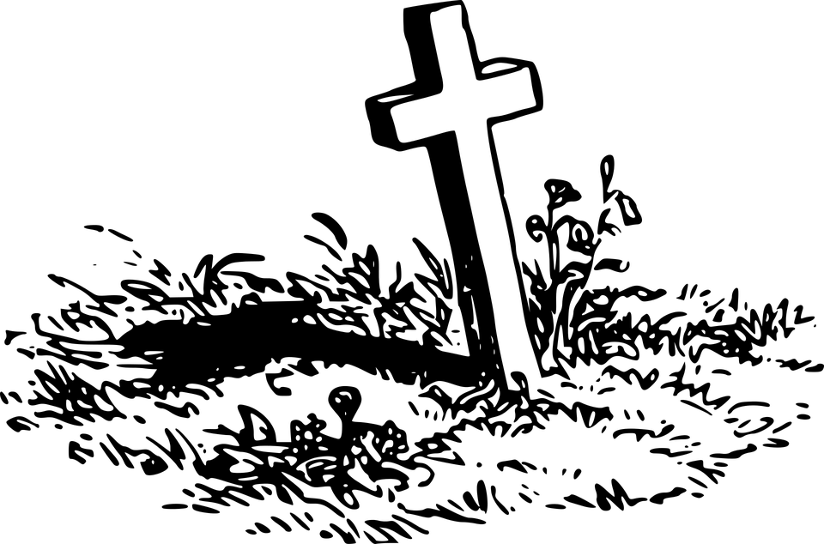
Strong mental base like a triangle
Notes:
He didn't have much money, and instead of a tractor he used an old horse to plough his field.
One afternoon, while working in the field, the horse dropped dead.

Slide 7
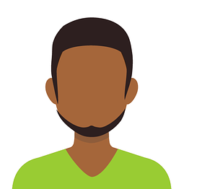


Strong mental base like a triangle
Oh, what a horrible thing to happen
We'll see.
Notes:
Everyone in the village said, "Oh, what a horrible thing to happen." The farmer said simply, "We'll see."
He was so at peace and so calm that everyone in the village got together, and, admiring his attitude, gave him a new horse as a gift.

Slide 8
Strong mental base like a triangle
What a lucky man
We'll see.
Notes:
Everyone's reaction now was, "What a lucky man." But the farmer said, "We'll see."
A couple of days later, the new horse jumped a fence and ran away.

Slide 9
Strong mental base like a triangle
What a poor fellow.
We'll see.
We'll see.
What a fortunate man.
Notes:
Everyone in the village shook their heads sadly and said, "What a poor fellow."
The farmer smiled and said, "We'll see."
Eventually, the horse found his way home, and everyone again said happily, "What a fortunate man."
Again, the farmer said, "We'll see."

Slide 10
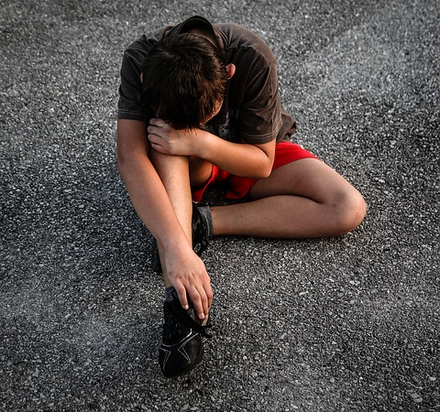
Strong mental base like a triangle
We'll see.
What a shame for the poor boy
Notes:
Later in the year, the farmer's young boy went out riding on the horse and fell and broke his leg. Everyone in the village said, "What a shame for the poor boy."
The farmer said, "We'll see."

Slide 11

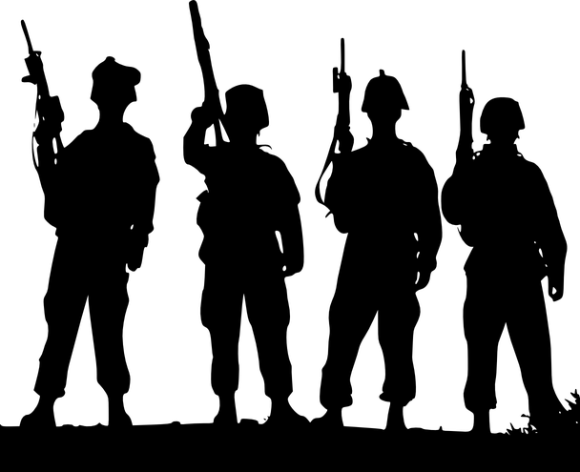

Strong mental base like a triangle
What a fortunate young man
We'll see.
Notes:
Two days later, the army came into the village to draft new recruits. When they saw that the farmer's son had a broken leg, they decided not to take him.
Everyone said, "What a fortunate young man."
The farmer smiled again and said, "We'll see."
The farmer never lost his equilibrium in spite of the events that befell him. He did not become overly ecstatic or terribly upset. He maintained equanimity.

Slide 12

Strong mental base like a triangle
Maintain Equanimity !
Notes:
Chilldren!
You felt sad when you received less marks in Maths and felt happy when you topped the class in Chemistry. Now that you learnt about Equanimity, how could you have reacted?
(let children come out with their ideas).
The teacher can add:
In the case of Maths paper where you got less marks, you can resolve to put in more hard work and do better next time and not to worry too much.
In the case of topping the class in science, you can resolve not to allow the success to go to your head so that you work less and get less marks next time.

Slide 13
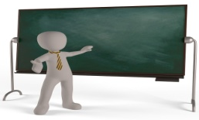
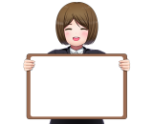
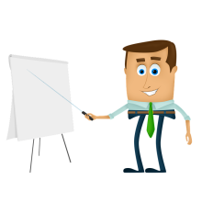








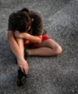
MM Index
Slide# | Thumbnail | Source and Attribution
2 |  | https://pixabay.com/illustrations/teacher-school-university-board-1015630/
3 |  | https://pixabay.com/illustrations/moe-girls-women-manga-anime-3793863/
4 |  | https://pixabay.com/illustrations/businessman-cartoons-training-607831/
5 |  | https://pixabay.com/illustrations/map-china-borders-country-1027655/
5 |  | https://pixabay.com/illustrations/farmer-caw-boy-work-vector-clipart-2306373/
6 |  | https://pixabay.com/photos/currency-chinese-money-yuan-100-1954/
6 |  | https://pixabay.com/illustrations/vector-horse-chinese-zodiac-1988659/
6 |  | https://pixabay.com/vectors/burial-cemetery-cross-dead-death-1299277/
7, 8, 9 |  | https://pixabay.com/illustrations/crowd-human-silhouettes-personal-2045499/
7, 8,9, 11 |  | https://pixabay.com/illustrations/avatar-clients-customers-icons-2191918/
7, 8, 9, 10 |  | https://pixabay.com/vectors/the-horse-konik-galop-jump-animal-2798829/
10 |  | https://pixabay.com/photos/cry-harm-accident-pain-suffering-2764845

Slide 14




MM Index
Slide# | Thumbnail | Source and Attribution
11 |  | https://pixabay.com/vectors/military-army-soldiers-walking-42352/
11 |  | https://pixabay.com/vectors/army-guns-soldier-platoon-war-305276/
11 |  | https://pixabay.com/vectors/members-group-people-team-business-42919/
12 |  | https://pixabay.com/vectors/tux-animal-bird-book-books-161406/

