Slide 1
History Of Percents
Notes:
Notes for Teacher - < Information for further reference or explanation >
Suggestions: <Ideas/ Images/ Animations / Others – To make better representation of the content >
Source of Multimedia Objects (Image/audio/ Video/Animation) used in this slide -
1. <Short Description> - <SOURCE URL>

Slide 2
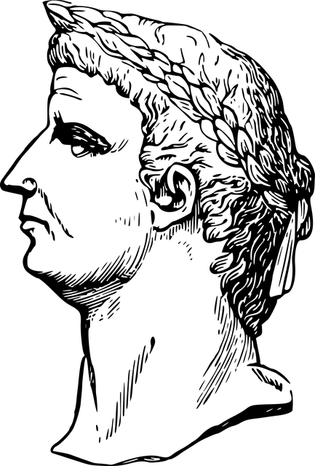
History Of Percents
Augustus,
The First Roman Emperor
Notes:
Notes for Teacher – The teacher may convey about Augustus from the asset document.
Source of Multimedia Objects (Image/audio/ Video/Animation) used in this slide -

Slide 3

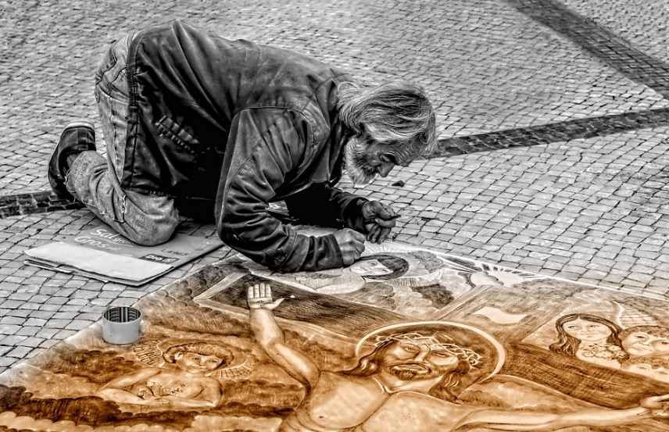

The month of August was named after him
Art and economy flourished
Notes:
https://pixabay.com/photos/man-artist-street-painter-painting-343674/
https://pixabay.com/photos/august-summer-daylight-saving-time-3356763/

Slide 4
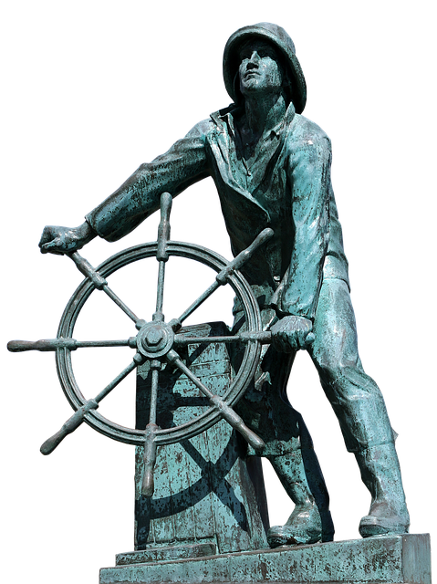
Augustus levied a tax of 1/100 on goods sold at auction

Slide 5

As denominations of money grew, it was more common to use 100 as denominator in computations.
NOTE: We know that today
1/100 = 1%
10/100 = 10%.... etc
Notes:
https://pixabay.com/photos/money-laundering-crime-fighting-1963184/

Slide 6
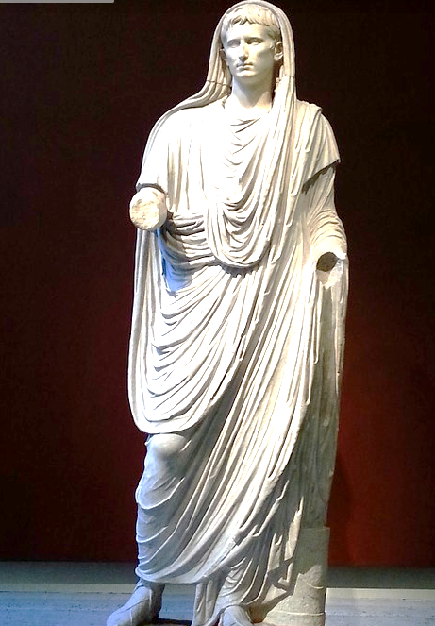
Thus, we can say that history of Percents dates back to the early Roman period.

Slide 7






MM Index
Slide# | Thumbnail | Source and Attribution
2 |  | https://pixabay.com/vectors/augustus-caesar-claudius-emperor-2028406/
3 |  | https://pixabay.com/photos/man-artist-street-painter-painting-343674/
3 |  | https://pixabay.com/photos/august-summer-daylight-saving-time-3356763/
4 |  | https://pixabay.com/photos/tax-man-steering-wheel-captain-2789168/
6 |  | https://pixabay.com/photos/caesar-augustus-sculpture-roman-955274/
5 |  | https://pixabay.com/photos/money-laundering-crime-fighting-1963184/

