Slide 1
PROFIT
LOSS
Notes:
Notes for Teacher - < Information for further reference or explanation >
Suggestions: <Ideas/ Images/ Animations / Others – To make better representation of the content >
Source of Multimedia Objects (Image/audio/ Video/Animation) used in this slide -
1. <Short Description> - <SOURCE URL>

Slide 2
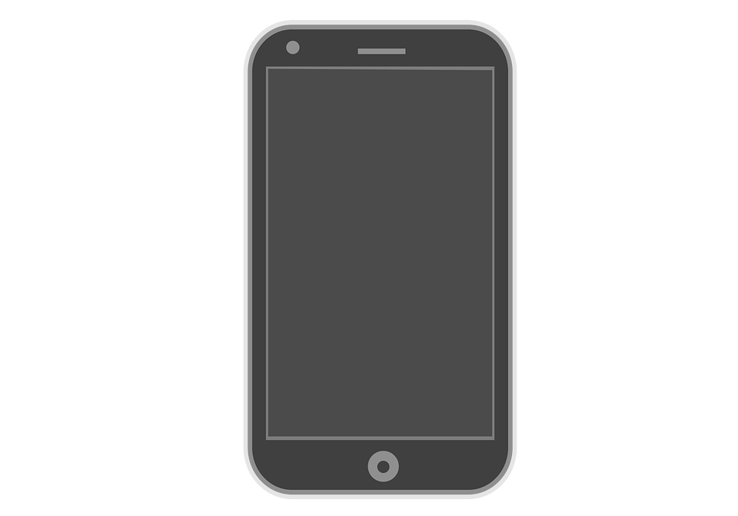
PROFIT OR LOSS
1
By selling a mobile phone for Rs. 2,700, Gokul loses 10%. At what price should he sell it in order to gain 20%?
Let the cost price be Rs. x,
Its selling price is Rs. 2,700
Loss is 10%
Thus, when the cost price is Rs100, selling price is Rs. 90
100 : 90 = x : 2700
90x = 2700 × 100 = 270000
x = 270000 / 90 = 3000
Cost price of the mobile phone = Rs3,000
Let the selling price be Rs y when the gain is 20%
Gain is 20%
Notes:
Notes for Teacher - < Information for further reference or explanation >
Suggestions: <Ideas/ Images/ Animations / Others – To make better representation of the content >
Source of Multimedia Objects (Image/audio/ Video/Animation) used in this slide -
1. <Mobile phone> - CC0:<https://pixabay.com/vectors/mobile-phone-phone-screen-iphone-6088490/>

Slide 3
PROFIT OR LOSS
When the cost price is Rs100, selling price is Rs. 120
When the cost price is Rs3,000, selling price is:
Rs y. 100 : 120 = 3000 : y
100y = 3000 × 120 = 360000
y = 360000 / 100 = 3,600
He should sell it, at Rs. 3,600, in order to gain 20%
Notes:
Notes for Teacher - < Information for further reference or explanation >
Suggestions: <Ideas/ Images/ Animations / Others – To make better representation of the content >
Source of Multimedia Objects (Image/audio/ Video/Animation) used in this slide -

Slide 4

PROFIT OR LOSS
2
The cost of 15pens is equal to the selling price of 12 pens. Find the loss or profit percent irrespective of the cost of the pen.
Let the cost of one pen be Rs x
Then cost of 12 pens = Rs 12x
Selling price of 12 pens = Cost price of 15 pens = 15x
Selling price is more than cost price.
Thus, Profit = Selling price of 12 pens – Cost price of 12 pens = 15x – 12x = 3x
Notes:
Notes for Teacher - < Information for further reference or explanation >
Suggestions: <Ideas/ Images/ Animations / Others – To make better representation of the content >
Source of Multimedia Objects (Image/audio/ Video/Animation) used in this slide -
1. <Pen> - CC0:<https://pixabay.com/photos/fountain-pen-notebook-paper-pen-1854169/>

Slide 5
PROFIT OR LOSS
Profit % = (Profit by selling 12 pens / Cost of 12 pens) × 100
= (3x / 12x) × 100 = 25
Profit percentage is 25
Notes:
Notes for Teacher - < Information for further reference or explanation >
Suggestions: <Ideas/ Images/ Animations / Others – To make better representation of the content >
Source of Multimedia Objects (Image/audio/ Video/Animation) used in this slide -

Slide 6
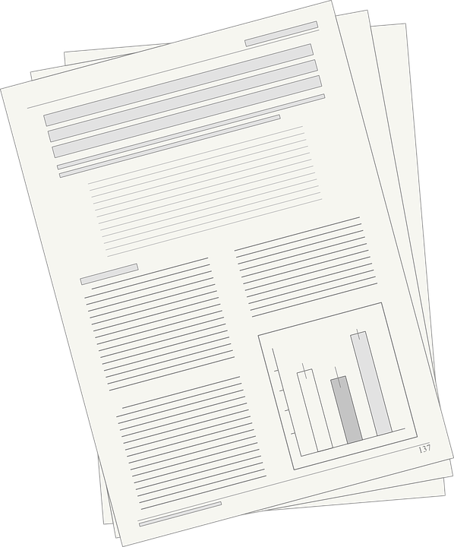
PROFIT OR LOSS
3
By selling an article 20% discount off on the market price a shop keeper still makes 12.5% profit on his cost. If cost price is Rs 3,200, find the marked price.
Cost price of the article = Rs 3,200.
Profit = 12.5% of Rs 3,200 = Rs (12.5/100) × 3200 = Rs (25/200) × 3200 = Rs 400.
Selling price = Cost price + Profit = Rs (3200 + 400) = Rs 3,600
Let the Marked price be Rs x
Discount is 20%
Notes:
Notes for Teacher - < Information for further reference or explanation >
Suggestions: <Ideas/ Images/ Animations / Others – To make better representation of the content >
Source of Multimedia Objects (Image/audio/ Video/Animation) used in this slide -
1. <Article> - CC0:<https://pixabay.com/vectors/manuscript-newspaper-article-paper-149606/>

Slide 7
PROFIT OR LOSS
When the marked price is Rs 100, selling price is Rs 80
When the marked price is Rs x, selling price is Rs 3600
100 : 80 = x : 3600
80x = 3600 × 100 = 360000
x = 360000/80 = 4,500
Marked price of the article is Rs. 4,500
Notes:
Notes for Teacher - < Information for further reference or explanation >
Suggestions: <Ideas/ Images/ Animations / Others – To make better representation of the content >
Source of Multimedia Objects (Image/audio/ Video/Animation) used in this slide -

Slide 8



MM Index
Slide# | Thumbnail | Source and Attribution
2 |  | CC0: <https://pixabay.com/vectors/mobile-phone-phone-screen-iphone-6088490/>
4 |  | CC0:<https://pixabay.com/photos/fountain-pen-notebook-paper-pen-1854169/>
6 |  | CC0:<https://pixabay.com/vectors/manuscript-newspaper-article-paper-149606/>

