Slide 1
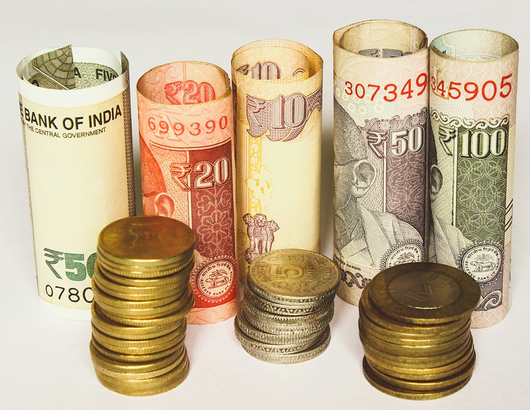
Simple Interest
Notes:
Notes for Teacher – N/A
Suggestions: N/A
Source of Multimedia Objects (Image/audio/ Video/Animation) used in this slide -
https://pixabay.com/fr/photos/roupie-indien-inde-l-argent-4395524/

Slide 2
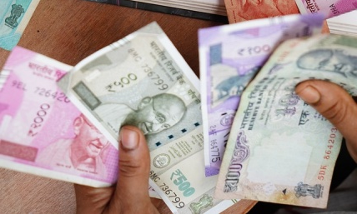
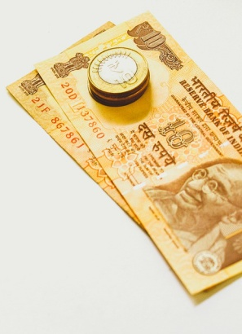
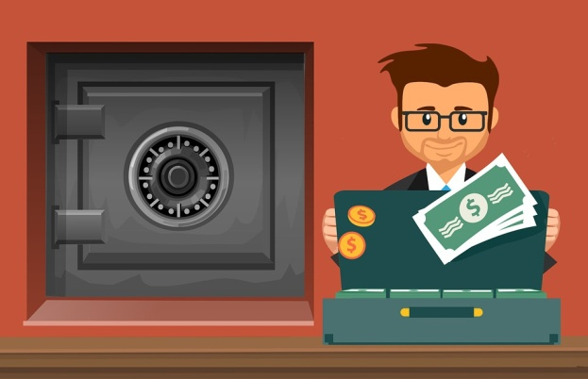
Simple Interest
Introduction
For starting any business we need to invest money
- We may borrow from friends and relatives
- Or go to a bank to borrow money
Banks lend money for a certain period of time
- It charges a certain amount for lending the money.
- The amount paid for the use of money is called interest
Bank
Lend money
Charge
Interest
Notes:
Notes for Teacher – N/A
Suggestions: N/A
Source of Multimedia Objects (Image/audio/ Video/Animation) used in this slide -
https://pixabay.com/fr/illustrations/banque-d%C3%A9p%C3%B4t-s%C3%A9curit%C3%A9-teller-4202986/
https://pixabay.com/fr/photos/inde-roupie-occupation-3887567/
https://pixabay.com/fr/photos/roupie-indien-inde-l-argent-4505204/

Slide 3

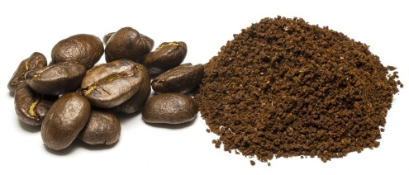
Simple Interest
If you want to start a coffee powder business.
Assume that you require about Rs 3,00000 to start the business (to buy coffee seeds, to pay the advance for the building etc.)
Notes:
Notes for Teacher – N/A
Suggestions: N/A
Source of Multimedia Objects (Image/audio/ Video/Animation) used in this slide -
https://pixabay.com/fr/photos/caf%C3%A9-restaurant-menu-cafe-interior-984275/
https://pixabay.com/fr/photos/caf%C3%A9-haricots-poudre-de-caf%C3%A9-brown-549107/

Slide 4
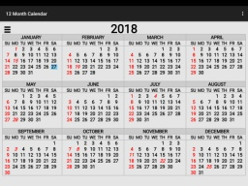
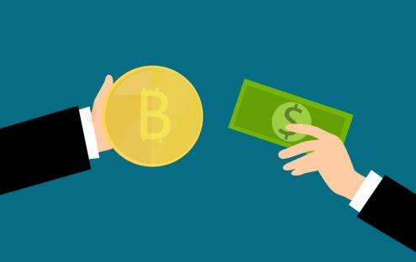

Simple Interest
If you want to borrow Rs. 3, 00,000 from a local bank and the bank charges interest of 10% for a period of 1 year
10% interest = bank charges Rs.10 for every Rs.100
borrowed for a period = 1 year
or
10% of Rs.300000 x 1year
Interest
+
Bank charges
3,00,000
Interest = Rs. 30,000
Notes:
Notes for Teacher – N/A
Suggestions: N/A
Source of Multimedia Objects (Image/audio/ Video/Animation) used in this slide -
https://www.publicdomainpictures.net/en/view-image.php?image=263729&picture=blockchain-bitcoin-bank
https://www.publicdomainpictures.net/en/view-image.php?image=241749&picture=2018-calendar

Slide 5
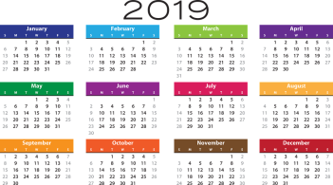

Simple Interest
After one year,
Amount to be repaid=
original amount borrowed + interest amount
= Rs.3,00,000 + Rs.30,000.
Example:
you are the borrower, the bank is the lender
The principal of the loan is (P) = Rs. 3, 00,000
The interest ( I) = Rs. 30, 000
The total amount (A) = Rs. 3, 30,000
Rs.3,30,000
The total amount paid by you to the bank after one year is, A = Rs 3, 30,000
Notes:
Notes for Teacher – N/A
Suggestions: N/A
Source of Multimedia Objects (Image/audio/ Video/Animation) used in this slide -
https://www.publicdomainpictures.net/en/view-image.php?image=263729&picture=blockchain-bitcoin-bank
https://pixabay.com/illustrations/agenda-calendar-2019-schedule-plan-3314601/

Slide 6
Simple Interest
Terminologies in Simple Interest
Principal(P) - Money that is borrowed or lent
Interest (I) - Money paid on the Principal
Rate (R) - Percentage of Principal paid as interest
Time (T) - Duration for which Principal is borrowed
Amount (A) - Money paid back at the end of the time
period
Amount = Principal + Interest
Notes:
Notes for Teacher – N/A
Suggestions: N/A
Source of Multimedia Objects (Image/audio/ Video/Animation) used in this slide - N/A

Slide 7


Simple Interest
Interest for multiple years
If you keep the money for two years then the bank charges you another 10% for the extra year
You pay the interest 10% of 3,00,000 twice
10% of 3,00,000 × 2
30,000 + 30,000
Rs. 3,60,000
= Rs.60,000
Note:
The principal remains the same for any number of years and the interest alone gets added up. This type of interest is called SIMPLE INTEREST
Notes:
Notes for Teacher – N/A
Suggestions: N/A
Source of Multimedia Objects (Image/audio/ Video/Animation) used in this slide –
https://www.publicdomainpictures.net/en/view-image.php?image=263729&picture=blockchain-bitcoin-bank
https://pixabay.com/sv/illustrations/kalender-2017-veckor-m%C3%A5nader-%C3%A5r-1508663/
https://www.publicdomainpictures.net/en/view-image.php?image=241749&picture=2018-calendar
https://pixabay.com/illustrations/agenda-calendar-2019-schedule-plan-3314601/

Slide 8
Simple Interest
Simple Interest Formula
P
borrow from bank
Interest per annum R%
P
Rs.100 borrowed
Interest Rs.R
By property of proportionality
For Rs.P borrowed,the interest to be paid after a year is (P x R)/100
For Rs.P borrowed,the interest to be paid after 2 years is [(P x R)/100]x2
For Rs.P borrowed,the interest to be paid after 3 years is [(P x R)/100]x3
The formula for Simple Interest : I = (P x R x T)/100
Notes:
Notes for Teacher – N/A
Suggestions: N/A
Source of Multimedia Objects (Image/audio/ Video/Animation) used in this slide - N/A

Slide 9
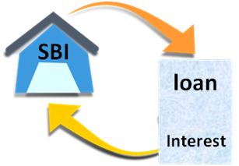


Simple Interest
Examples
Rs 4000 is borrowed for a five year period at 8% rate. What is the total amount of interest this loan will cost?
Principal amount(P) = Rs.4000, T = 5 Years, R = 8%
= Rs. 1600
Solution
The amount of interest to be paid is Rs. 1600
Notes:
Notes for Teacher – N/A
Suggestions: N/A
Source of Multimedia Objects (Image/audio/ Video/Animation) used in this slide –
https://pixabay.com/sv/vectors/hypoteksl%C3%A5n-hypothecary-kredit-l%C3%A5n-149882/

Slide 10

Simple Interest
Suresh received an interest payment of Rs 9000. His investments result in two such payments per year. If the simple interest rate is 9% how much is his investment?
T=1year , R=9%, Principal amount invested be = P
Total interest received by Suresh in a year =
9000 + 9000 = 18,000
9P = 1800000
Solution
P = 200000
Suresh invested = Rs.20,00,000
Notes:
Notes for Teacher – N/A
Suggestions: N/A
Source of Multimedia Objects (Image/audio/ Video/Animation) used in this slide -
https://pixabay.com/sv/vectors/hypoteksl%C3%A5n-hypothecary-kredit-l%C3%A5n-149882/

Slide 11


MM Index
Slide# | Thumbnail | Source and Attribution
1 |  | https://pixabay.com/fr/photos/roupie-indien-inde-l-argent-4395524/
2 |  | https://pixabay.com/fr/illustrations/banque-d%C3%A9p%C3%B4t-s%C3%A9curit%C3%A9-teller-4202986
2 |  | https://pixabay.com/fr/photos/inde-roupie-occupation-3887567/
2 |  | https://pixabay.com/fr/photos/roupie-indien-inde-l-argent-4505204/
3 |  | https://pixabay.com/fr/photos/caf%C3%A9-restaurant-menu-cafe-interior-984275/
3 |  | https://pixabay.com/fr/photos/caf%C3%A9-haricots-poudre-de-caf%C3%A9-brown-549107/
4,5,7 |  | https://www.publicdomainpictures.net/en/view-image.php?image=263729&picture=blockchain-bitcoin-bank

Slide 12

MM Index
Slide# | Thumbnail | Source and Attribution
4 |  | https://pixabay.com/sv/illustrations/kalender-2017-veckor-m%C3%A5nader-%C3%A5r-1508663/
5 |  | https://pixabay.com/illustrations/agenda-calendar-2019-schedule-plan-3314601/
7 |  | https://pixabay.com/sv/illustrations/kalender-2017-veckor-m%C3%A5nader-%C3%A5r-1508663/
9,10 |  | https://pixabay.com/sv/vectors/hypoteksl%C3%A5n-hypothecary-kredit-l%C3%A5n-149882/

