Slide 1

DISCOUNT
Notes:
Notes for Teacher - < Information for further reference or explanation >
Suggestions: <Ideas/ Images/ Animations / Others – To make better representation of the content >
Details of Multimedia Objects (Image/audio/ Video/Animation) used in this slide -
1. https://pixabay.com/illustrations/discount-sale-hand-like-offer-2736253/

Slide 2
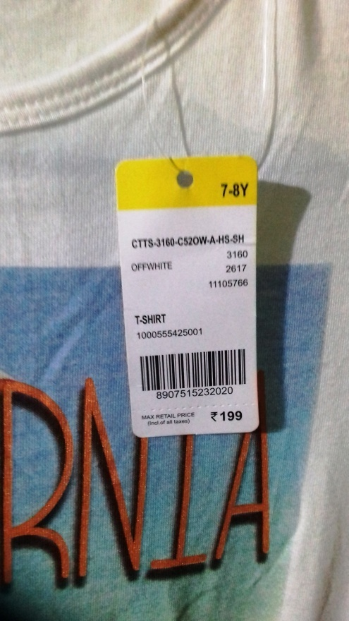
Discount
Market Price
Have you seen price tags on the articles in the market ?
It is called MARKET PRICE, CATALOG PRICE or LIST PRICE of the article.
Notes:
Notes for Teacher - < Information for further reference or explanation >
Suggestions: <Ideas/ Images/ Animations / Others – To make better representation of the content >
Details of Multimedia Objects (Image/audio/ Video/Animation) used in this slide -
1. Image Source: Original Contribution by saithri@yahoo.co.in

Slide 3


Discount
Discount
Sometimes to Increase the sale Or clear the old stock, the retailer offers a certain percent of the DISCOUNT on the Market price.
The percentage of discount is calculated on the Market price.
Notes:
Notes for Teacher - < Information for further reference or explanation >
Suggestions: <Ideas/ Images/ Animations / Others – To make better representation of the content >
Details of Multimedia Objects (Image/audio/ Video/Animation) used in this slide -
1. https://pixabay.com/illustrations/fifty-percent-off-discount-sale-1424818/
2. https://pixabay.com/illustrations/sale-icon-sign-set-business-1956066/

Slide 4
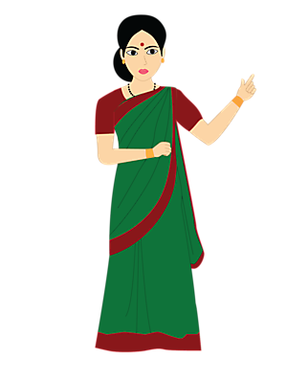
Discount
Selling Price
The amount, the purchaser actually pays for the article at the time of purchase is called SELLING PRICE of the article.
Selling Price = Market Price – Discount
Notes:
Notes for Teacher - < Information for further reference or explanation >
Suggestions: <Ideas/ Images/ Animations / Others – To make better representation of the content >
Details of Multimedia Objects (Image/audio/ Video/Animation) used in this slide -
1. Teacher: SSSVV Gallery-Keyword-teacher

Slide 5
Discount
Example - 1
Shamitha went to a shop to buy a dress.
Market price of the dress is Rs. 1250.
But, shop owner gave her a discount of 8%.
How much amount Shamitha has paid to buy the dress?
Ans
Discount = 8% of 1250
= 1250 × ( ) = 100
Selling price = Market price – Discount
=1250 – 100 = 1150
Shamitha paid Rs. 1150 to buy the dress.
8
100
Notes:
Notes for Teacher - < Information for further reference or explanation >
Suggestions: <Ideas/ Images/ Animations / Others – To make better representation of the content >
Details of Multimedia Objects (Image/audio/ Video/Animation) used in this slide -

Slide 6
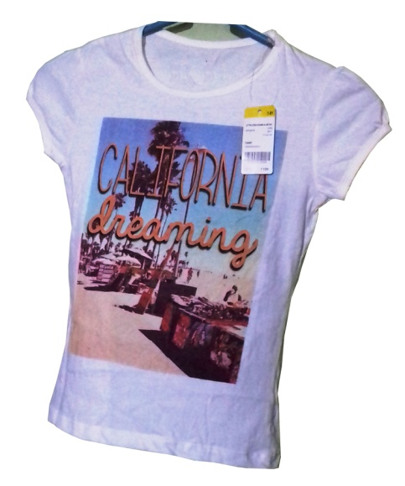
Discount
Example - 2
A dress costing Rs. 5600 is being sold for Rs. 4800.
Find the discount and discount percentage.
Ans
Discount is calculated on Market price. So, we take Market price as base.
Discount = Rs 5600 - Rs 4800 = Rs 800
Let discount percent be x.
On the Market price Rs 5600, discount is Rs. 800
On the Market price Rs 100, discount is Rs. x
5600:800 = 100:x , 5600x = 800×100 = 80000
x = = 14.3
The discount is Rs 800 and discount percent is 14.3
5,600
4,800
80000
5600
Notes:
Notes for Teacher - < Information for further reference or explanation >
Suggestions: <Ideas/ Images/ Animations / Others – To make better representation of the content >
Details of Multimedia Objects (Image/audio/ Video/Animation) used in this slide -
1. Image Source: Original Contribution by saithri@yahoo.co.in

Slide 7
Discount
Successive Discount
Assume that an article has been discounted by 20%.
And then again discounted by 10%.
It is called SUCCESSIVE DISCOUNT.
Is it equivalent to a discount of 30%?
No, Let us consider one example.
Two successive discounts 15% and 10% are given on the purchase of a bag.
If the market price of the bag is Rs. 2500,
Find
Its selling price
Find the single discount percentage equivalent to these two discounts
Solution
Notes:
Notes for Teacher - < Information for further reference or explanation >
Suggestions: <Ideas/ Images/ Animations / Others – To make better representation of the content >
Details of Multimedia Objects (Image/audio/ Video/Animation) used in this slide -

Slide 8
Discount
Successive Discount
Solution
a)
Market price of the bag is Rs. 2500.
First discount = 15% of Rs. 2500
= Rs. ( ) × 2500 = Rs. 375
Price after the first discount = Rs. 2500 – Rs. 375 = Rs. 2125.
Second discount = 10% of Rs. 2125
= Rs. ( )×2125 = Rs. 212.5
Price after second discount = Rs. 2125 – Rs. 212.5 = Rs. 1912.5
Net selling price = Rs. 1912.5
15
100
10
100
Notes:
Notes for Teacher - < Information for further reference or explanation >
Suggestions: <Ideas/ Images/ Animations / Others – To make better representation of the content >
Details of Multimedia Objects (Image/audio/ Video/Animation) used in this slide -

Slide 9
Discount
Successive Discount
Solution
b)
Single discount equivalent to given discounts
= Rs.2500 – Rs. 1912.5 = Rs. 587.5
Let x be the percentage discount corresponding to these two successive discounts.
Then, 100 : x = 2500 : 587.5
587.5 × 100 = 2500 × x
x = = 23.5
Percentage discount equivalent to the given two successive discounts of 15% and 10% is 23.5. It’s not 15 +10 =25%
(587.5× 100)
2500
Notes:
Notes for Teacher - < Information for further reference or explanation >
Suggestions: <Ideas/ Images/ Animations / Others – To make better representation of the content >
Details of Multimedia Objects (Image/audio/ Video/Animation) used in this slide -

Slide 10



Slide# | Thumbnail | Source and Attribution
1 |  | https://pixabay.com/illustrations/discount-sale-hand-like-offer-2736253/
3 |  | https://pixabay.com/illustrations/sale-icon-sign-set-business-1956066/
3 |  | https://pixabay.com/illustrations/fifty-percent-off-discount-sale-1424818/

