Slide 1
CG3- Develop the ability to write simple and compound sentence structures to express their understanding and experiences.
CG 3.4- Uses appropriate grammar and structure in their writing.
Students will be able to relate to the practical use of active and passive voice.

Slide 2
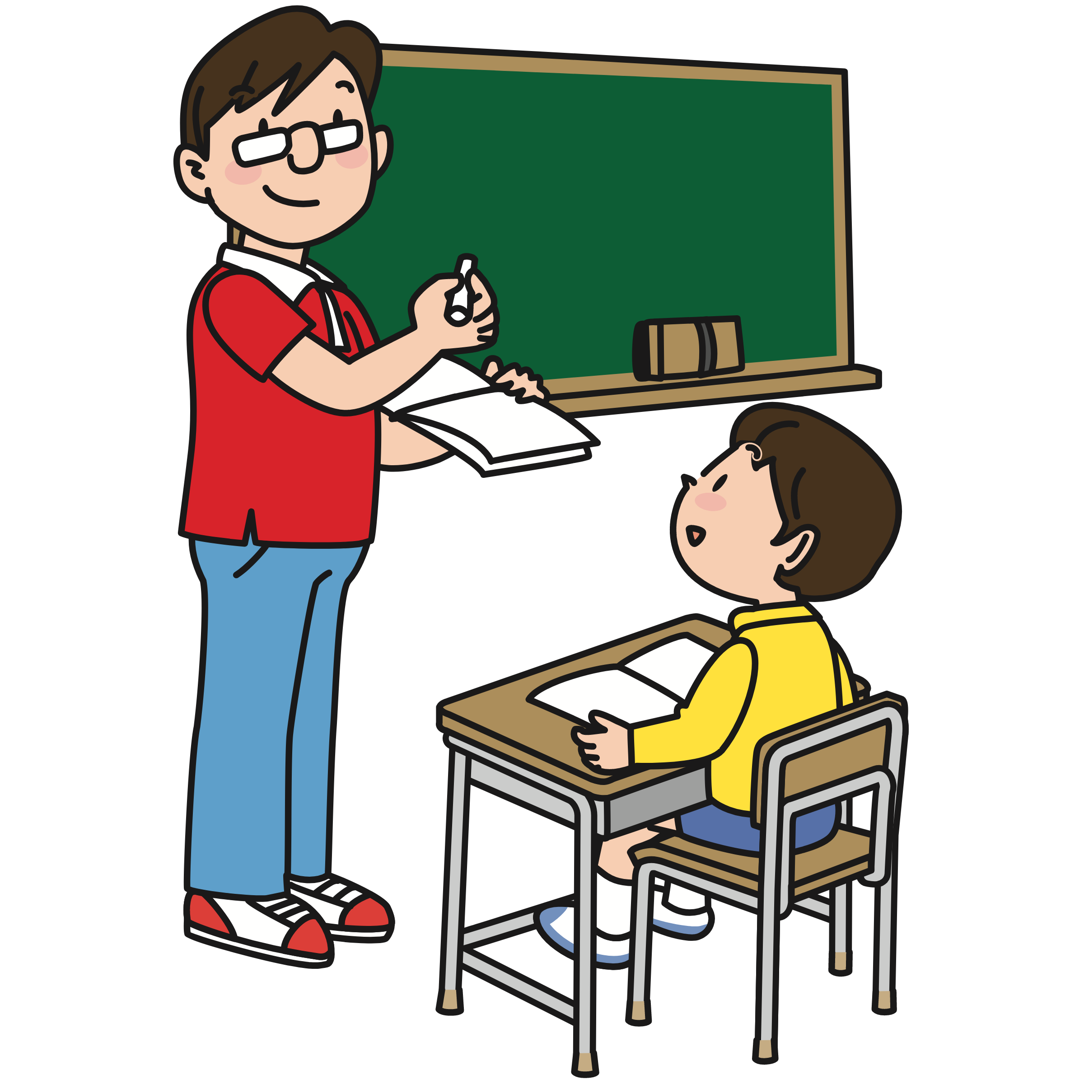


Active and Passive Voice
Active voice- subject is prominent
These monkeys ate all the bananas.
Active voice with two objects
Mr. Sushant teaches science to the students.
Active voice- subject is understood
They built schools in the villages.
Passive voice with one of the
two objects being prominent
Students are taught science by
Mr. Sushant. (OR)
Science is taught to the students by Mr. Sushant.
Passive voice- object is prominent
All the bananas were eaten by these monkeys.
Passive voice- subject is not mentioned
Schools were built in the villages.
Notes:
[Notes to the teacher: Use the poster attached to help students notice the practical use of Active and Passive Voice.]

Slide 3

# | Thumbnail | Source link | Author
2 |  | https://www.freepik.com/free-vector/monkey-eating-banana-cartoon-character-sticker_21196694.htm#fromView=search&page=1&position=16&uuid=d9e7f95b-1c13-4d59-ae2b-785382f384e3 | brgfx on Freepik
9 |  | https://freesvg.org/male-teacher-and-student | OpenClipart
9 |  | https://free-vectors.net/buildings/construction-machinery-vector | FREE-VECTORS.NET

