Slide 1
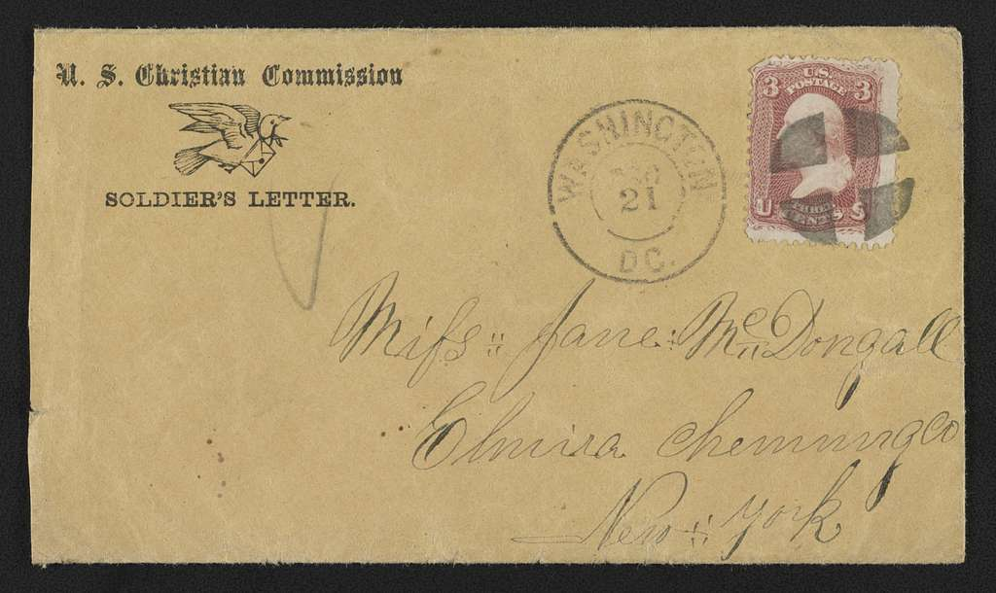
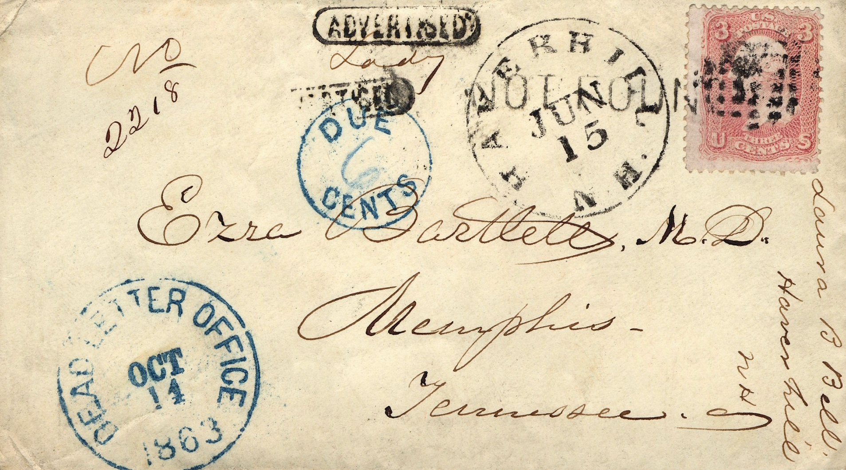
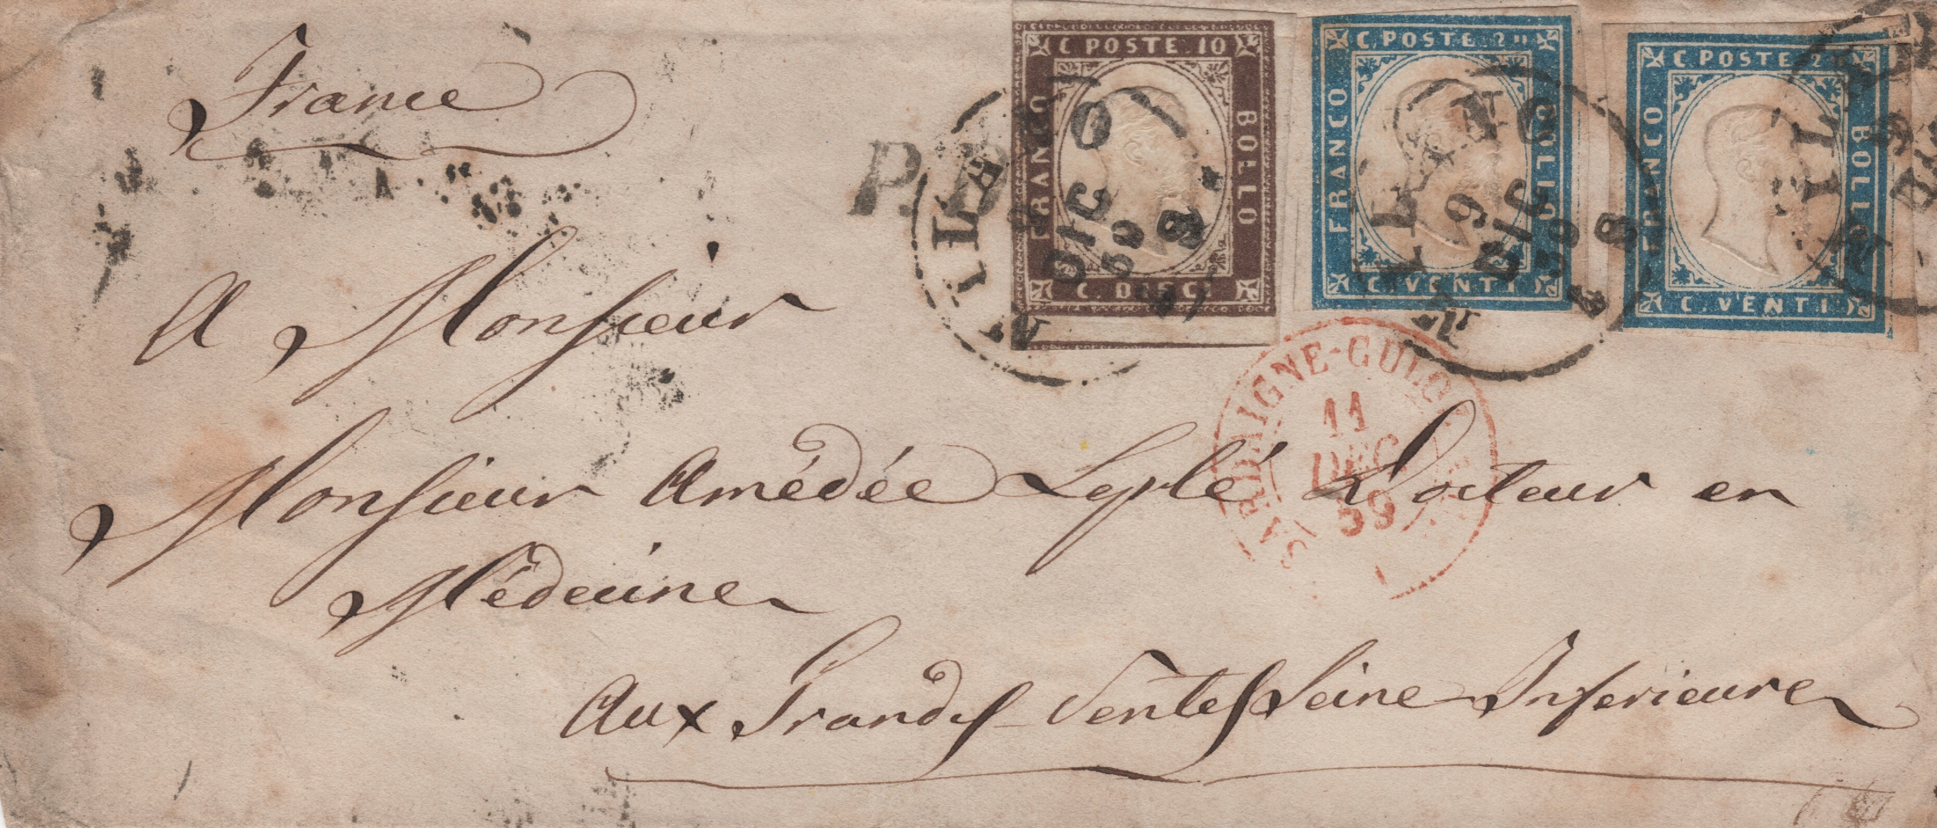
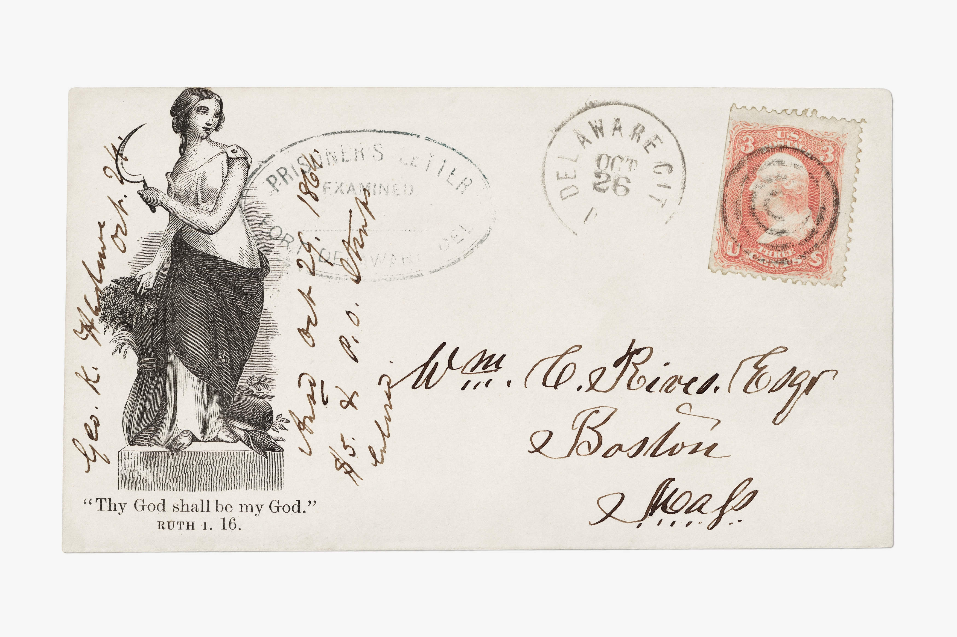
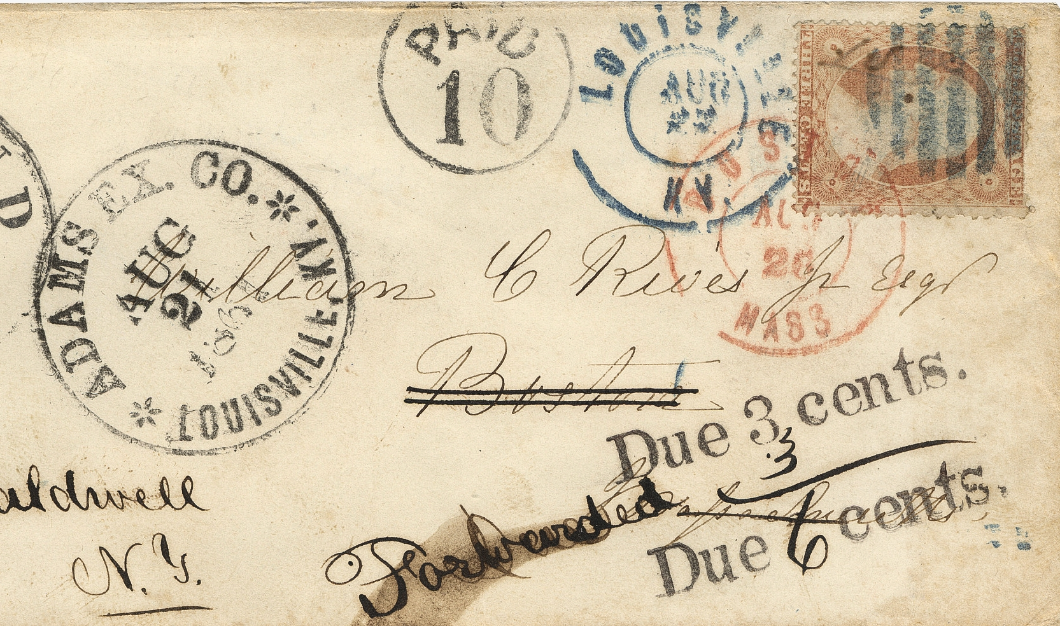
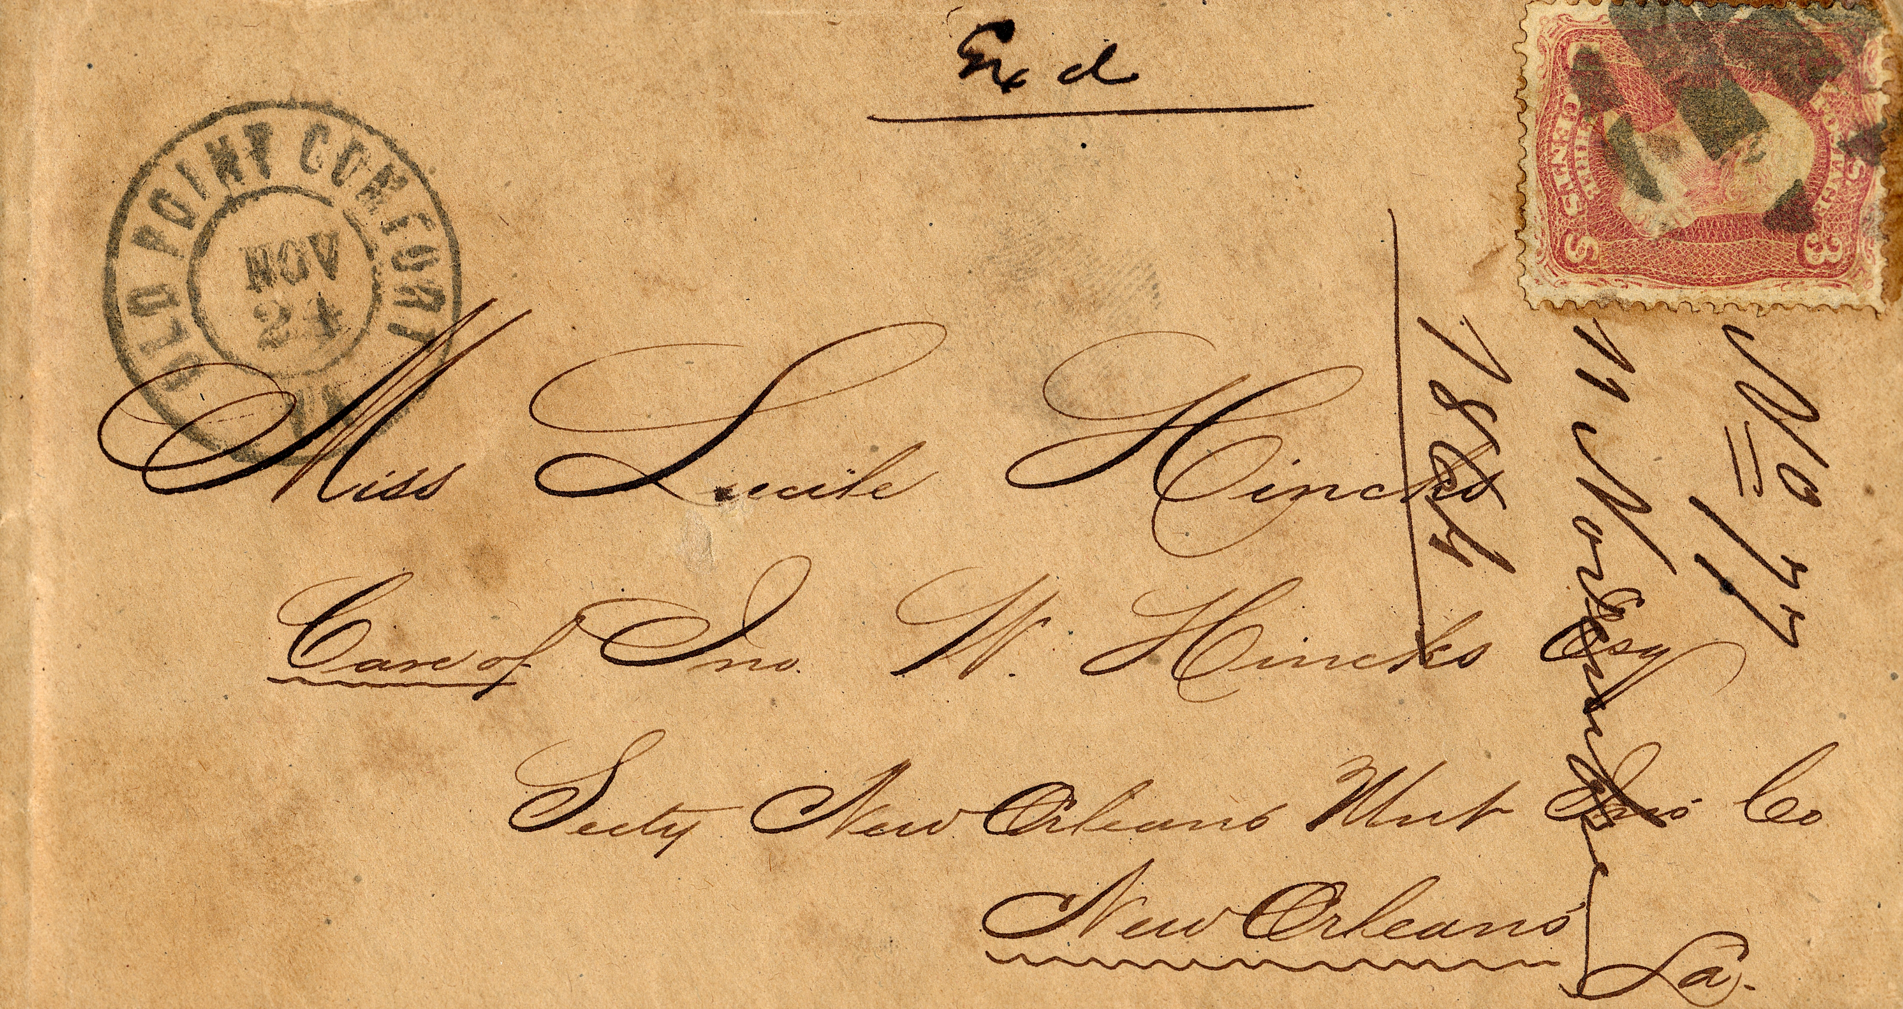
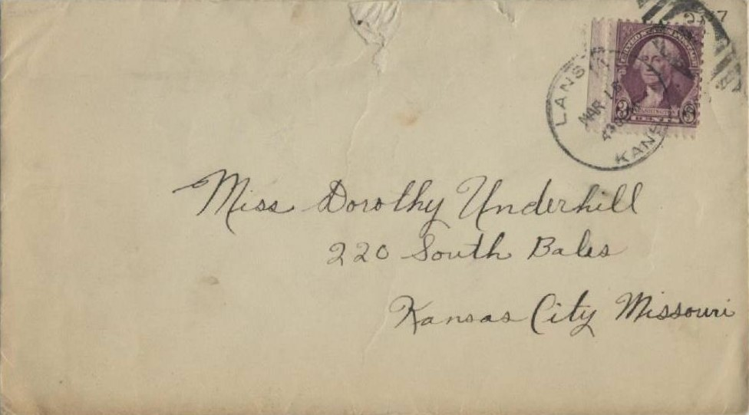
Letter Writing

Slide 2
CG-1 To develop the capacity for effective communication using language skills for description, analysis, and response.
C-1.4 Writes different kinds of letters using appropriate style and registers for different audiences and purposes.
The students will be able to identify the errors in the two letters shown.

Slide 3


How much do you know
1. Letter to the sports company for enquiry of footballs ordered for the school.
Arjun Khanna
801/10, Pink City
Ambala
10th March 2024
The Manager
Kadia Sports
Chandigarh
Notes:
Notes for Teacher - < Notes to the teacher: Use the PPTS given to show the two letters. Elicit from the children the errors in the letters shown by saying- Spot the errors. After the students come up with the errors do write them on the board. (Sample to be given in IM)
Suggestions: <Ideas/ Images/ Animations / Others – To make better representation of the content >
Source of Multimedia used in this slide - <Please provide source URL where we find the image and the license agreement>

Slide 4

How much do you know
Subject: ORDER NO 23230 (FOOTBALL)
Hi Sir/Madam
I am very delighted to inform you that we are going to have a football tournament in our school next week. I am looking forward to this as it is my favourite sport and I will be participating and representing our school. By the way, I think you have forgotten about the order we had placed with you regarding the footballs. Please, don't forget about the order and deliver them in time. Hoping we will receive the order given, this week.
Yours lovingly
Arjun Khanna
Notes:
Notes for Teacher - < Notes to the teacher: Use the PPTS given to show the two letters. Elicit from the children the errors in the letters shown by saying- Spot the errors. After the students come up with the errors do write them on the board. (Sample to be given in IM)
Suggestions: <Ideas/ Images/ Animations / Others – To make better representation of the content >
Source of Multimedia used in this slide - <Please provide source URL where we find the image and the license agreement>

Slide 5
How much do you know
2. Email to the sports company for enquiry of footballs ordered for the school.
FROM: ARJUNKHANNA08@gmail.com
TO: Kadiasports19@yahoo.com
DATE: 13 MARCH 2024
SUBJECT: ORDER NO. 23230 (FOOTBALLS)
RESPECTED SIR,
I AM WRITING ON BEHALF OF ST MARY’S SCHOOL REGARDING THE ORDER NO 23230 WHICH WAS PLACED WITH YOUR COMPANY BY OUR SPORTS INSTRUCTOR ON 25 FEB, 2024. KINDLY PROVIDE INFORMATION REGARDING THE EXPECTED DELIVERY DATE FOR THE SAME.
Notes:
Notes for Teacher - < Notes to the teacher: Use the PPTS given to show the two letters. Elicit from the children the errors in the letters shown by saying- Spot the errors. After the students come up with the errors do write them on the board. (Sample to be given in IM)
Suggestions: <Ideas/ Images/ Animations / Others – To make better representation of the content >
Source of Multimedia used in this slide - <Please provide source URL where we find the image and the license agreement>

Slide 6

How much do you know
WE WOULD REQUEST YOU TO FULFILL OUR GIVEN ORDER BY THIS WEEK AS WE REQUIRE THE PURCHASED ARTICLES FOR THE SOCCER TOURNAMENT THAT IS TO BE HELD IN THE COMING WEEK.
HOPING WE WILL RECEIVE THE DELIVERY EARLY.
YOURS FAITHFULLY
ARJUN KHANNA
*Please note- writing in capitals in an email is equivalent to shouting.
Refer to the Notes Section below for instructional details.
Notes:
Notes for Teacher - : Click for the note to appear
Suggestions: <Ideas/ Images/ Animations / Others – To make better representation of the content >
Source of Multimedia used in this slide - <Please provide source URL where we find the image and the license agreement>

Slide 7
Corrected Format
Business letter
1. Letter to the sports company for enquiry of footballs ordered for the school.
Arjun Khanna
801/10, Pink City
Ambala
10th March 2024
The Manager
Kadia Sports
Chandigarh
Notes:
Notes for Teacher - < Notes to the teacher: Use the PPTS given to show the two letters. Elicit from the children the errors in the letters shown by saying- Spot the errors. After the students come up with the errors do write them on the board. (Sample to be given in IM)
Suggestions: <Ideas/ Images/ Animations / Others – To make better representation of the content >
Source of Multimedia used in this slide - <Please provide source URL where we find the image and the license agreement>

Slide 8
Corrected Format
Business letter
Respected Sir,
Subject: ORDER NO 23230 (FOOTBALL)
I am writing on behalf of St. Mary’s school regarding the order no. 23230 which was placed with your company by our Sports Instructor on 25 Feb, 2024. Kindly provide information regarding the expected delivery date for the same. We would request you to fulfill our given order by this week as we require the purchased articles for the soccer tournament that is to be held in the coming week.
Hoping we will receive the delivery early.
Yours faithfully
Arjun Khanna
Notes:
Notes for Teacher - < Notes to the teacher: Use the PPTS given to show the two letters. Elicit from the children the errors in the letters shown by saying- Spot the errors. After the students come up with the errors do write them on the board. (Sample to be given in IM)
Suggestions: <Ideas/ Images/ Animations / Others – To make better representation of the content >
Source of Multimedia used in this slide - <Please provide source URL where we find the image and the license agreement>

Slide 9
Corrected Format - Email
2. Email to the sports company for enquiry of footballs ordered for the school.
From: Arjunkhanna08@gmail.com
To: Kadiasports19@yahoo.com
Date: 13 March 2024
Subject: Order No. 23230 (footballs)
Respected Sir,
I am writing on behalf of St. Mary’s school regarding the order no. 23230 which was placed with your company by our Sports Instructor on 25 February, 2024. Kindly provide information regarding the expected delivery date for the same.
Notes:
Notes for Teacher - < Notes to the teacher:
Suggestions: <Ideas/ Images/ Animations / Others – To make better representation of the content >
Source of Multimedia used in this slide - <Please provide source URL where we find the image and the license agreement>

Slide 10
Corrected Format - Email
We would request you to fulfill our given order by this week as we require the purchased articles for the soccer tournament that is to be held in the coming week.
Hoping we will receive the delivery early.
Yours faithfully
Arjun Khanna
Notes:
Notes for Teacher - :
Suggestions: <Ideas/ Images/ Animations / Others – To make better representation of the content >
Source of Multimedia used in this slide - <Please provide source URL where we find the image and the license agreement>

Slide 11



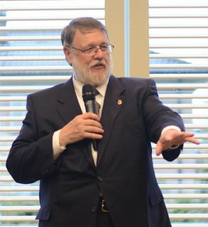
Evolution of e-mails
Ray Tomlinson
From: Ray Tomlinson@host
To: Ray Tomlinson@host
QWERTYUIOP
Only mark (@) that is retained in our emails today
The first email written by Ray Tomlinson in 1971
Notes:
Notes for Teacher - : The first email written is shown to the students. Click for content to appear gradually.
Suggestions: <Ideas/ Images/ Animations / Others – To make better representation of the content >
Source of Multimedia used in this slide - <Please provide source URL where we find the image and the license agreement>

Slide 12


Attribution / Citation
Slide # | Thumbnail | Source link | Author
1 |  | https://picryl.com/media/civil-war-envelope-for-us-christian-commission-showing-carrier-pigeon-with | Library of Congress
1 |  | https://www.rawpixel.com/image/10103420/image-paper-art-vintage | Raw Pixel
1 |  | https://www.rawpixel.com/image/11493577/image-paper-art-vintage | Raw Pixel
1 |  | https://www.rawpixel.com/image/8845690/confederate-flag-of-truce-cover | Raw Pixel
1 |  | https://www.pickpik.com/stamps-letter-rarity-colors-ephemera-old-137318 | Pickpik
1 |  | https://www.rawpixel.com/image/9700544/image-background-person-art | Raw Pixel
1 |  | https://jenikirbyhistory.getarchive.net/media/handwritten-letter-by-wilbur-underhill-jr-envelope-5295f3 | Wikimedia Commons
3-10 |  | https://www.rawpixel.com/image/9216349/image-paper-logo-illustrations | Raw Pixel
3, 7 |  | https://www.rawpixel.com/image/378428/free-photo-image-football-soccer-sports | Raw Pixel
4, 8 |  | https://pixabay.com/id/photos/menulis-tangan-kopi-buku-catatan-3321866/ | Mengedit gambar
11 |  | https://www.needpix.com/photo/618245/email-icon-marketing-information-message-connect-mobile-internet-network | Maialisa (pixabay.com)
6,10 |  | https://pixabay.com/id/photos/papan-ketik-tangan-menulis-3689236/ | geralt

Slide 13
Attribution / Citation
Slide # | Thumbnail | Source link | Author
11 |  | https://www.rawpixel.com/image/6870646/png-sticker-vintage | Raw Pixel
11 |  | https://www.flickr.com/photos/elonuniversity/6961636490 | Elon University
11 |  | https://pixabay.com/id/vectors/di-tanda-surel-berita-e-mail-pada-1083508/ | IO-Images

