Slide 1
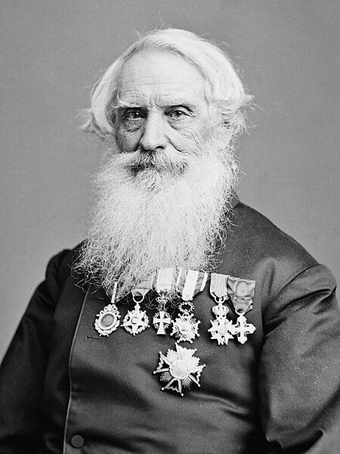
Morse Code
‘MORSE CODE’, a unique code, invented by the American inventor Samuel F.B.Morse, was, and is still used, to send telegraphic messages to sailors and pilots.
Morse code needs special skills to comprehend the messages quickly.
Every English alphabet has a different representation of dots and dashes.
The messages can be transmitted instantly via radio signals.
The distress signal SOS (…---…) is the most popular Morse code used to date.
SOS means ‘SAVE OUR SHIP’.
Notes:
Notes to the teacher: Utilize the poster that is provided to give students an overview of "MORSE CODE," a novel messaging system that requires a certain level of comprehension to understand the dots and dashes.

Slide 2
# | Thumbnail | Source link | Author
1 |  | https://en.wikipedia.org/wiki/Samuel_Morse | Mathew Brady

