Slide 1

Comprehending Data

Slide 2
CG-1
Develops the capacity for effective communication using language skills for description, analysis and response.
C-1.1
Identifies main points and summarises from a careful listening or reading of the text or data.
Students will be able to compile the given data.

Slide 3

Comprehending Data
Recently, stock-taking was conducted in the library of SSS Public School. 4 people collected the data, compiled it and presented it for review. Each one’s presentation was different.
See carefully and make notes of the data in each presentation.
Notes:
Notes for Teacher - Use this slide to introduce the activity.
Suggestions: Not applicable
Source of Multimedia used in this slide - https://www.freepik.com/free-vector/people-reading-books-library-with-bookshelf-flat_7286039.htm#fromView=search&page=1&position=3&uuid=8e85d3bd-3091-4fc7-b881-903edd332a9f

Slide 4
Comprehending Data
Notes:
Notes for Teacher - Ask the students to make notes of the data (as they understand) in their notebooks. This type of data presentation is called a ‘Pie chart’.
Suggestions: Not applicable
Source of Multimedia used in this slide - Not applicable

Slide 5
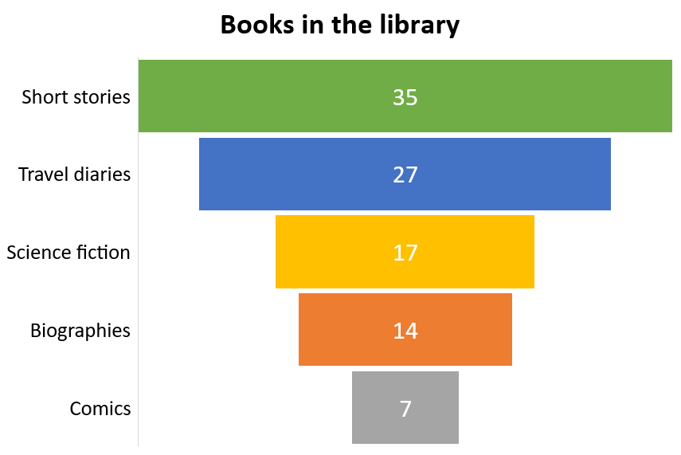
Comprehending Data
Notes:
Notes for Teacher - Ask the students to make notes of the data (as they understand) This type of data presentation is called a ‘Funnel’.
Suggestions: Not applicable
Source of Multimedia used in this slide - Not applicable

Slide 6
Comprehending Data
Notes:
Notes for Teacher - Ask the students to make notes of the data (as they understand) This type of data presentation is called a ‘Bar Graph’.
Suggestions: Not applicable
Source of Multimedia used in this slide - Not applicable

Slide 7
Comprehending Data
Books in the library
7%
14%
Short stories
Travel diaries
17%
Science fiction
27%
Biographies
Comics
35%
Notes:
Notes for Teacher - Ask the students to make notes of the data (as they understand) This type of data presentation is called a ‘Pyramid’.
Suggestions: Not applicable
Source of Multimedia used in this slide - Not applicable

Slide 8

Comprehending Data
Fill in the empty cells using your observations from the various presentations.
Report of stock-taking in the library of SSS Public School
Category | Percentage
Short stories
 | 27
Science fiction
 | 14
Comics
Click for answers
35
Travel diaries
17
Biographies
7
Notes:
Notes for Teacher - This type of data presentation is called a ‘T chart’.
Ask the students to copy the table in their notebooks. Then allow 5 minutes to fill in the empty cells using their observations.
Reveal the answers after the next exercise is also done.
Suggestions: Not applicable
Source of Multimedia used in this slide - Not applicable

Slide 9
Comprehending Data
Fill in the blanks.
Report of library stock-taking
A stock-taking was conducted in a school library recently. It was found that the number of books under the ____________ category was the maximum, about ____. The least number of books were found under the ______ category, just 7%. ____________ were about 27% of the books, while science fiction and __________ were close to each other, ____ and 14% respectively.
short stories
Click for answers
35%
comics
Travel diaries
biographies
17%
Notes:
Notes for Teacher - Ask the students to copy the passage in their notebooks. Allow 5 minutes to fill in the blanks. Now reveal the answers for both exercises and ask them to exchange and check. (peer assessment). This type of data presentation is called a ‘Report’.
Suggestions: Not applicable
Source of Multimedia used in this slide - Not applicable

Slide 10
Comprehending Data
What is common to all the presentations and what is different?
All the presentations have the same data, but they are represented differently.
Notes:
Notes for Teacher - Ask the question and allow the students to think and answer. Encourage maximum participation. Accept all answers before revealing the correct one. (IQ- trigger question)
Suggestions: Not applicable
Source of Multimedia used in this slide - Not applicable

Slide 11
All about comprehension check
7
Map
6
Report
5
T-Chart
Information can be presented in many different forms:
4
Pyramid
3
2
Bar graph
1
Funnel
Pie Chart
To comprehend data, it is very important to study and understand the index.
Notes:
Notes for Teacher – Show the previous slides and tell the names of each kind of data compilation. Elicit from the students about the various forms in which the same data was presented. Explain the other forms like a map or a graph (will be shown as TLMs for DD) which can also be used to represent data. Highlight the need to study the index for a clear understanding of the data presentation.
Suggestions: Not applicable
Source of Multimedia used in this slide - Not applicable

Slide 12
Attribution / Citation
Slide # | Thumbnail | Source link | Author
1 |  | https://www.freepik.com/free-vector/data-inform-illustration-concept_6195525.htm#fromView=search&page=1&position=2&uuid=086a02f5-0934-4aec-9706-d8f696fe1c7a | storyset on Freepik
3 |  | https://www.freepik.com/free-vector/people-reading-books-library-with-bookshelf-flat_7286039.htm#fromView=search&page=1&position=3&uuid=8e85d3bd-3091-4fc7-b881-903edd332a9f | macrovector on Freepik

