Slide 1
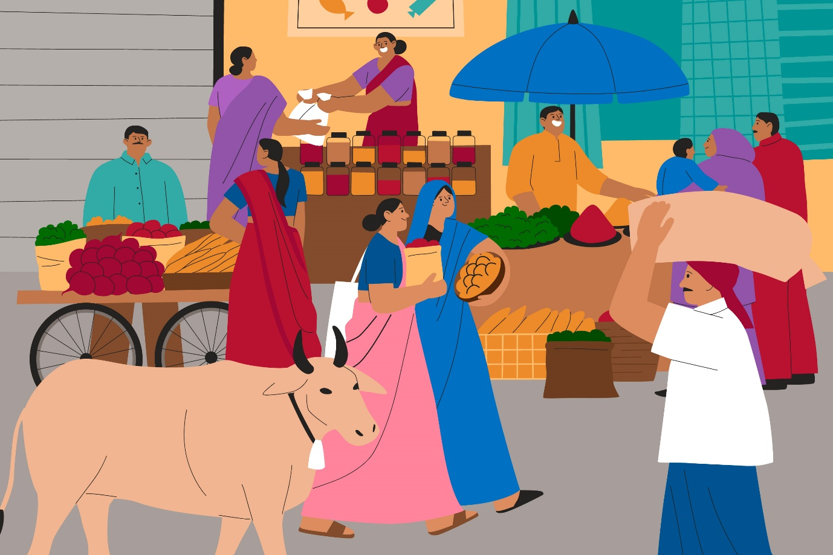
Market

Slide 2

Garden

Slide 3
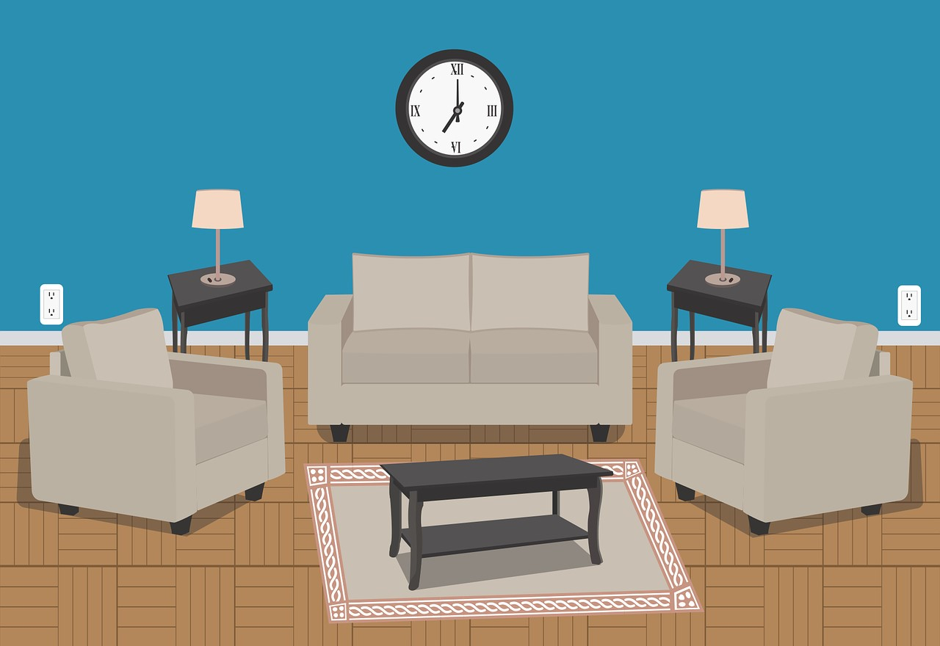
Living Room

Slide 4
# | Thumbnail | Source link | Author
1 |  | https://www.freepik.com/free-vector/flat-design-india-market-illustration_31590531.htm#fromView=search&page=1&position=12&uuid=8c286032-4acc-4255-92e5-4d50b29e9050 | Pikisuperstar
2 |  | https://pixabay.com/illustrations/day-care-center-playground-7355025/ | RosZie
3 |  | https://pixabay.com/vectors/living-room-home-room-furniture-3749761 | EmmanuelMendez

