Slide 1

How to Write a Poem
Notes:
Notes for Teacher - < Information for further reference or explanation >
Suggestions: <Ideas/ Images/ Animations / Others – To make better representation of the content >
Source of Multimedia used in this slide - https://www.freepik.com/free-vector/one-happy-girl-writing-desk_6360147.htm#fromView=search&page=1&position=13&uuid=83bff680-1c23-4ac8-a3f9-3a3354583415

Slide 2
CG-2 appreciates the language and literary and cultural heritage by exploring various forms of literary devices.
C- 2.2 identifies literary devices ( similes , personifications, rhyming words, alliterations) by reading a variety of literature and using them while writing.
Students will be able to describe incidents, feelings and ideas in poetic form.

Slide 3
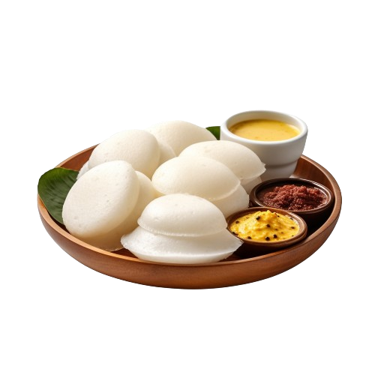
Prose and Poetry
1
2
At breakfast today, hot steaming idlis on my plate,
With spicy sambar and chutney to taste.
Idlis round and white like the moon,
Into my mouth they vanished soon.
Idlis soft and fluffy as feather,
What a great cook is my mother.
Today, I had hot idlis with spicy sambar and chutney for breakfast. It was delicious. The idlis were so soft. You know, my mother is a great cook.
Notes:
Notes for Teacher - Show the passage given and the poem. Ask the students to find the differences between the two forms of writing (Prose and poetry) though it deals with the same subject. Students can be asked to point out the differences like the use of rhyming words, similes and imagery in the poetic form of writing. Ask the students what is a poem.
Suggestions: <Ideas/ Images/ Animations / Others – To make better representation of the content >
Source of Multimedia used in this slide - https://www.freepik.com/free-psd/idli-isolated-transparent-background_146758140.htm#fromView=search&page=1&position=4&uuid=18d67922-b5c2-4993-8ac3-05b65f13c91e

Slide 4
Forms of Poetry
Poetry is a form of writing that uses carefully chosen words, often rhythmic, to express feelings, evoke emotions and convey ideas. There are three main forms of poetry:
Narrative Poetry
Poems that tell a story, like our epics Mahabharata and Ramayana written in the Sanskrit language.
Dramatic Poetry
Poems that form a part of a drama or play. Example: The poem ‘Mercy’ by Shakespeare.
Lyric Poetry
Poems which express personal emotions or feelings. Example: ‘I Wish’ by Rabindranath Tagore.
Notes:
Notes for Teacher - < Information for further reference or explanation >
Suggestions: <Ideas/ Images/ Animations / Others – To make better representation of the content >
Source of Multimedia used in this slide - <Please provide source URL where we find the image and the license agreement>

Slide 5
Tools used for writing Poetry
The tools that can be used for writing poetry can be remembered with an acronym- RAPS.
R: Rhyming words – words with the same ending sound. For example, ‘fair-air’, ‘light-bright’, ‘round-found’.
P: Personification – attributing human characteristics to things and abstract ideas. For example, ‘the old banyan tree can tell many stories.’
A
P
S
R
A: Alliteration – use of same letter or sound at the beginning of the words that are close as in ‘Bindu bought blue bangles in the bazar’.
S: Simile – phrase that compares something to something else using ‘like’ or ‘as’. For example, ‘as soft as silk’, ‘as bright as the sun’, etc.
Notes:
Notes for Teacher - < Information for further reference or explanation >
Suggestions: <Ideas/ Images/ Animations / Others – To make better representation of the content >
Source of Multimedia used in this slide - <Please provide source URL where we find the image and the license agreement>

Slide 6
Devices used for writing Poetry
Imagery produces a vivid picture in the minds of the people listening or reading. For example, ‘I walked on the lawn’ can be written as ‘I walked on a soft carpet of green grass.’
You can use your senses – sight, hearing, smell, taste and touch to describe things in poetry. For example, ‘the aroma of coffee was so inviting’, appeals to the senses of taste and smell.
Rhyme and rhythm add flow and beauty to the poem.
Descriptive language enhances the poem by creating a vivid image in the minds of listeners or readers. For example, ‘my heart with pleasure fills and dances with the daffodils’.
Notes:
Notes for Teacher - < Information for further reference or explanation >
Suggestions: <Ideas/ Images/ Animations / Others – To make better representation of the content >
Source of Multimedia used in this slide - <Please provide source URL where we find the image and the license agreement>

Slide 7

Let’s write a Poem!
Suppose you want to write a small poem about your pet dog.
Think of words rhyming with the dog, the physical characteristics and the qualities of your pet.
Think of a title, for example, ‘My Best Friend’ or ‘Tommy’.
Describe some physical characteristics using similes.
For example:
I have a pet dog,
On biscuits he likes to hog.
His coat is smooth as silk,
He loves to drink milk.
He enjoys a walk,
In the nearby park,
And chases the birds with his bark.
Notes:
Notes for Teacher - < Information for further reference or explanation >
Suggestions: <Ideas/ Images/ Animations / Others – To make better representation of the content >
Source of Multimedia used in this slide - https://www.freepik.com/free-vector/happy-boy-sitting-floor-pets-dog_24085186.htm#fromView=search&page=1&position=13&uuid=3ae01bbd-2a10-4b00-b15c-b95467f890be

Slide 8
Tips for writing Poetry
We can express our thoughts and emotions in a beautiful way in a poem by choosing words that reflect our emotions and create imagery.
Tip 1
Once you have written a poem it can be improved by revision, checking for grammatical errors, punctuation marks, reading it aloud and getting feedback from peers and teachers.
Tip 2
Notes:
Notes for Teacher - < Information for further reference or explanation >
Suggestions: <Ideas/ Images/ Animations / Others – To make better representation of the content >
Source of Multimedia used in this slide - <Please provide source URL where we find the image and the license agreement>

Slide 9
Attribution / Citation
Slide # | Thumbnail | Source link | Author
1 |  | https://www.freepik.com/free-vector/one-happy-girl-writing-desk_6360147.htm#fromView=search&page=1&position=13&uuid=83bff680-1c23-4ac8-a3f9-3a3354583415 | brgfx on Freepik
3 |  | https://www.freepik.com/free-psd/idli-isolated-transparent-background_146758140.htm#fromView=search&page=1&position=4&uuid=18d67922-b5c2-4993-8ac3-05b65f13c91e | tohamina on Freepik
7 |  | https://www.freepik.com/free-vector/happy-boy-sitting-floor-pets-dog_24085186.htm#fromView=search&page=1&position=13&uuid=3ae01bbd-2a10-4b00-b15c-b95467f890be | brgfx on Freepik
Notes:
Notes for Teacher - < Information for further reference or explanation >
Suggestions: <Ideas/ Images/ Animations / Others – To make better representation of the content >
Source of Multimedia used in this slide - <Please provide source URL where we find the image and the license agreement>

