Slide 1
What is in Store
Notes:
Notes for Teacher - < Information for further reference or explanation >
Suggestions: <Ideas/ Images/ Animations / Others – To make better representation of the content >
Source of Multimedia used in this slide - <Please provide source URL where we find the image and the license agreement>

Slide 2
CG- 2 Appreciates the language and literary and cultural heritage in and related to language by exploring various forms of literary devices
C- 2.1 Identifies and appreciates different forms of literature and styles of writing (narrative, descriptive) from various cultures and time periods.
Students will be able to take delight in watching the two forms of writing.
Notes:
SDG-4 To ensure inclusive and equitable quality education and promote lifelong learning opportunities for all.

Slide 3
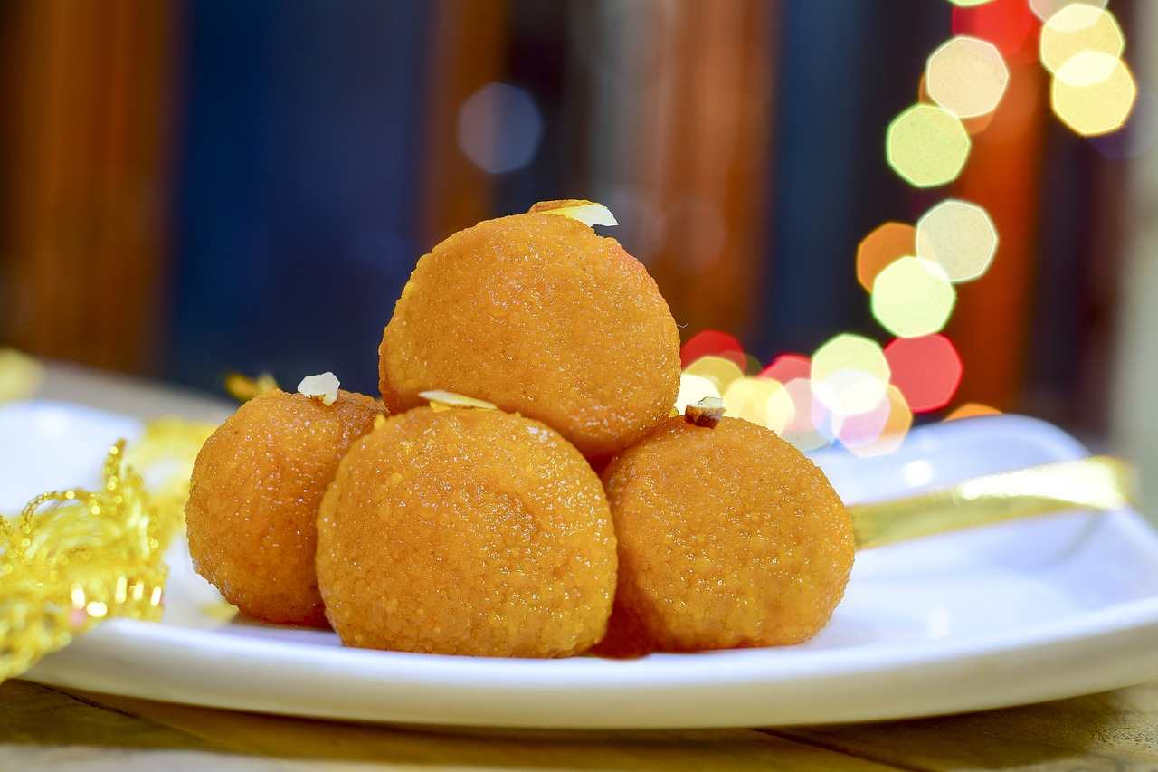
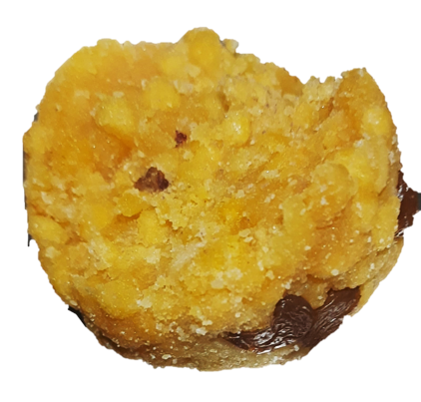
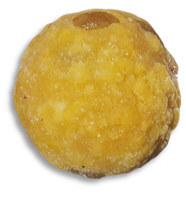
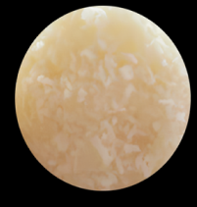
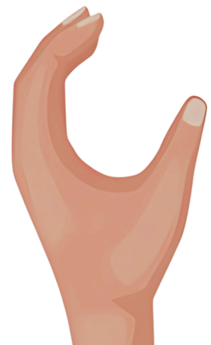
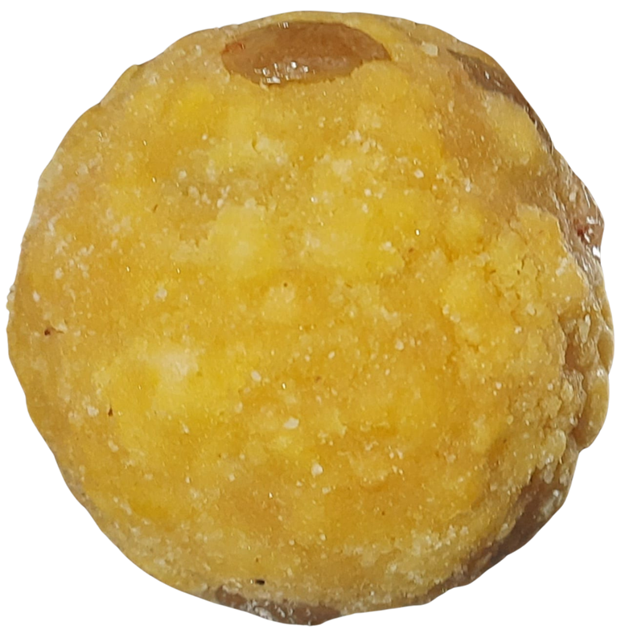
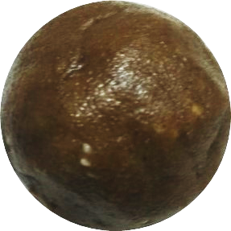
Autobiography
I am bright golden yellow,
Sometimes brown, sometimes white,
And I am everyone’s delight.
Present on all happy occasions,
The cynosure of all eyes.
Gods or demons I do not fear,
But I tremble when humans appear,
I am Laddu
Because instantly Ooh! Ahaa! Ahum!
And I disappear.
Now you know me I am sure!
Notes:
Notes for Teacher -Show the PPT provided. The first poem is an autobiographical poem-Laddu, and the second is a biographical passage - The story of a Smile.
Suggestions: <Ideas/ Images/ Animations / Others – To make better representation of the content >
Source of Multimedia used in this slide - <Please provide source URL where we find the image and the license agreement>
Laddu : https://pixabay.com/photos/motichoor-laddu-sweet-diwali-food-7683487/ (RavendraSingh)
White laddu - https://pxhere.com/en/photo/971014
Yellow laddu – Boondi Laddu – SSSVV Media Bank
Half eaten laddu – Half Boondi Laddu – SSSVV Media Bank
Brown laddu – Keyword: Brown Laddu – SSSVV Media Bank
Smile - https://pixabay.com/vectors/smile-emoji-happy-happiness-5865208/ (95C)
Frown - https://pixabay.com/vectors/smile-emoji-sad-sullen-sad-face-5872116/ (95C)
Hand - https://www.freepik.com/free-vector/hands-collection-with-different-poses-hand-drawn-style_2096309.htm (freepik)
Face - https://www.freepik.com/free-vector/happy-cartoon-child-with-sparkling-eyes_155088386.htm (brgfx)

Slide 4
Biography: Story of a Smile
In laughter land where laughter flowed, a character named Smile was born to Mrs. Giggles and Mr. Chuckles.
Smile
Smile was so bright she spread happiness far, near and wide.
She spread joy from morning to night.
Notes:
Notes for Teacher - < Information for further reference or explanation >
Suggestions: <Ideas/ Images/ Animations / Others – To make better representation of the content >
Source of Multimedia used in this slide - <Please provide source URL where we find the image and the license agreement>
Smiley : https://pixabay.com/fr/vectors/graphique-sympathique-smiley-smiley-4008068/ (BilliTheCat)
Happy : https://pxhere.com/en/photo/539763

Slide 5
Biography: Story of a Smile
One day she travelled to Frown land, chased away the scowls and frowns and turned everything into a cheerful scene.
When pranks were played on
Mr.Frown he too laughed aloud.
Notes:
Notes for Teacher - < Information for further reference or explanation >
Suggestions: <Ideas/ Images/ Animations / Others – To make better representation of the content >
Source of Multimedia used in this slide - <Please provide source URL where we find the image and the license agreement>
Smiley : https://www.freepik.com/free-vector/flat-design-hate-emoji-illustration_86749986.htm# (freepik)
Smiley : https://pixabay.com/vectors/smiley-laughing-face-teeth-orange-155845/ (OpenClipart-Vectors)

Slide 6
Biography: Story of a Smile
This story spread like a guiding light bringing happiness far and wide.
She became a symbol of cheer for all to see and in every heart she left a mark and lit the world with her spark.
* Always Keep Smiling*
Notes:
Notes for Teacher - < Information for further reference or explanation >
Suggestions: <Ideas/ Images/ Animations / Others – To make better representation of the content >
Source of Multimedia used in this slide - <Please provide source URL where we find the image and the license agreement>
smiley : https://pixabay.com/illustrations/emoticon-emoji-smile-happy-1610573/ (TheDigitalArtist)

Slide 7
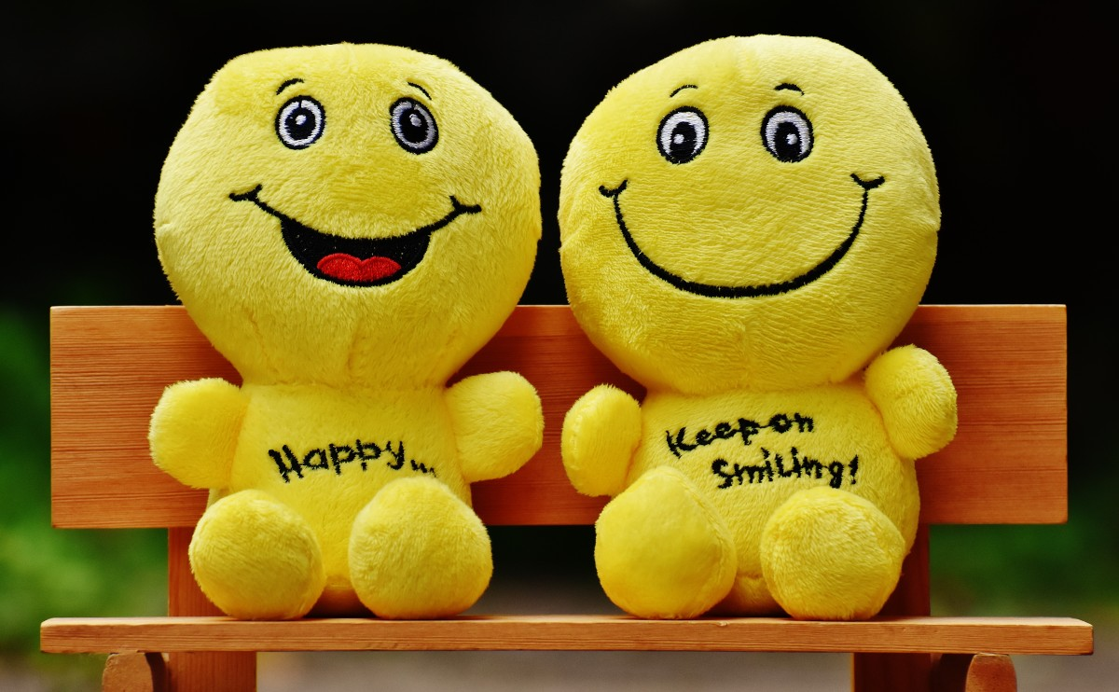
Attribution / Citation
Slide # | Thumbnail | Source link | Author
3 |  | Laddu : https://pixabay.com/photos/motichoor-laddu-sweet-diwali-food-7683487/ White laddu - https://pxhere.com/en/photo/971014 Smile - https://pixabay.com/vectors/smile-emoji-happy-happiness-5865208/ Frown - https://pixabay.com/vectors/smile-emoji-sad-sullen-sad-face-5872116/ Hand - https://www.freepik.com/free-vector/hands-collection-with-different-poses-hand-drawn-style_2096309.htm Face - https://www.freepik.com/free-vector/happy-cartoon-child-with-sparkling-eyes_155088386.htm (brgfx) | Ravendrasingh pxhere 95C 95C Freepik brgfx
4 |  | Smiley : https://pixabay.com/fr/vectors/graphique-sympathique-smiley-smiley-4008068/ Happy : https://pxhere.com/en/photo/539763 | BilliTheCat pxhere
5 |  | Smiley : https://www.freepik.com/free-vector/flat-design-hate-emoji-illustration_86749986.htm# Smiley : https://pixabay.com/vectors/smiley-laughing-face-teeth-orange-155845/ | freepik OpenClipart-Vectors)
6 |  | smiley : https://pixabay.com/illustrations/emoticon-emoji-smile-happy-1610573/ | TheDigitalArtist)
Notes:
Notes for Teacher - < Information for further reference or explanation >
Suggestions: <Ideas/ Images/ Animations / Others – To make better representation of the content >
Source of Multimedia used in this slide - <Please provide source URL where we find the image and the license agreement>

