Slide 1
Where do I belong
Notes:
Notes for Teacher - < Information for further reference or explanation >
Suggestions: <Ideas/ Images/ Animations / Others – To make better representation of the content >
Source of Multimedia used in this slide - <Please provide source URL where we find the image and the license agreement>

Slide 2
CG-2 Appreciates the language and literary and cultural heritage in and related to language by exploring the various forms of literary devices.
CG-2.1 Identifies and appreciates different forms of literature and styles of writing (narrative, descriptive) from various cultures and time periods.
Students will be able to identify different forms of writing.
Notes:
Notes to Teacher: The quiz and the riddles can be used to ask questions to the students to lead them to the concept of different forms of writing (autobiography and biography)
Suggestions: N/A
Source of Multimedia used in this slide - N/A

Slide 3
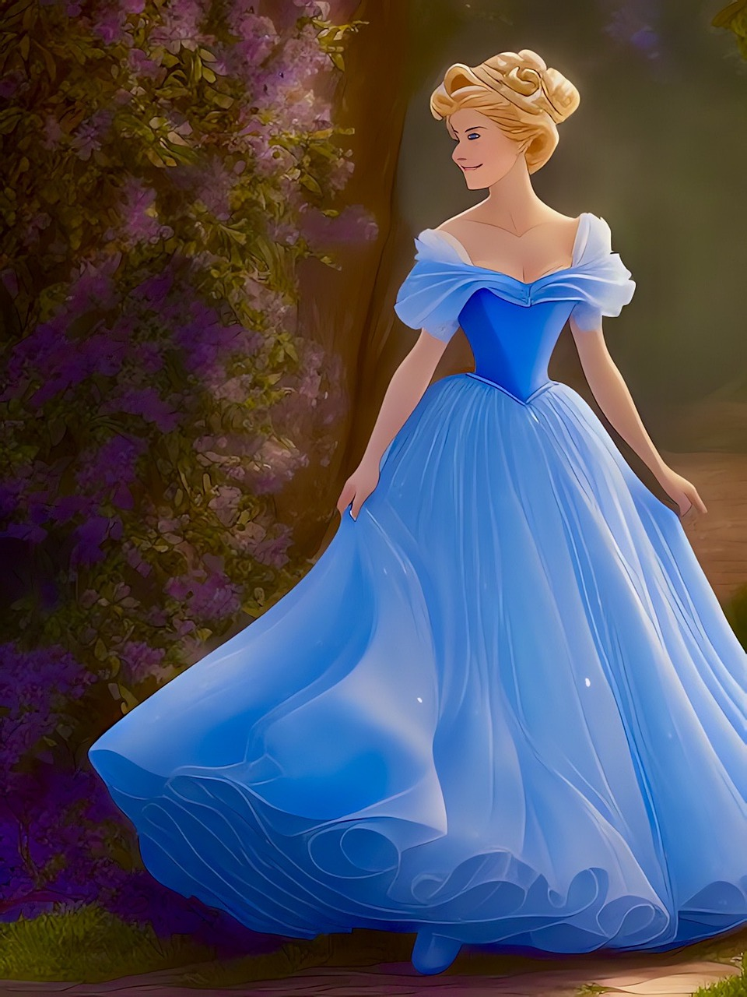
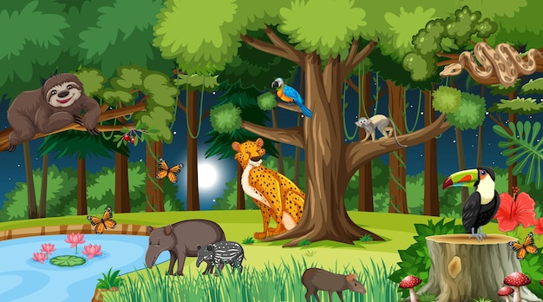
Quiz
The lion and the mouse
Click
Stars wars
Fables
Cinderella
Science fiction
The ant and the grasshopper
Harry potter series
Fantasy
Panchatantra
Fairy tales
ET
Ramayan
Historical stories
Swami and his friends
Fiction
Stories of Akbar and Birbal
Notes:
Notes for Teacher: Click each story box to know in which categories they are
Suggestions: N/A
Source of Multimedia used in this slide -
Cinderella : https://pixabay.com/illustrations/fantasy-cinderella-fairy-tale-7697380/ (JuliusH)
Stories : https://www.freepik.com/free-vector/forest-night-landscape-scene-with-different-wild-animals_18384169.htm# (brgfx)

Slide 4
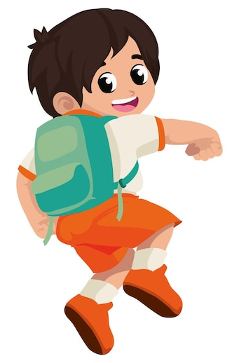
Riddles
Hello young scholars, guess who am I? I am your faithful friend who accompanies you to school every day. Stuffed like a samosa, not with
spicy potatoes but with books and notebooks ready to burst
Click here for solution
It is with a sigh of relief that you download me at school and with a
Hurrah! when you reach home. I catch the aroma of your lunch in the tiffin boxes.
I hide your hidden treasures comic books and candy stash. Mostly
I get a piggyback ride on you. My favorite moments are the weekends
when I get time to relax and catch my breath.
I am a school bag !!
Notes:
Notes for Teacher - The solution to the two riddles is the same but what is the difference in the two forms of writing?
Suggestions: N/A
Source of Multimedia used in this slide -
Boy : https://www.freepik.com/free-vector/student-back-school-happiness-icon-isolated_88419503.htm# (jemastock)
Bag : https://www.freepik.com/free-vector/backpack-with-books-materials_1215870.htm# (freepik)

Slide 5
Riddles
It is a constant companion that travels with you to school everyday.
Click here for solution
It is made of waterproof material.
It contains a storehouse of knowledge, but also yummy things like tiffin boxes and candies.
It’s me the school bag !!
It is mostly stuffed resembling a gunny bag.
Sometimes it serves as a pillow for an impromptu nap.
It gets a piggyback ride on you daily.
It dreams of becoming slim and light but till that paperless day dawns It will remain your loyal friend.
Friends, guess the identity of the described object.
Notes:
Notes for Teacher - The solution to the two riddles is the same but what is the difference in the two forms of writing?
Suggestions: <Ideas/ Images/ Animations / Others – To make better representation of the content >
Source of Multimedia used in this slide - <Please provide source URL where we find the image and the license agreement>
Boy : https://www.freepik.com/free-vector/cute-boy-with-backpack-paper-greeting-white_6874082.htm# (brgfx)
Kids : https://www.freepik.com/free-vector/back-school-background-with-kids_2499203.htm# (freepik)

Slide 6
Riddles
The solution to the two riddles is the same, but what is the difference in the two forms of writing.
THINK!
Notes:
Notes for Teacher - < Information for further reference or explanation >
Suggestions: <Ideas/ Images/ Animations / Others – To make better representation of the content >
Source of Multimedia used in this slide - <Please provide source URL where we find the image and the license agreement>

Slide 7
Attribution / Citation
Slide # | Thumbnail | Source link | Author
3 |  | Cinderlla : https://pixabay.com/illustrations/fantasy-cinderella-fairy-tale-7697380/ Stories : https://www.freepik.com/free-vector/forest-night-landscape-scene-with-different-wild-animals_18384169.htm# | JuliusH brgfx
4 |  | Boy : https://www.freepik.com/free-vector/student-back-school-happiness-icon-isolated_88419503.htm# Bag : https://www.freepik.com/free-vector/backpack-with-books-materials_1215870.htm# | jemastock freepik
5 |  | Boy : https://www.freepik.com/free-vector/cute-boy-with-backpack-paper-greeting-white_6874082.htm# Kids : https://www.freepik.com/free-vector/back-school-background-with-kids_2499203.htm# | brgfx freepik
Notes:
Notes for Teacher - < Information for further reference or explanation >
Suggestions: <Ideas/ Images/ Animations / Others – To make better representation of the content >
Source of Multimedia used in this slide - <Please provide source URL where we find the image and the license agreement>

