Slide 1
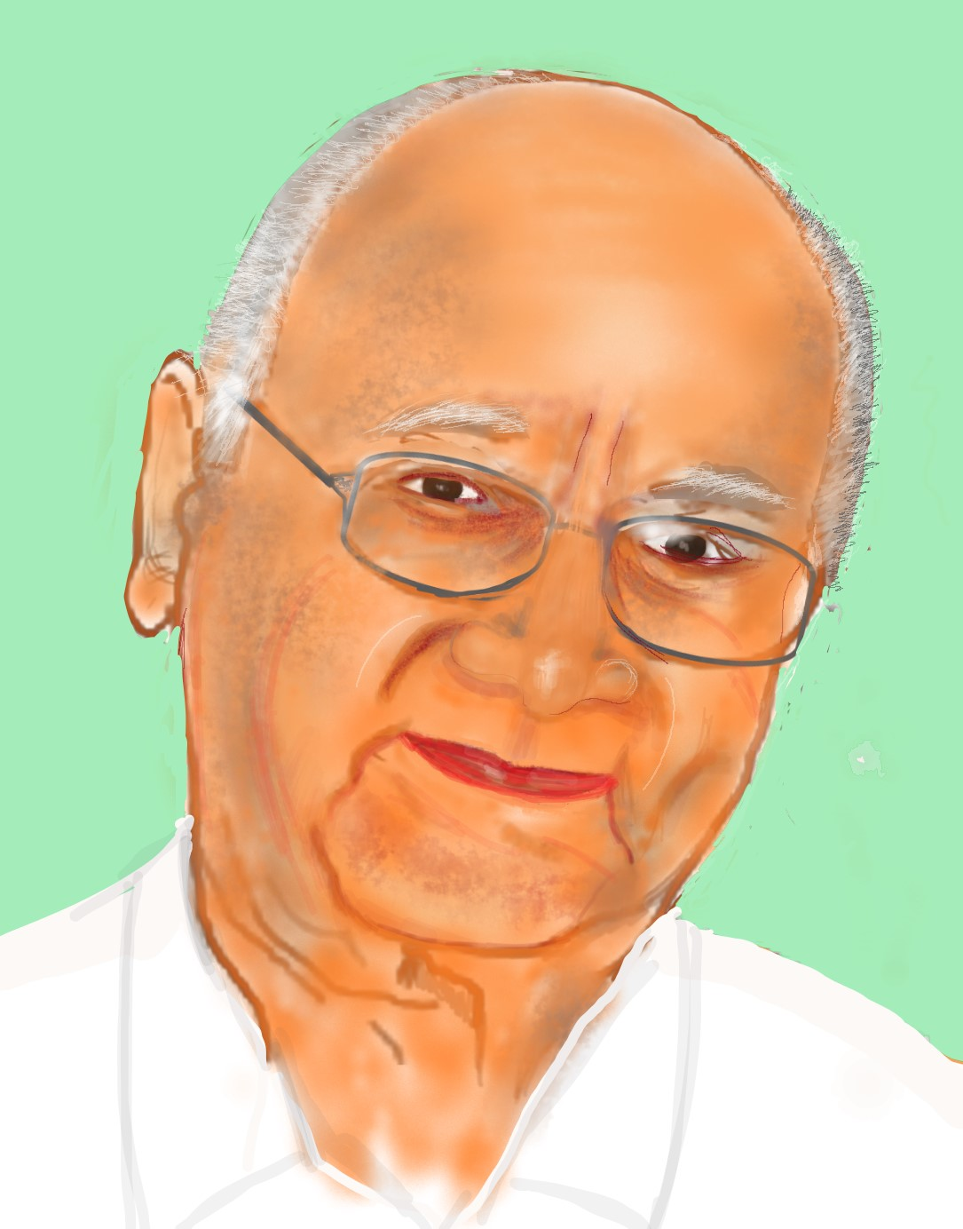
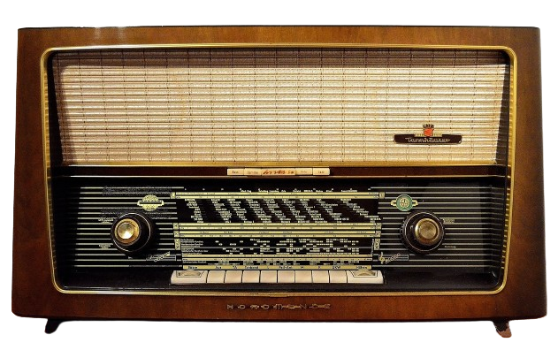
THE FIRST NEWS REPORT ANNOUNCING THE INDEPENDENCE OF INDIA
15th August 1947
05:30 a.m.
India is a free country!
On August 15, 1947, at 5:30 a.m., young Poornam Viswanathan became the first Indian to announce India's freedom in a historic radio broadcast from All India Radio to East Asia.
His first sentence, 'India is a free country!' was followed by Pandit Jawaharlal Nehru's 'Tryst with Destiny' speech.
Notes:
Image of Poornam Viswanathan – SSSVV gallery – Search words – Poornam, Viswanathan

Slide 2
ATTRIBUTIONS/CITATIONS
# | Thumbnail | Source link | Author
1 |  | https://www.freepik.com/free-vector/calendar-icon-white-background_23722481.htm#fromView=search&page=1&position=3&uuid=9494b03a-2108-4062-9e5f-ee3eaacfca02 | brgfx on Freepik
1 |  | https://www.freepik.com/free-vector/clock-flat-style_198044264.htm#fromView=search&page=1&position=1&uuid=d530b72f-31f9-4393-98e9-8d85ac0fdbc5 | juicy_fish on Freepik
1 |  | https://pixabay.com/photos/radio-tube-radio-radio-device-1954856/ | Detmold
1 |  | https://boudewijnhuijgens.getarchive.net/amp/media/prasar-bharti-air-and-dd-08c685 | Wikimedia Commons

