Slide 1
Sentence Transformation, Reordering & Gap-filling

Slide 2
CG-3
Develops the ability to write simple and compound sentence structures to express their understanding and experiences.
CG-3.4
Uses appropriate grammar and structure in their writing and oral communication.
Students will be able to identify the differences in the sentence types.

Slide 3

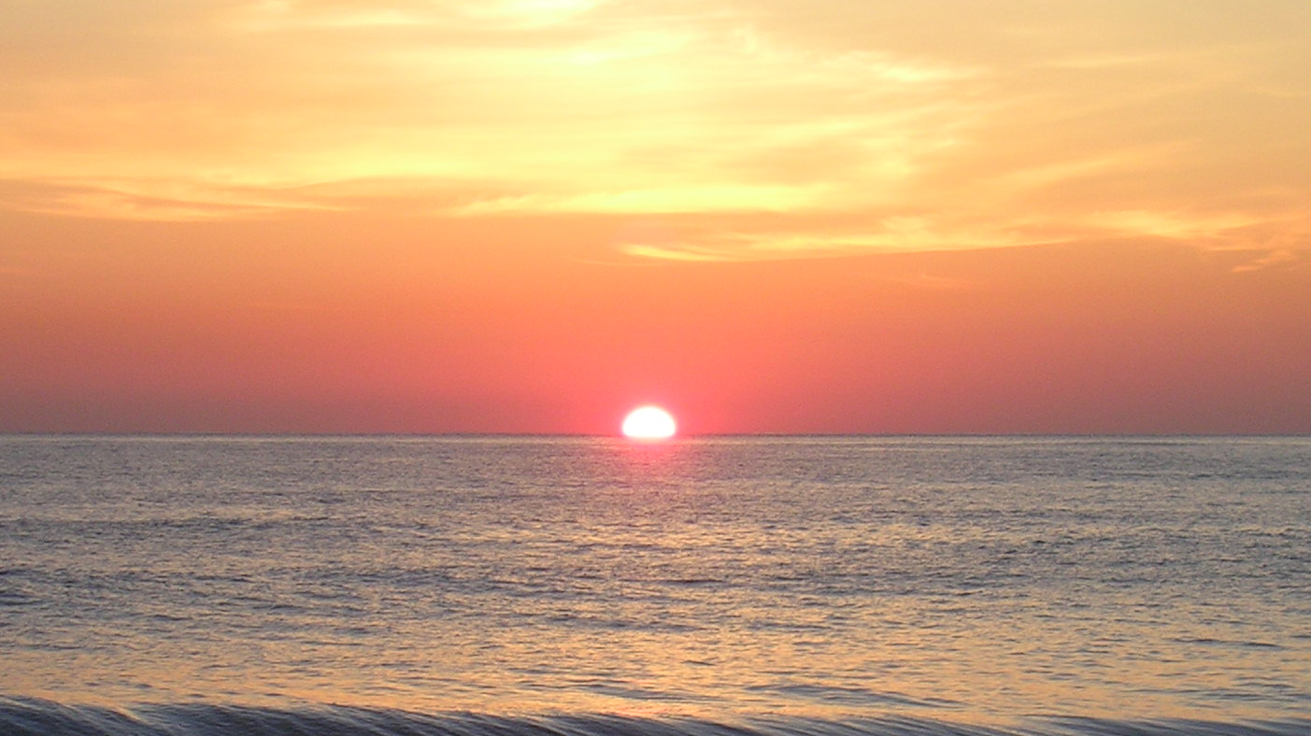
Listen and Enjoy!
I woke up at 6 this morning.
Oh, I woke up at 6 this morning!
What a lovely sight the rising sun was!
The rising sun was a lovely sight.
1
2
It was a pleasure to hear the birds chirping.
Such a pleasure it was to hear the birds chirping!
Can you believe that I woke up at 6 in the morning?
Try to wake up at 6 in the morning.
3
4
Do you know what a lovely sight the rising sun was?
You should enjoy the lovely sight of the sun rising.
How can I describe the pleasure of hearing the birds chirping?
Do not miss the pleasure of hearing the birds chirping.
Notes:
Notes for Teacher - Play the ppt on ‘slide show’ mode and allow the students to listen to the voiceover (keep the volume high) on this slide. You may play it twice if required.
Suggestions: <Ideas/ Images/ Animations / Others – To make better representation of the content >
Source of Multimedia used in this slide - <Please provide source URL where we find the image and the license agreement>

Slide 4
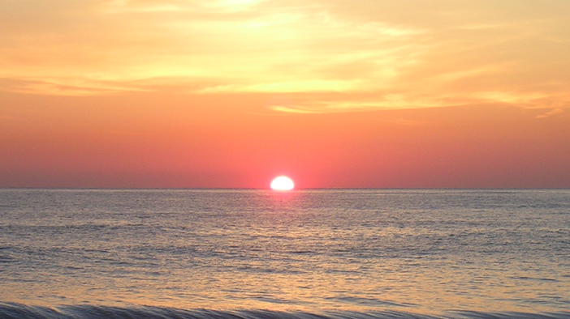
Think and Answer!
I woke up at 6 this morning.
Oh, I woke up at 6 this morning!
What a lovely sight the rising sun was!
The rising sun was a lovely sight.
1
2
It was a pleasure to hear the birds chirping.
Such a pleasure it was to hear the birds chirping!
Can you believe that I woke up at 6 in the morning?
Try to wake up at 6 in the morning.
3
4
Do you know what a lovely sight the rising sun was?
You should enjoy the lovely sight of the sun rising.
How can I describe the pleasure of hearing the birds chirping?
Do not miss the pleasure of hearing the birds chirping.
Question: What is common in these 4 sets of sentences?
Answer: The beauty of dawn
Notes:
Notes for Teacher - Now ask the students to identify the similarity in the four sets of sentences. Allow the students to discuss with their next partner for a minute before answering. Accept all answers before giving the correct answer (All the sets have the same subject- the beauty of dawn.)
Suggestions: <Ideas/ Images/ Animations / Others – To make better representation of the content >
Source of Multimedia used in this slide - <Please provide source URL where we find the image and the license agreement>

Slide 5
Think and Answer!
I woke up at 6 this morning.
Oh, I woke up at 6 this morning!
What a lovely sight the rising sun was!
The rising sun was a lovely sight.
1
2
It was a pleasure to hear the birds chirping.
Such a pleasure it was to hear the birds chirping!
Can you believe that I woke up at 6 in the morning?
Try to wake up at 6 in the morning.
3
4
Do you know what a lovely sight the rising sun was?
You should enjoy the lovely sight of the sun rising.
How can I describe the pleasure of hearing the birds chirping?
Do not miss the pleasure of hearing the birds chirping.
Question: Is there any difference between these sets of sentences? If yes, what is it?
Answer: Every set is made of a specific type of sentence.
Notes:
Notes for Teacher - Move on to the next question about the difference. (Each set has a different type of sentence.)
Suggestions: <Ideas/ Images/ Animations / Others – To make better representation of the content >
Source of Multimedia used in this slide - <Please provide source URL where we find the image and the license agreement>

Slide 6
Think and Answer!
I woke up at 6 this morning.
Oh, I woke up at 6 this morning!
What a lovely sight the rising sun was!
The rising sun was a lovely sight.
1
2
It was a pleasure to hear the birds chirping.
Such a pleasure it was to hear the birds chirping!
Can you believe that I woke up at 6 in the morning?
Try to wake up at 6 in the morning.
3
4
Do you know what a lovely sight the rising sun was?
You should enjoy the lovely sight of the sun rising.
How can I describe the pleasure of hearing the birds chirping?
Do not miss the pleasure of hearing the birds chirping.
Question: What other differences can you spot?
Answer: Punctuations, sentence structure and intonation.
Notes:
Notes for Teacher - Probe the students to notice more differences. (punctuations, sentence structure and intonation)
Suggestions: <Ideas/ Images/ Animations / Others – To make better representation of the content >
Source of Multimedia used in this slide - <Please provide source URL where we find the image and the license agreement>

Slide 7
All about sentences
 | ASSERTIVE SENTENCE | INTERROGATIVE SENTENCE
PUNCTUATIONS | Starts with a capital letter and ends with a full stop. My pet puppy loves playing in the garden. | Starts with a capital letter and ends with a question mark. Does your pet puppy love playing in the garden?
SENTENCE STRUCTURE |  | Auxiliary verb+ Subject + verb + object for yes/no question- Will you come home for dinner? ‘wh’ word + auxiliary verb + subject + verb + object for ‘wh’ question When will you come home for dinner?
INTONATION | A plain tone with no emotions.
Subject + verb + object
These flowers bloom in summer.
A rising tone to indicate questioning.
Click for answers
Notes:
Notes for Teacher - Students can be asked to copy this table in their notebooks and fill in the empty boxes. Guide them as and when required. Now allow the students to check their answers. Encourage students to come up with examples of their own but check the accuracy.
Suggestions: <Ideas/ Images/ Animations / Others – To make better representation of the content >
Source of Multimedia used in this slide - <Please provide source URL where we find the image and the license agreement>

Slide 8
All about sentences
 | EXCLAMATORY SENTENCE | IMPERATIVE SENTENCE
PUNCTUATIONS
SENTENCE STRUCTURE | Interjection (Oh, Wow) + verb + subject (with !) Wow, it is a lovely day! Or Exclamatory pronoun (how/what/such) + subject + verb (with !) What a lovely day it is! | Subject + verb (with a suitable modal verb) + object You ought to finish your project by tomorrow.
INTONATION |  | A tone of authority to show command or a calm tone to request or suggest.
Starts with a capital letter and ends with an exclamation mark.
Oh, my pet puppy loves playing in the garden!
Such a joy it is to see my pet puppy playing in the garden!
Starts with a capital letter and ends with a full stop.
You should see my pet puppy playing in the garden.
Strong tone to suit the feeling expressed.
Click for answers
Notes:
Notes for Teacher - Students can be asked to copy this table in their notebooks and fill in the empty boxes. Guide them as and when required. Now allow the students to check their answers. Encourage students to come up with examples of their own but check the accuracy.
Suggestions: <Ideas/ Images/ Animations / Others – To make better representation of the content >
Source of Multimedia used in this slide - <Please provide source URL where we find the image and the license agreement>

Slide 9

All about sentences
02
The rising sun was a lovely sight.
01
I woke up at 6 this morning.
Click to reorder
04
It was a pleasure to hear the birds chirping.
03
The sky was a beautiful orange.
Question: Are these sentences arranged in a logical order?
Answer: No
It is very important to arrange the sentences in the proper sequence to bring out the appropriate meaning.
Notes:
Notes for Teacher - Allow the students to notice the order in which the sentences have been placed. Highlight the need for proper sequencing of sentences to make the communication effective and meaningful.
Suggestions: <Ideas/ Images/ Animations / Others – To make better representation of the content >
Source of Multimedia used in this slide - <Please provide source URL where we find the image and the license agreement>

Slide 10
All about sentences
Fill in the blanks with suitable words to complete the passage. (You may use any word that you think will suit the context.)
01
at
I woke up ____ 6 this morning.
Click for answers
02
sun
The rising _____ was a lovely sight.
03
The
_____ sky was a beautiful orange.
hear
04
It was a pleasure to _____ the birds chirping.
Certain words cannot be replaced if the information and the meaning are to be effectively conveyed.
Notes:
Notes for Teacher - All the students to notice that the words that fit into the blanks are very specific and cannot be replaced. Emphasise on the need to use the right words for effective communication.
Suggestions: <Ideas/ Images/ Animations / Others – To make better representation of the content >
Source of Multimedia used in this slide - <Please provide source URL where we find the image and the license agreement>

Slide 11




Sentences in use
To make a statement that conveys some information.
Walking is good for health.
ASSERTIVE SENTENCE
INTERROGATIVE SENTENCE
To ask a question.
When is the train supposed to arrive?
EXCLAMATORY SENTENCE
To express strong feelings like joy, surprise, sorrow, anger.
Oh, the food is so tasty!
To request, suggest or command.
You should go to bed early.
IMPERATIVE SENTENCE
Notes:
Notes for Teacher - Draw the students’ attention to the practical use of different types of sentences. Encourage them to come up with examples from their daily life. (at home, with friends, at the marketplace, etc.) Emphasise on the intonations specific to each type of sentence.
Suggestions: <Ideas/ Images/ Animations / Others – To make better representation of the content >
Source of Multimedia used in this slide - PPT icons

Slide 12
Attribution / Citation
Slide # | Thumbnail | Source link | Author
3, 4, 5 and 6 |  | https://commons.wikimedia.org/wiki/File:Sunrise_at_ocean.JPG | Belinda

