Slide 1
Anne Frank’s Diary

Slide 2
CG-1 Develops the capacity for effective communication using language skills for description, analysis, and response.
Teacher will be able to use the suggestions, pedagogical approaches, ideas, references, teaching aids for transacting the topic Speech-writing.
C-1.5 Writes different kinds of letters, essays, and reports using the appropriate style and registers for different audiences and purposes.
Students will be able to get a taste of diary entry.

Slide 3
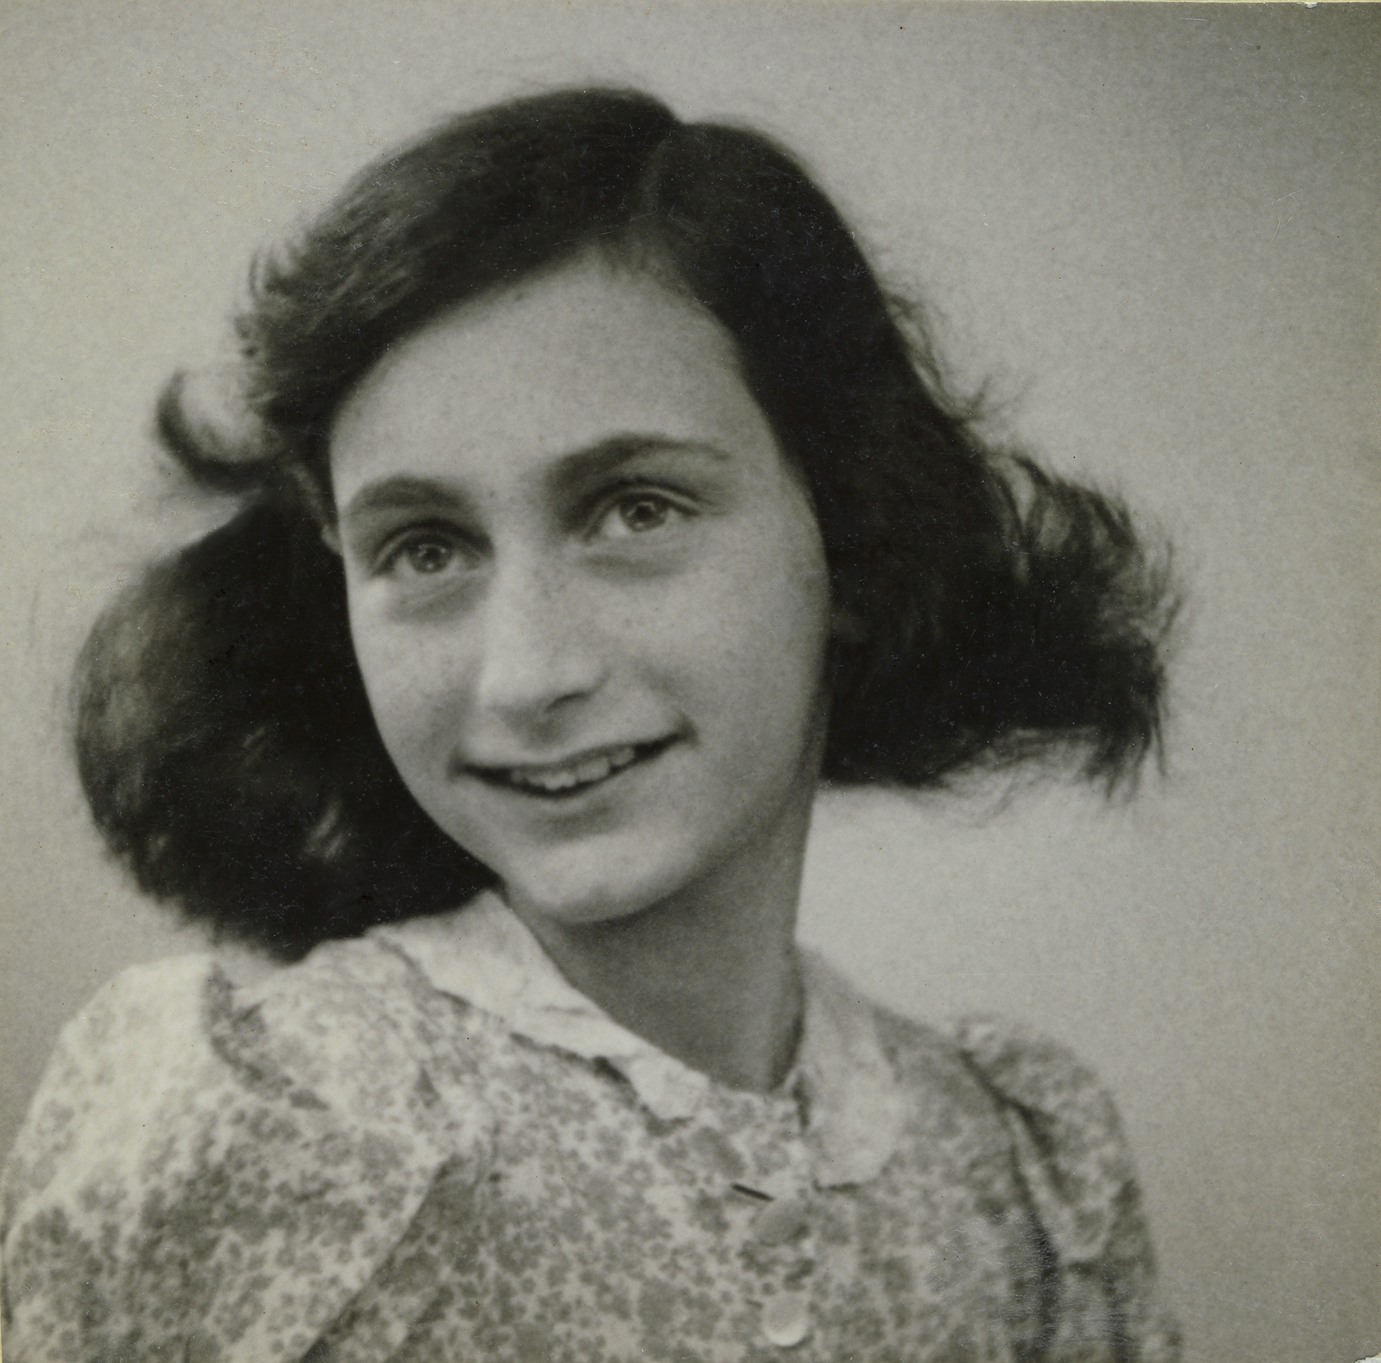
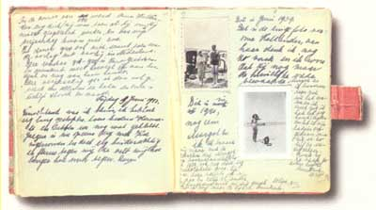
Anne Frank And Her Diary
Anne Frank
Anne Frank’s diary
Notes:
Notes for Teacher - < Information for further reference or explanation >
Suggestions: <Ideas/ Images/ Animations / Others – To make better representation of the content >
Source of Multimedia used in this slide - <Please provide source URL where we find the image and the license agreement>

Slide 4

Extracts From The Diary Of Anne Frank
SATURDAY, JUNE 20, 1942
“Paper is more patience than man”. I thought of this saying on one of those days when I was feeling a little depressed and was sitting at home with my chin in my hands, bored and listless, wondering whether to stay in or go out. I finally stayed where I was, brooding. Yes paper does have more patience and since I'm not planning to let anyone else read this stiff-backed notebook grandly referred to as a "diary," unless I should ever find a real friend, it probably won't make a bit of difference.
Notes:
Notes for Teacher - < Information for further reference or explanation >
Suggestions: <Ideas/ Images/ Animations / Others – To make better representation of the content >
Source of Multimedia used in this slide - <Please provide source URL where we find the image and the license agreement>

Slide 5


Let’s Discuss!
Question 1
Question 2
What do you understand by diary entry?
How is diary writing unique to other forms, such as notice writing?
Notes:
Notes for Teacher - < Information for further reference or explanation >
Suggestions: <Ideas/ Images/ Animations / Others – To make better representation of the content >
Source of Multimedia used in this slide - <Please provide source URL where we find the image and the license agreement>

Slide 6
Attribution / Citation
Slide # | Thumbnail | Source link | Author
1 |  | https://www.vecteezy.com/vector-art/2686702-diary-book-cartoon-hygge-style | stockgiu
3 |  | https://www.flickr.com/photos/isabel_maree/1720807034 | Isabelle GM
3 |  | https://www.flickr.com/photos/collection_annefrankhouse/31927397212 | Photo Collection Anne Frank House
4 |  | https://www.freepik.com/free-photo/old-book-open-dark-wood-background_1273906.htm#fromView=search&page=1&position=3&uuid=08548311-f275-4c15-af25-469a8086dd63 | Image by aopsan on Freepik
5 |  | https://www.freepik.com/icon/diary_3238016#fromView=search&page=1&position=0&uuid=bff3fc64-e327-479c-8f3a-35480540dd2e | Freepik
5 |  | https://www.freepik.com/icon/write_9686299#fromView=search&page=1&position=57&uuid=0bf2d830-c657-43ac-bca1-b2e7ff6eb314 | kliwir art on Freepik

