Slide 1
Language Enhancers
Let us learn ‘Language Enhancers’ today!
Types of phrases
Notes:
Notes for Teacher - < Information for further reference or explanation >
Suggestions: <Ideas/ Images/ Animations / Others – To make better representation of the content >
Source of Multimedia used in this slide - <Please provide source URL where we find the image and the license agreement>

Slide 2
CG-4. Develops the ability to recognise basic linguistic aspects (word and structure) and use them in oral and written expression.
C-4.1 Interprets, understands, applies basic linguistic aspects (rules) such as sentence structure, punctuation, tense, gender, phrases and parts of speech.
The students will be able to analyze the usage of different types of phrases.

Slide 3
Phrase Expansion Game
For example, ‘girl’.
The studious young girl,
who was wise beyond her years,
hit the books every evening to prepare for her exams.
This sentence has a noun phrase, adjective phrase and an idiomatic phrase.
Notes:
Notes for Teacher - Introduce adjective phrases, noun phrases and idiomatic phrases to students in a fun and engaging way. You can integrate interactive activities and real-life examples.
Begin with a few sentences with a noun phrase, adjective phrase and idiomatic phrase in them. Explain their usage and then elaborate them with the help of a Phrase Expansion Game.
Start with a simple noun as given. Students take turns expanding the noun into a longer noun phrase by adding adjectives, articles, and other modifiers.
Suggestions: <Ideas/ Images/ Animations / Others – To make better representation of the content >
Source of Multimedia used in this slide - <Please provide source URL where we find the image and the license agreement>

Slide 4
Your Turn!
Describe a butterfly and a giant using noun phrases, adjective phrases, and idiomatic phrases.
Sample answer: A delicate colourful garden visitor (noun phrase), light as a feather (adjective phrase) that goes flitting from flower to flower. (idiomatic phrase)
Sample answer: A mountain like man (noun phrase), as strong as an ox (adjective phrase), and a force of nature to reckon with. (idiomatic phrase)
Notes:
Notes for Teacher - Objective: Encourage creative thinking and a deeper understanding of how phrases are constructed to add more meaning to the sentence. Provide a list of noun, adjective and idiomatic phrases after the students have created sentences with different types of phrases.
Suggestions: <Ideas/ Images/ Animations / Others – To make better representation of the content >
Source of Multimedia used in this slide - <Please provide source URL where we find the image and the license agreement>

Slide 5
Types of Phrases
Noun
Phrases
Group of words
Adjective
Phrases
Phrases
Idiomatic
Phrases
Notes:
Notes for Teacher - < Information for further reference or explanation >
Suggestions: <Ideas/ Images/ Animations / Others – To make better representation of the content >
Source of Multimedia used in this slide - <Please provide source URL where we find the image and the license agreement>

Slide 6
Noun Phrases
A group of words that act as a noun.
A noun phrase consists of a noun.
Any word that modifies or describes the noun.
Structure: Determiner + Adjective(s) + Noun
Example 1: The tall boy ran across the field.
Noun phrase: The tall boy
Here, ‘the’ is the determiner, ‘tall’ is the adjective, and ‘boy’ is the noun.
Notes:
Notes for Teacher - < Information for further reference or explanation >
Suggestions: <Ideas/ Images/ Animations / Others – To make better representation of the content >
Source of Multimedia used in this slide - <Please provide source URL where we find the image and the license agreement>

Slide 7
Noun Phrases
Example 2: A basket of fruits was on the table.
Noun phrase: A basket of fruits
‘A’ is the determiner, ‘basket’ is the noun, and ‘of fruits’ gives more information about the noun.
A noun phrase is
centered around the noun.
About who or what is being talked about.
It gives more detail.
Notes:
Notes for Teacher - < Information for further reference or explanation >
Suggestions: <Ideas/ Images/ Animations / Others – To make better representation of the content >
Source of Multimedia used in this slide - <Please provide source URL where we find the image and the license agreement>

Slide 8
Adjective Phrases
A group of words that describe a noun/pronoun.
It gives more details.
About the noun it is modifies/qualifying.
Structure: Adjective + Modifiers
Example 1: The cake was very delicious.
Adjective phrase: very delicious
‘Very’ modifies ‘delicious,’ which describes the noun ‘cake’.
Notes:
Notes for Teacher - < Information for further reference or explanation >
Suggestions: <Ideas/ Images/ Animations / Others – To make better representation of the content >
Source of Multimedia used in this slide - <Please provide source URL where we find the image and the license agreement>

Slide 9
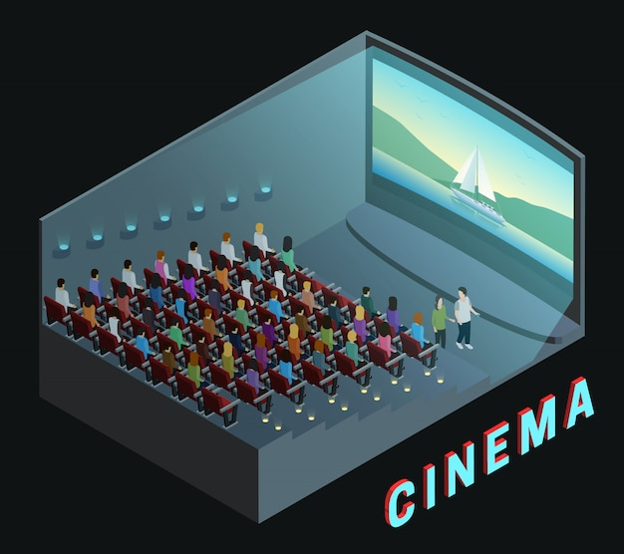
Adjective Phrases
Example 2: The movie was exciting beyond belief.
Adjective phrase: exciting beyond belief
‘Exciting’ is the adjective and ‘beyond belief’ modifies it, giving more detail about how exciting the movie was.
Adjective phrases can come.
The noun or pronoun they describe.
Before or after.
Notes:
Notes for Teacher - < Information for further reference or explanation >
Suggestions: <Ideas/ Images/ Animations / Others – To make better representation of the content >
Source of Multimedia used in this slide - <Please provide source URL where we find the image and the license agreement>

Slide 10
Idiomatic Phrases
Expressions whose meanings are not literal.
Often have cultural significance.
Understood by native speakers.
Idiom 1: Break the ice.
Meaning: To start a conversation or make people feel more comfortable in a situation.
Example: The host told a joke to his guests to break the ice.
Notes:
Notes for Teacher - < Information for further reference or explanation >
Suggestions: <Ideas/ Images/ Animations / Others – To make better representation of the content >
Source of Multimedia used in this slide - <Please provide source URL where we find the image and the license agreement>

Slide 11
Idiomatic Phrases
Idiom 2: Piece of cake.
Meaning: Something that is very easy to do.
Example: For Amit, solving the math problem was a piece of cake.
Idiomatic phrases often don't make sense,
if you try to understand them word by word.
You have to learn their meaning as a whole.
Notes:
Notes for Teacher - Provide a list of noun, adjective and idiomatic phrases after the students have created sentences with different types of phrases.
Suggestions: <Ideas/ Images/ Animations / Others – To make better representation of the content >
Source of Multimedia used in this slide - <Please provide source URL where we find the image and the license agreement>

Slide 12
Attribution / Citation
Slide # | Thumbnail | Source link | Author
1 |  | https://www.freepik.com/free-vector/teacher-with-blackboard-design_1023438.htm# | Sapann-Design on Freepik
3 |  | 1. https://www.freepik.com/free-vector/one-happy-girl-writing-desk_6360147.htm# 2. https://www.freepik.com/free-vector/critical-thinking-concept-illustration_20863438.htm# 3. https://www.freepik.com/free-vector/cheerful-young-girl-vector-portrait_165707139.htm# | 1. brgfx on Freepik 2. storyset on Freepik 3. brgfx on Freepik
4 |  | 1. https://www.freepik.com/free-vector/butterfly-realistic-isolated_1530375.htm# 2. https://www.freepik.com/free-vector/hand-drawn-lumberjack-cartoon-illustration_138642441.htm | 1. macrovector on Freepik 2. pikisuperstar on Freepik
6 |  | https://www.freepik.com/free-vector/teenager-boy-cartoon_5038320.htm# | stockgiu on Freepik
7 |  | https://www.freepik.com/free-vector/tropical-fruits-background_5728215.htm# | gstudioimagen on Freepik
8 |  | https://www.freepik.com/free-vector/sweet-birthday-cake-with-candles_70015375.htm# | jemastock on Freepik
9 |  | https://www.freepik.com/free-vector/cinema-movie-theater-indoor-auditorium-isometric-view-poster_3789849.htm# | macrovector on Freepik
10 |  | https://www.freepik.com/free-vector/group-therapy_9884643.htm# | freepik
11 |  | https://www.freepik.com/free-vector/font-design-word-math-genius-cute-boy-school-item_7541403.htm# | brgfx on Freepik
Notes:
Notes for Teacher - < Information for further reference or explanation >
Suggestions: <Ideas/ Images/ Animations / Others – To make better representation of the content >
Source of Multimedia used in this slide - <Please provide source URL where we find the image and the license agreement>

