Slide 1
Exponents
and
Computers
Notes:
Notes for Teacher - < Information for further reference or explanation >
Suggestions: <Ideas/ Images/ Animations / Others – To make better representation of the content >
Source of Multimedia Objects (Image/audio/ Video/Animation) used in this slide -
1. <Short Description> - <SOURCE URL>

Slide 2
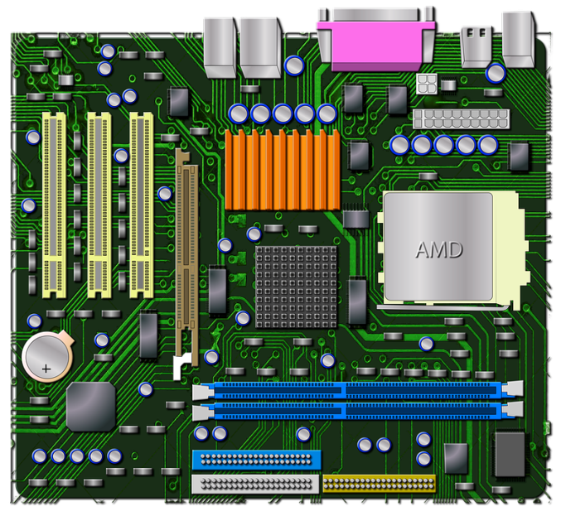

Exponents and Computers
In Computer science, file sizes are expressed as an exponent
A computer file size is measured using megabytes
Megabytes are an expression of an exponent
A megabyte is equivalent to 10 6 bytes
Knowledge of exponents help in writing computer programs efficiently
Notes:
Notes for Teacher – N/A
Suggestions: N/A
Source of Multimedia Objects (Image/audio/ Video/Animation) used in this slide -
Motherboard: https://pixabay.com/illustrations/motherboard-pc-computer-amd-683247/
Programming: https://pixabay.com/photos/programming-computer-environment-1857236/

Slide 3


MM Index
Slide# | Thumbnail | Source and Attribution
2 |  | https://pixabay.com/illustrations/motherboard-pc-computer-amd-683247/
2 |  | https://pixabay.com/photos/programming-computer-environment-1857236/

