Slide 1
Patterns in Numbers
Notes:
Notes for Teacher – NA
Suggestions: NA
Source of Multimedia used in this slide - NA

Slide 2
CG 1: Looks for patterns and appreciates relationships between numbers.
CG-9: Knows and appreciates the development of mathematical ideas over a period of time and the contributions of past and modern mathematicians from India and across the world.
C1.2: Discovers, identifies, and explores patterns in numbers and describes rules for their formation (e.g., multiples of 7, powers of 3, prime numbers) and explains relations between different patterns
C9.2: Knows and appreciates the contributions of ancient Indian Mathematicians
Students will be able to
connect to real-world examples like patterns of numbers in train berths [Fulfills C1.2]
identify the rule that governs a pattern [Fulfills C1.2]
predict the next term in a sequence [Fulfills C1.2]
create their patterns using numbers. [Fulfills C1.2]
Notes:
Notes for Teacher – NA
Suggestions: NA
Source of Multimedia used in this slide - NA

Slide 3
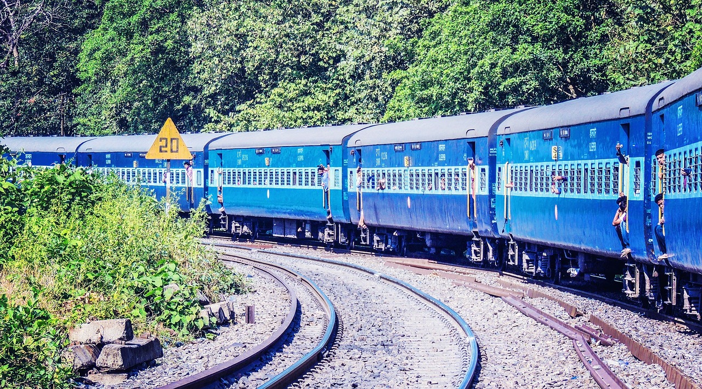
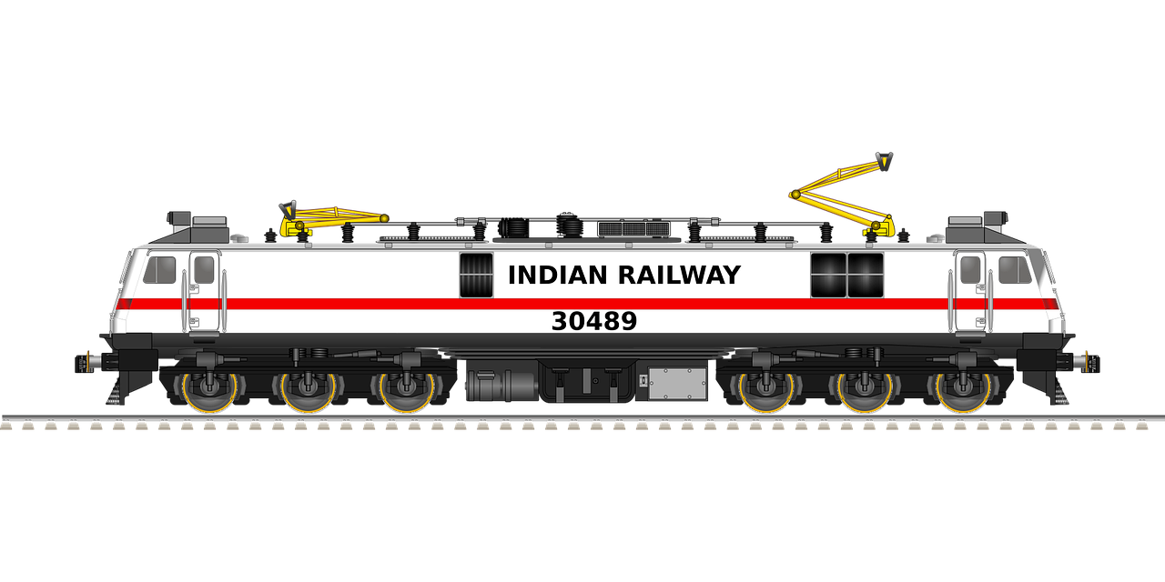
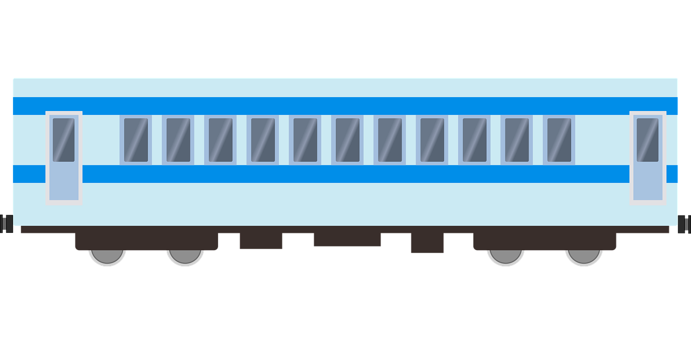
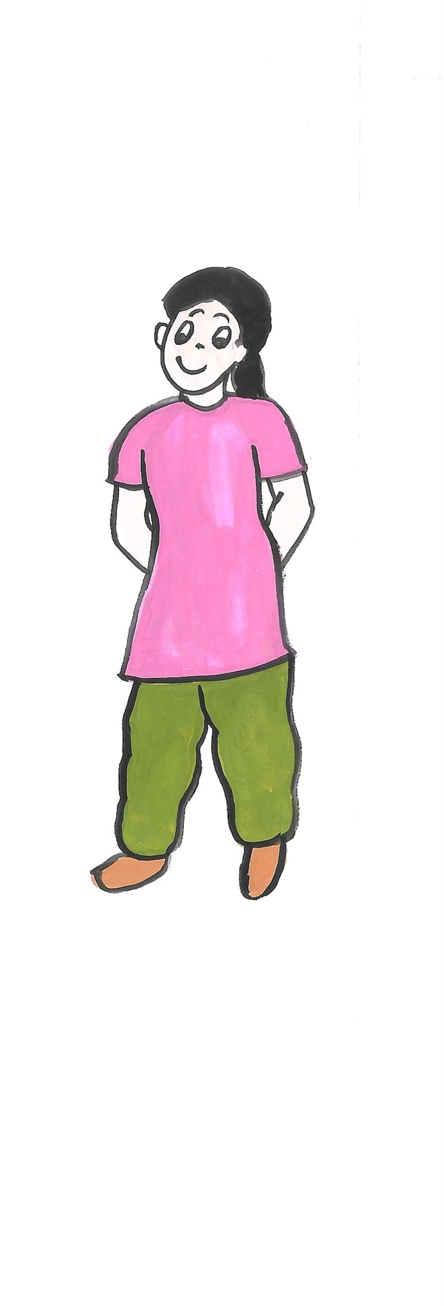
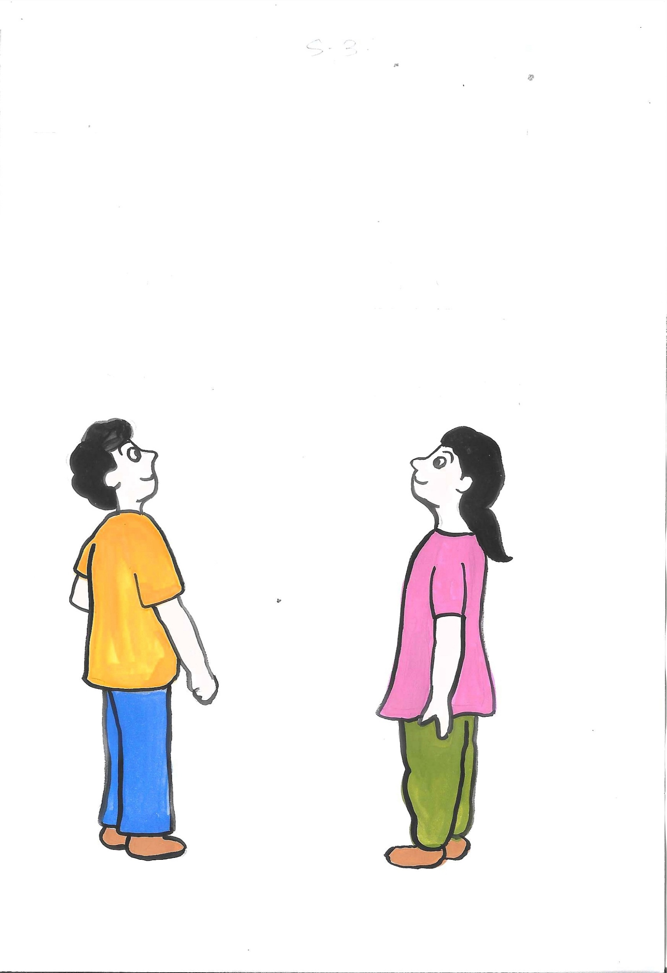
Story: Journey in a Train
Sirish and Shriya boarded a train from Hyderabad to New Delhi with their parents for a holiday trip.
They were both very excited as they were travelling for the first time by train. They were very curious about everything around them. They were
in the coach numbered S9.
S1
S2
S3
S4
S5
S6
S7
S8
S9
S10
S11
Notes:
Notes for Teacher – NA
Suggestions: NA
Source of Multimedia used in this slide -
Train : https://pixabay.com/photos/india-train-transportation-railway-771288/ (antriksh)
Train 2 : https://pixabay.com/vectors/engine-electric-train-railway-7289466/ (sanctumdigital)
Train 3 : https://pixabay.com/vectors/boxcar-car-goods-train-railway-4562890/ (RealMotion)
Boy and girl : SSSVV Media Bank (Keyword: Boy, girl)

Slide 4
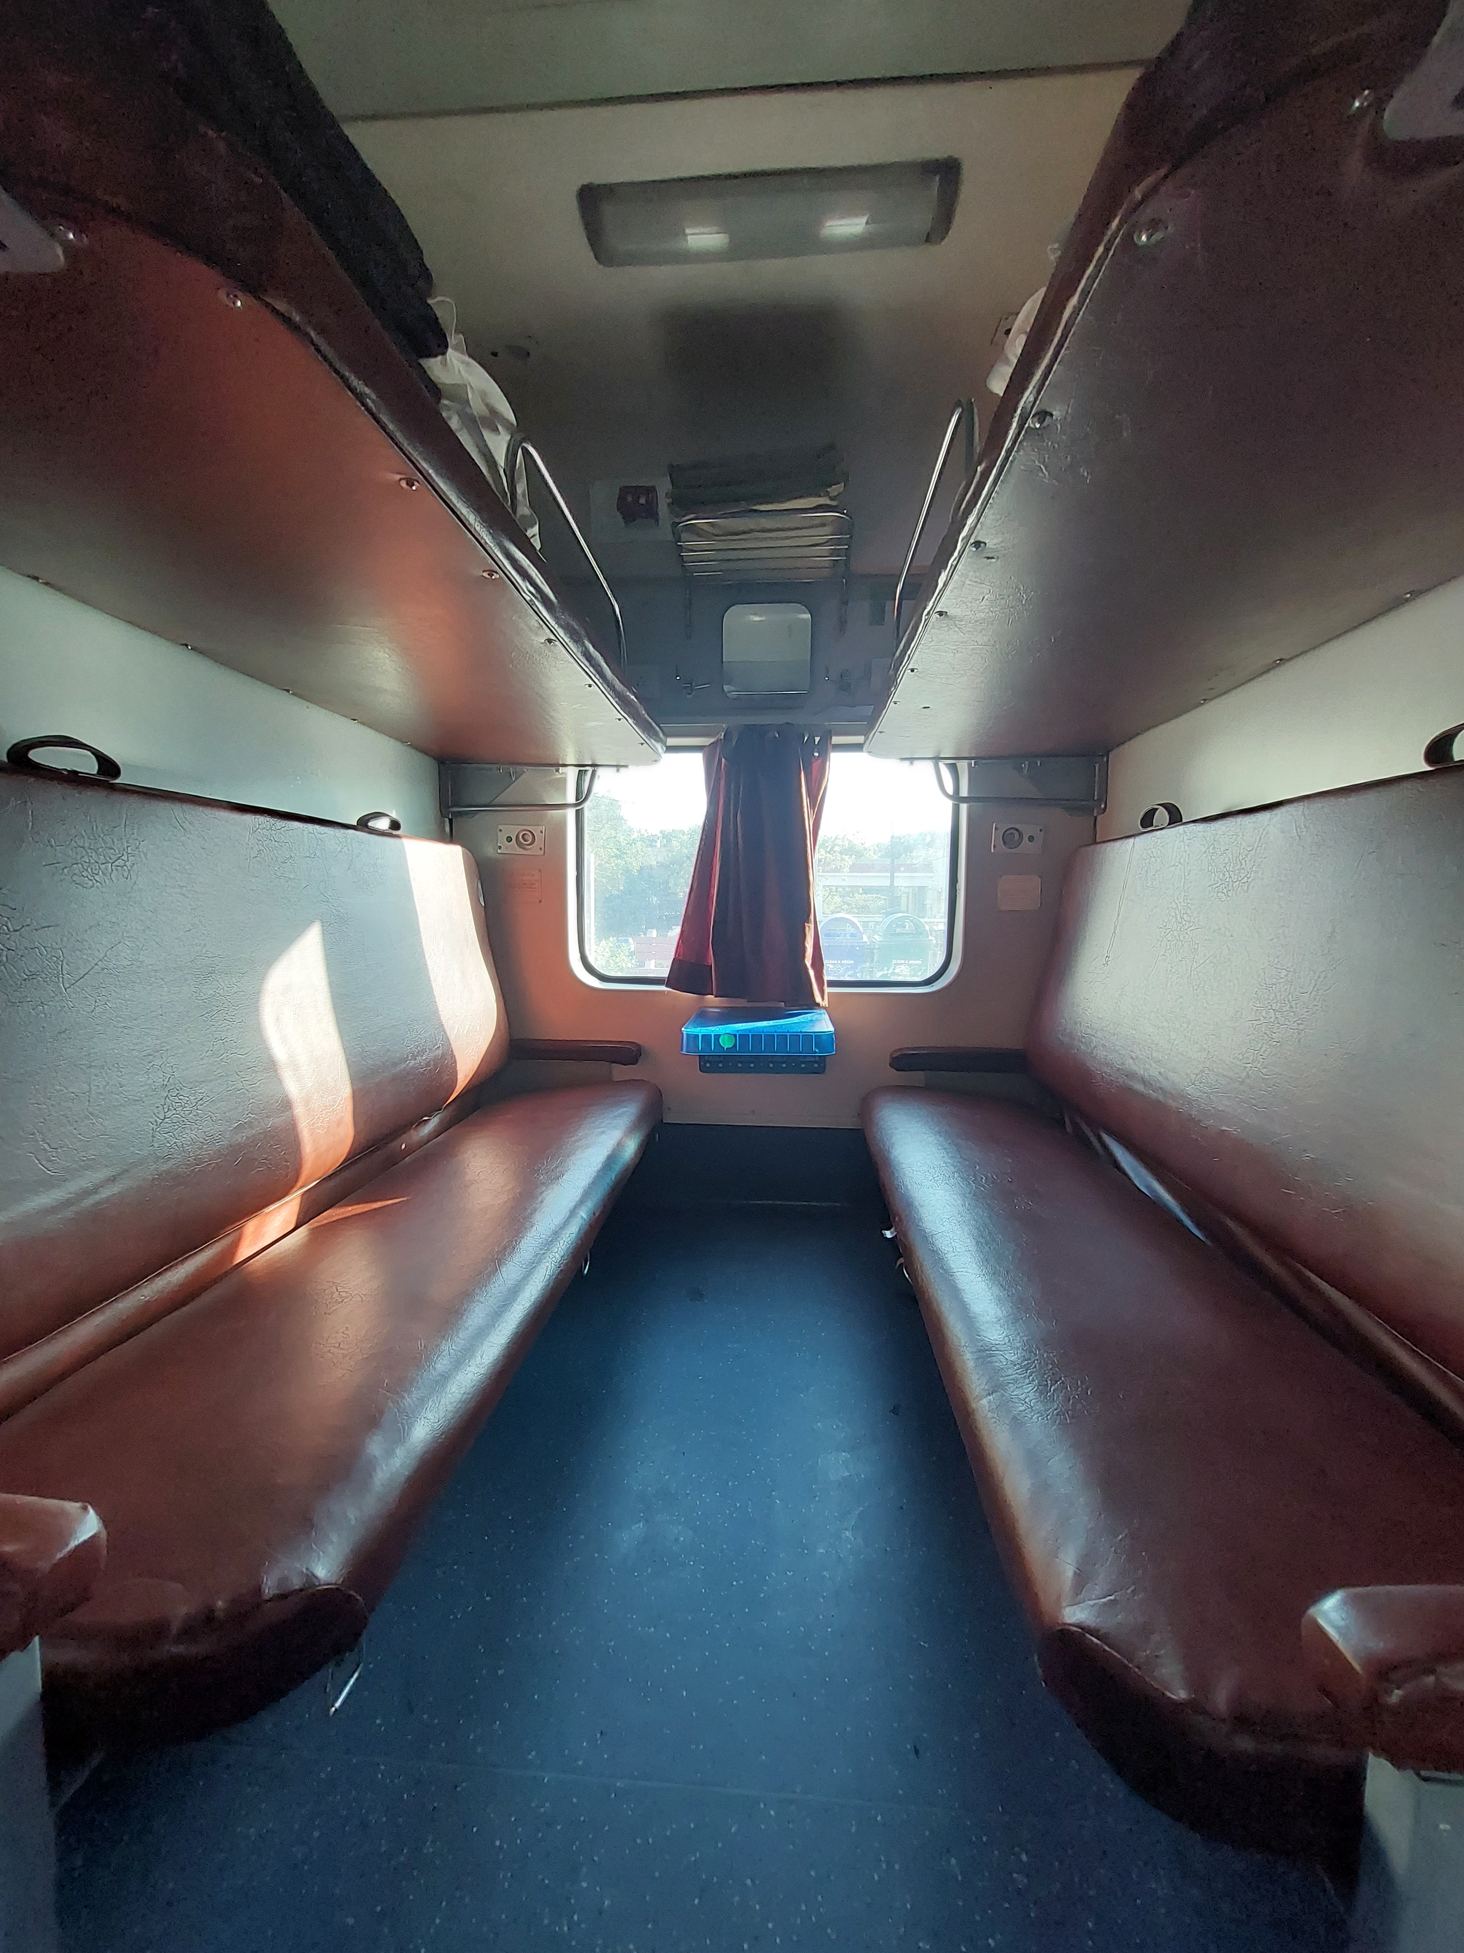
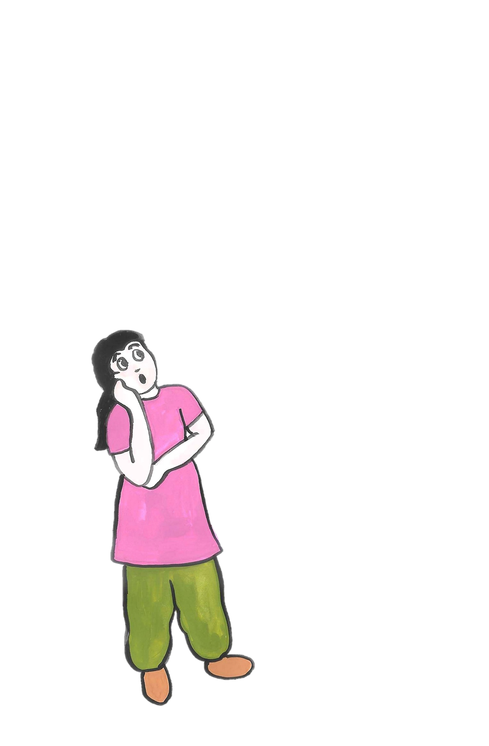
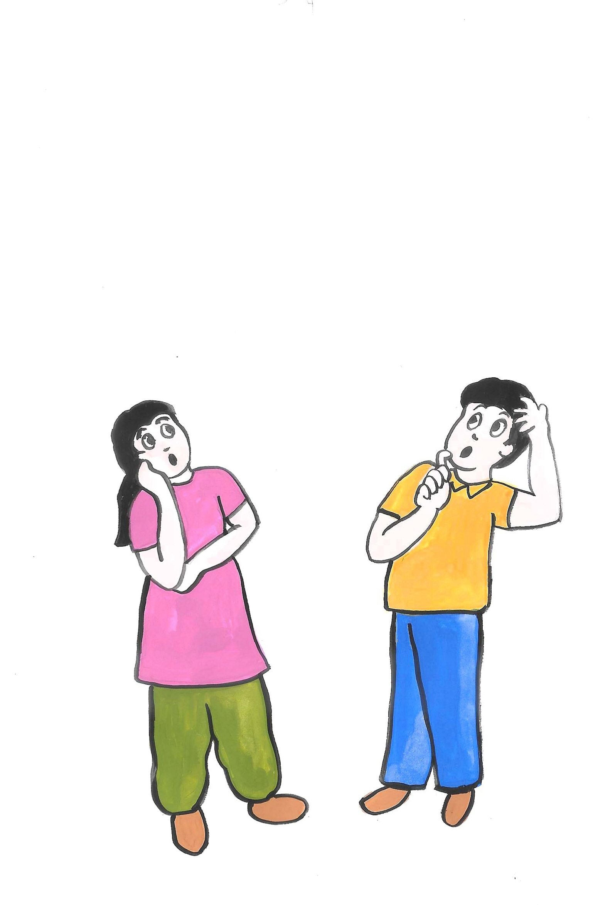
Story: Journey in a Train
How will the middle berth
hang up?
Will it be able to hold our weight?
1
2
4
3
6
5
Notes:
Notes for Teacher – NA
Suggestions: NA
Source of Multimedia used in this slide –
Train : SSSVV Media Bank (Keyword: Railway Coach)
Boy and girl : SSSVV Media Bank (Keyword: Boy, girl)

Slide 5
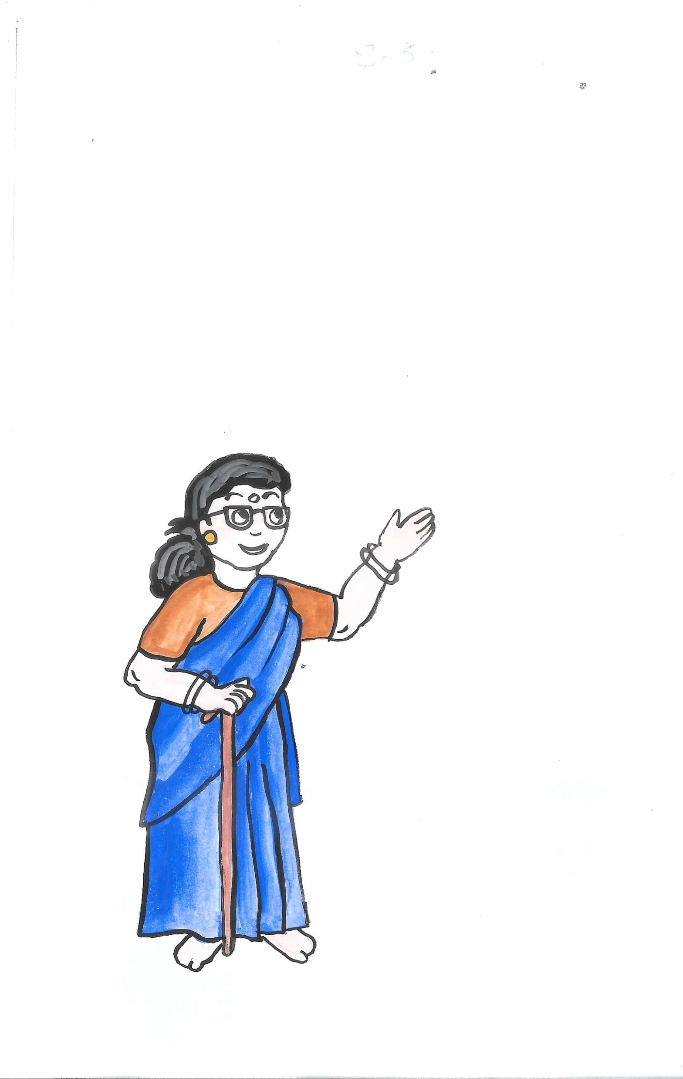
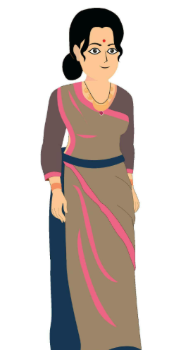
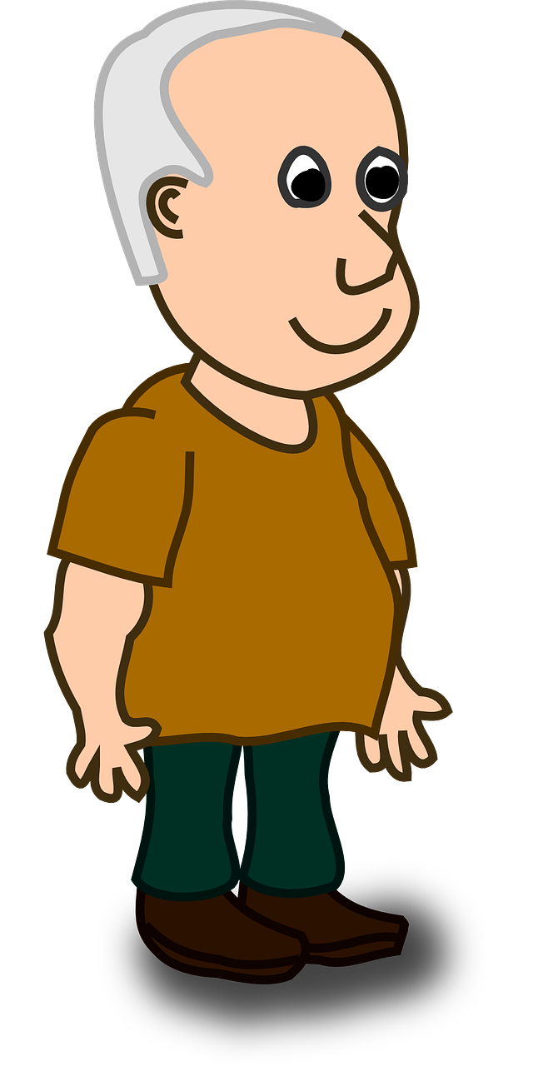
Story: Journey in a Train
Please show your tickets.
Hello, these seats are ours. Can you please vacate the seats?
1
2
5
4
3
6
Notes:
Notes for Teacher – NA
Suggestions: NA
Source of Multimedia used in this slide –
Train : SSSVV Media Bank (Keyword: Railway Coach)
Old Man : https://pixabay.com/vectors/man-cartoon-comic-person-character-37492/ (Clker-Free-Vector-Images)
Woman : https://www.vecteezy.com/vector-art/27569599-beautiful-women-in-sharee-flat-cartoon-vector-illustration
Blue saree Lady : SSSVV Media Bank (Keyword: grand mother)

Slide 6
Story: Journey in a Train
Oh, ok. Thank you. We will go to coach S8.
Your seat numbers are same as ours. Your coach is S8. But this is S9. Please go to S8 coach.
1
2
4
3
6
5
Notes:
Notes for Teacher – NA
Suggestions: NA
Source of Multimedia used in this slide –
Train : SSSVV Media Bank (Keyword: Railway Coach)
Old Man : https://pixabay.com/vectors/man-cartoon-comic-person-character-37492/ (Clker-Free-Vector-Images)
Woman : https://www.vecteezy.com/vector-art/27569599-beautiful-women-in-sharee-flat-cartoon-vector-illustration
Blue saree Lady : SSSVV Media Bank (Keyword: grand mother)

Slide 7
Story: Journey in a Train
Seats are numbered so that it will be easy for the passengers to locate their assigned seats.
Why numbers are written above our seats?
1
2
5
4
3
6
Notes:
Notes for Teacher – NA
Suggestions: NA
Source of Multimedia used in this slide –
Train : SSSVV Media Bank (Keyword: Railway Coach)
Old women : https://pixabay.com/illustrations/old-man-and-woman-6226673/ (Neha_Kumari)
Old Man : https://pixabay.com/vectors/man-cartoon-comic-person-character-37492/ (Clker-Free-Vector-Images)
Blue saree Lady : SSSVV Media Bank (Keyword: grand mother)

Slide 8
Story: Journey in a Train
You look at the seat numbers carefully and list them to find a pattern in how the lower berths, middle berths and upper berths are numbered.
Ok Mother.
1
2
4
3
6
5
Notes:
Notes for Teacher – NA
Suggestions: NA
Source of Multimedia used in this slide –
Train : SSSVV Media Bank (Keyword: Railway Coach)
Old women : https://pixabay.com/illustrations/old-man-and-woman-6226673/ (Neha_Kumari)
Old Man : https://pixabay.com/vectors/man-cartoon-comic-person-character-37492/ (Clker-Free-Vector-Images)
Blue saree Lady : SSSVV Media Bank (Keyword: grand mother)

Slide 9
Train Berth Numbers
There is a very interesting
pattern about the seat numbers.
Berth type Seat Numbers
Lower Berth 1, 4, 9, 12, 17, 20
Middle Berth 2, 5, 10, 13, 18, 21
Upper Berth 3, 6, 11,14, 19, 22
Side Lower Berth 7, 15, 23
Side Upper Berth 8, 16, 24
Notes:
Notes for Teacher – NA
Suggestions: NA
Source of Multimedia used in this slide –
Train : SSSVV Media Bank (Keyword: Railway Coach)
Boy and girl : SSSVV Media Bank (Keyword: Boy, girl)

Slide 10

Reflect and Answer
Look at the list made by Shriya and Sirish
01
Lower berths
1, 4, 7, 9, 12, 15, 17, 20, 23...
02
Middle berths
2, 5, 10, 13, 18, 21…
03
Upper berths
3, 6, 8, 11, 14, 16, 19, 22, 24 ….
What pattern did you notice in the seat numbers of middle berths? What would be the number of the next middle berth?
Answer
1
The middle berths are 2, 5, 10, 13, 18, 21…
Notes:
Notes for Teacher - Show the following questions on a slide and ask students to write the answer in their notebooks. Give them 10 minutes to reflect and write the answers. Discuss with probing questions in the class. Do not reveal the answer before the discussion. Some children may like to do a diagrammatic or pictorial representation by drawing. Please encourage them to do it.
Clues to answers
1) The middle berths are 2, 5, 10, 13, 18, 21, …
What rule can you observe in this list?
2 + 3 = 5
5 + 5 = 10
10 + 3 = 13
13 + 5 = 18
18 + 3 = 21
So, now what should be added to 21 to get the next middle berth? (Expected Answer: 5. Why?)
So, the next middle berth is 21 + 5 = 26.
Suggestions: NA
Source of Multimedia used in this slide –
Hand pointer: PPT icon

Slide 11
Reflect and Answer
Look at the diagram of the coach and identify which particular kind of berths the numbers 8, 16, 24, etc. represent. What is the common property of all the
numbers in this category?
2
60 | 57 | 52 | 49 | 44 | 41 | 36 | 33 | 28 | 25 | 20 | 17 | 12 | 9 | 4 | 1
61 | 58 | 53 | 50 | 45 | 42 | 37 | 34 | 29 | 26 | 21 | 18 | 13 | 10 | 5 | 2
62 | 59 | 54 | 51 | 46 | 43 | 38 | 35 | 30 | 27 | 22 | 19 | 14 | 11 | 6 | 3
63 | 64 | 55 | 56 | 47 | 48 | 39 | 40 | 31 | 32 | 23 | 24 | 15 | 16 | 7 | 8
Lower
Middle
Upper
Side Upper
Side Lower
8, 16, 24 are all side upper berths. All these numbers are multiples of 8.
Answer
Notes:
Notes for Teacher - Show the following questions on a slide and ask students to write the answer in their notebooks. Give them 10 minutes to reflect and write the answers . Discuss with probing questions in the class. Do not reveal the answer before the discussion.
Suggestions: NA
Source of Multimedia used in this slide –
Hand pointer: PPT icon

Slide 12
Reflect and Answer
If you are allotted number 57, which berth will it be? Were you able to identify the berth type by using any short-cut method?
3
Answer
Given any seat number greater than 8, we can find the type of berth using this technique.
Divide the seat number by 8 and find the remainder.
The remainder will give you the berth position.
When 57 is divided by 8, the remainder is 1.
Seat number 1 is a lower berth and hence 57 is a lower berth.
Notes:
Notes for Teacher - After 10 minutes, interactively elicit the answers from students and promote active discussion and participation in the class. Discuss with probing questions in the class. Do not reveal the answer before the discussion.
Suggestions: NA
Source of Multimedia used in this slide –
Hand pointer: PPT icon

Slide 13
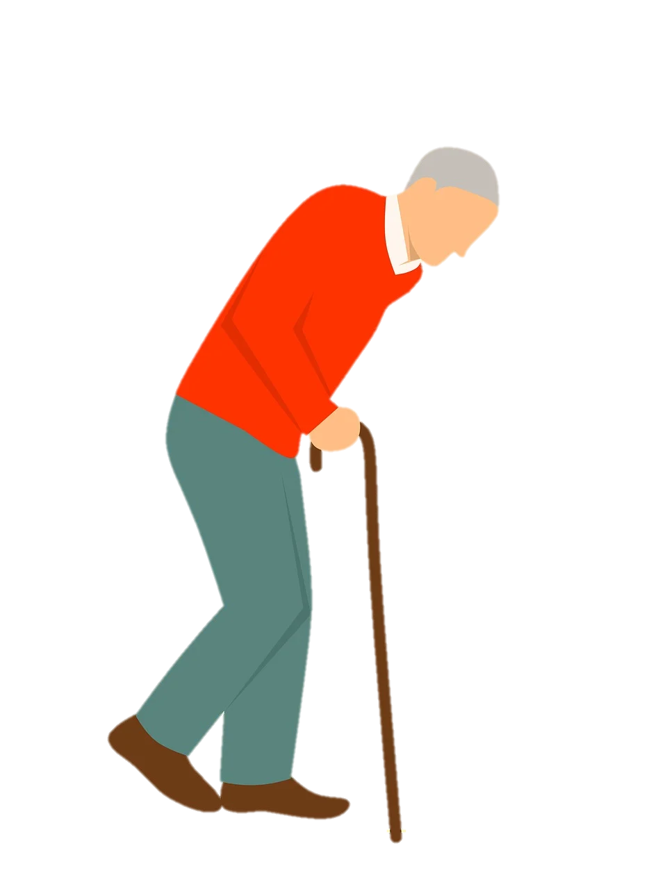
How would you respond?
A middle aged man with some knee problem has been allotted the middle berth.
How will you act when you find him disappointed with the berth allotted to him?
Choose the option that would be your response.
I will wait for the night. If he ask me for an exchange of seat, I will give him my berth.
I am afraid of falling down from the middle berth. It is not very comfortable for me. So I will not exchange my berth even if he ask me.
If I observe that any elder is having a difficulty with their allotted berth, I will offer to exchange my lower berth with him/her.
Notes:
Notes for Teacher - Continue with the train journey example to integrate the human value of empathy towards fellow humans
Suggestions: NA
Source of Multimedia used in this slide –
Old Man : https://pixabay.com/illustrations/old-walk-stick-tired-pain-3019430/ (Mohamed_hassan)

Slide 14
Rule that governs a pattern
Given a number pattern, with 4 or 5 terms, how can you find the next terms in the pattern?
Q1. Guess the next 3 terms of the following number patterns
2, 5, 8, 11, 14…
7, 14, 28, 56, 112…
Answer
2, 5, 8, 11, 14, 17,20, 23
7, 14, 28, 56, 112, 224, 448, 896
Q2. Given a number pattern, with 4 or 5 terms, how can you find the next terms in the pattern?
Answer
A sequence follows a specific rule that helps us to determine the next term
Notes:
Notes for Teacher - Use the TPS(Think Pair Share) technique. Write the following questions on the blackboard and allow students to think in pairs, discuss and write the answers in their notebooks. Give them 5 minutes for this task.
Suggestions: NA
Source of Multimedia used in this slide -
Hand : PPT icon

Slide 15
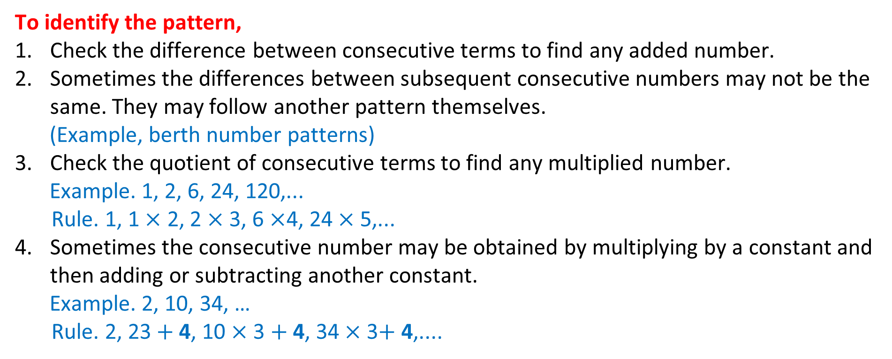
Rule that governs a pattern
Q3. How can you identify the specific rule that governs the pattern?
To identify the pattern,
Check the difference between consecutive terms to find any added number.
Sometimes the differences between subsequent consecutive numbers may not be the same. They may follow another pattern themselves.
(Example, berth number patterns)
Check the quotient of consecutive terms to find any multiplied number.
Example. 1, 2, 6, 24, 120,...
Rule. 1, 1 $×$ 2, 2 $×$ 3, 6 $×$4, 24 $×$ 5,...
Sometimes the consecutive number may be obtained by multiplying by a constant and then adding or subtracting another constant.
Example. 2, 10, 34, …
Rule. 2, 23$+$4, 10 $×$3 $+$ 4, 34$×$ 3$+$ 4,....
Notes:
Notes for Teacher - NA
Suggestions: NA
Source of Multimedia used in this slide - NA

Slide 16
Rule that governs a pattern
Now identify the next 2 terms in the following pattern
1, 2, 6, 24, 120……
Answer
1, 2, 6, 24, 120, 720, 5040
Notes:
Notes for Teacher - NA
Suggestions: NA
Source of Multimedia used in this slide -
Hand : PPT icon

Slide 17
Case Study
In the city of New Delhi, the air quality worsens in the months of October and November.
To reduce the air pollution, the government introduced the following plan
to reduce the number of vehicles on the road:
On all odd-numbered dates like ”1, 3, 5, …” only the vehicles with odd
registration numbers like 4053, 7121, .. would be allowed on the roads.
On all even-numbered dates like “2, 4, 6, …” only the vehicles with even
registration numbers like 5244, 6890, … would be allowed on the roads
But in spite of this, the air quality did not improve much. So, the authorities began to look for other measures to further reduce the number of vehicles on the roads.
Now, we want you to come up with your ideas in the form of number patterns.
Take a small sample of vehicle numbers, say, from 1201 to 1220. The same can
then be implemented for all numbers.
Notes:
Notes for Teacher - NA
Suggestions: NA
Source of Multimedia used in this slide - NA

Slide 18
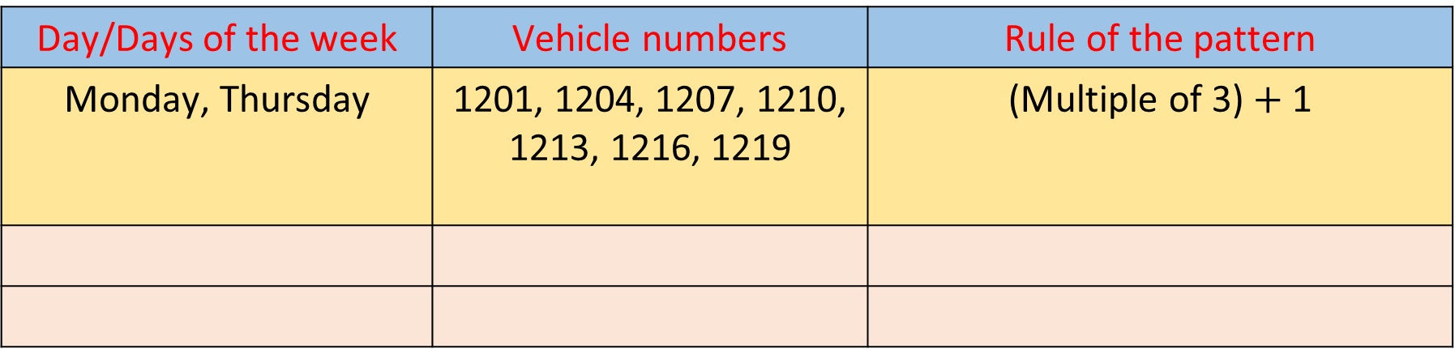
Number Patterns
Take a small sample of vehicle numbers, say, from 1201 to 1220. The same can then be implemented for all numbers.
Develop patterns so that all vehicles may get a chance to be on the roads for at least one day of the week
A sample is shown below. Fill it up to get an idea. Then, you may have a single day in the first column and different rules in the last column.
Day/Days of the week | Vehicle numbers | Rule of the pattern
Monday, Thursday | 1201, 1204, 1207, 1210, 1213, 1216, 1219 | (Multiple of 3) $+$ 1
Notes:
Notes for Teacher - NA
Suggestions: NA
Source of Multimedia used in this slide - NA

Slide 19

Number Patterns: Answer the following
On how many days in a week will a car with number 1205 be allowed on the roads?
1
1205
2
Do taxis and autos also have to follow the same rule? What do you think?
Suppose someone needs to be taken to the hospital and his vehicle number is not allowed that day. What is to be done? (EA: If taxis are allowed, take a taxi. Otherwise, make exemptions for medical emergencies.)
3
Notes:
Notes for Teacher – Divide the students into groups of 5 or 6.
Give 15 minutes for the students to come up with their ideas. After that, ask each group to come and present their solutions in front of the whole class. After each group presents, ask them the following questions.
Suggestions: NA
Source of Multimedia used in this slide - NA
Car : https://pixabay.com/illustrations/car-vintage-black-volkswagen-163666/ (No-longer-here)

Slide 20
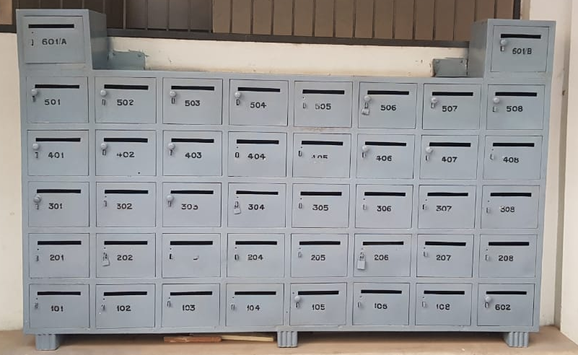
Uses of Number Patterns in day to day life
Have you seen such boxes any where?
What are these used for?
What do the numbers on the box indicate?
Is there any pattern?
Notes:
Notes for Teacher - NA
Suggestions: NA
Source of Multimedia used in this slide -
Letter box : SSSVV Media Bank Key word : letterbox,mailbox

Slide 21

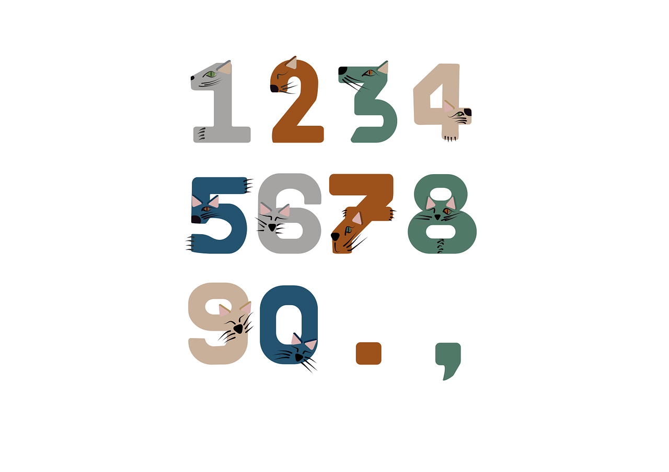

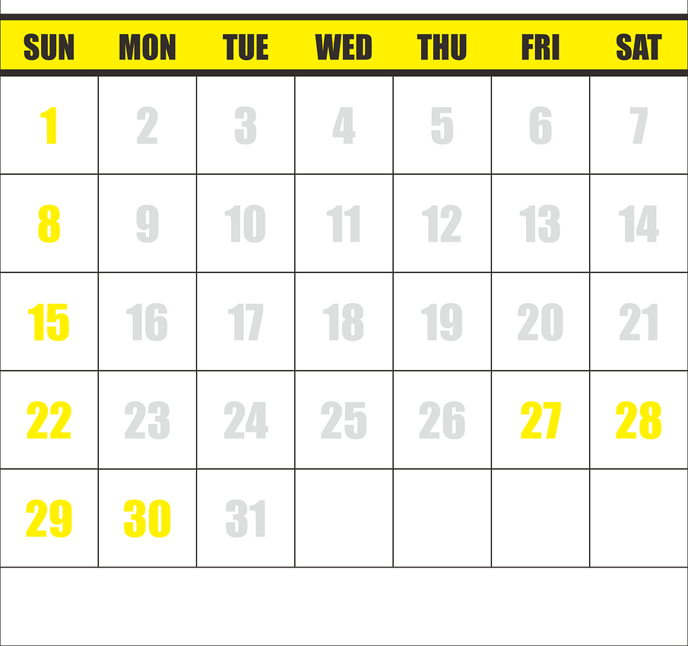
Uses of Number Patterns in day to day life
Click here to complete the flower
House Numbers
Car Registration Numbers
Odd-Even Rule
Patterns in Real Life
??
Mobile Numbers
Calendar
??
Leap years
??
Pincode
??
Helpline numbers
Notes:
Notes for Teacher – NA
Suggestions: NA
Source of Multimedia used in this slide -
Car : https://pixabay.com/vectors/car-automobile-headlamp-headlight-307152/ (ClkerFreeVector Image)
House : https://pixabay.com/vectors/house-property-building-home-6529416/ (DreamDigitalArtist)
Calender : https://pixabay.com/vectors/calendar-the-refinery-date-diary-1975256/ (OHMAOH)
Numbers : https://pixabay.com/vectors/cat-number-ten-number-system-colors-7675885/ (Jackielin1)
Hand : PPT icon

Slide 22
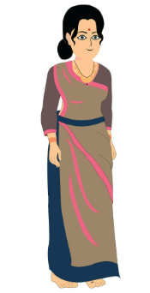
Attribution / Citation
Slide # | Thumbnail | Source link | Author
3 to 8 |  | Train : https://pixabay.com/photos/india-train-transportation-railway-771288/ | antriksh
3 |  | Train 2 : https://pixabay.com/vectors/engine-electric-train-railway-7289466/ Train 3 : https://pixabay.com/vectors/boxcar-car-goods-train-railway-4562890/ | sanctumdigital RealMotion
5, 6 |  | Old Man : https://pixabay.com/vectors/man-cartoon-comic-person-character-37492/ Woman : https://www.vecteezy.com/vector-art/27569599-beautiful-women-in-sharee-flat-cartoon-vector-illustration | Neha_Kumari Clker-Free-Vector-Images
13 |  | Old Man : https://pixabay.com/illustrations/old-walk-stick-tired-pain-3019430/ | Mohamed_hassan
19 |  | Car : https://pixabay.com/illustrations/car-vintage-black-volkswagen-163666/ | No-longer-here
21 |  | Car : https://pixabay.com/vectors/car-automobile-headlamp-headlight-307152/ House : https://pixabay.com/vectors/house-property-building-home-6529416/ Calender : https://pixabay.com/vectors/calendar-the-refinery-date-diary-1975256/ Numbers : https://pixabay.com/vectors/cat-number-ten-number-system-colors-7675885/ | ClkerFreeVector Image DreamDigitalArtist OHMAOH Jackielin1
Notes:
Notes for Teacher – NA
Suggestions: NA
Source of Multimedia used in this slide - NA

