Slide 1
Cooling Effect Of Evaporation
Notes:
NA

Slide 2
CG :1 Explores the world of matter and its constituents, properties and behaviour
C-1.4 Observes and explains the phenomena caused due to differences in temperature
1. The students will be able to record the change of temperature due to Evaporation
2. The students will be able to analyse the readings of the observation.
3. The students will be able to explain the phenomenon of cooling during evaporation

Slide 3
KWL Chart (Evaporation)
Name of Student: Topic: About evaporation. Date:
What I Know |  | What I Want To Know/Learn |  | What I Learned
Notes:
Notes for Teacher – NA
Suggestions: NA
Source of Multimedia used in this slide - NA

Slide 4
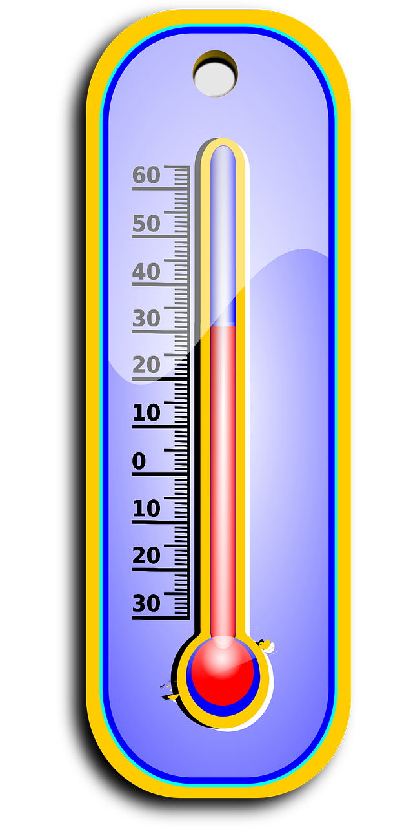
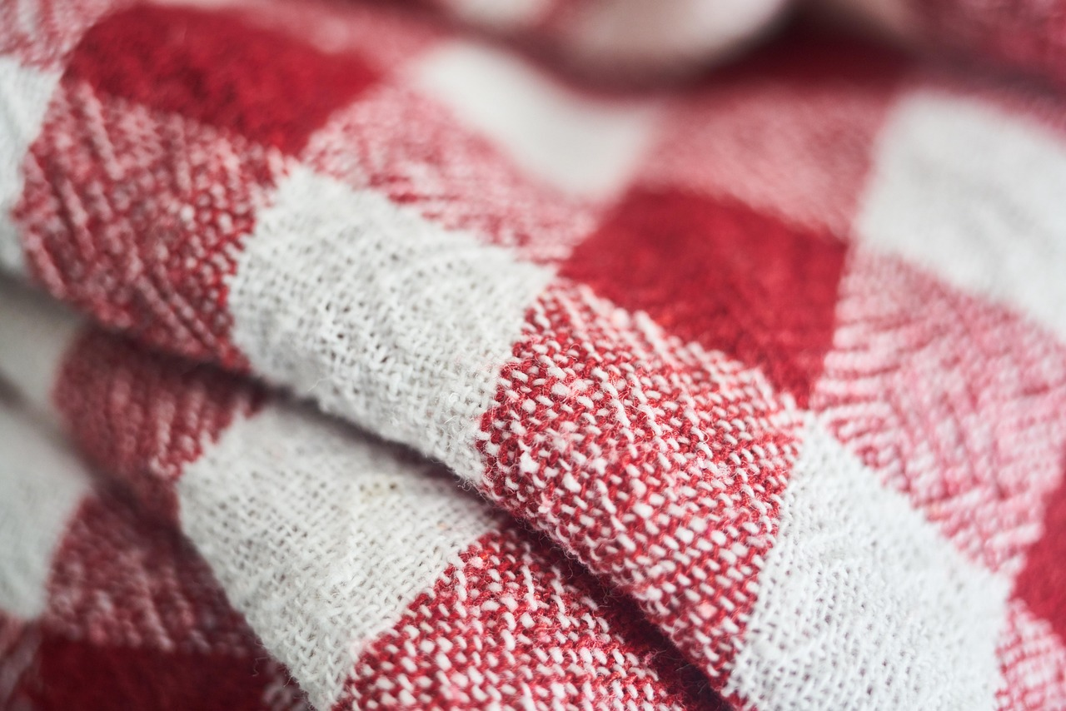
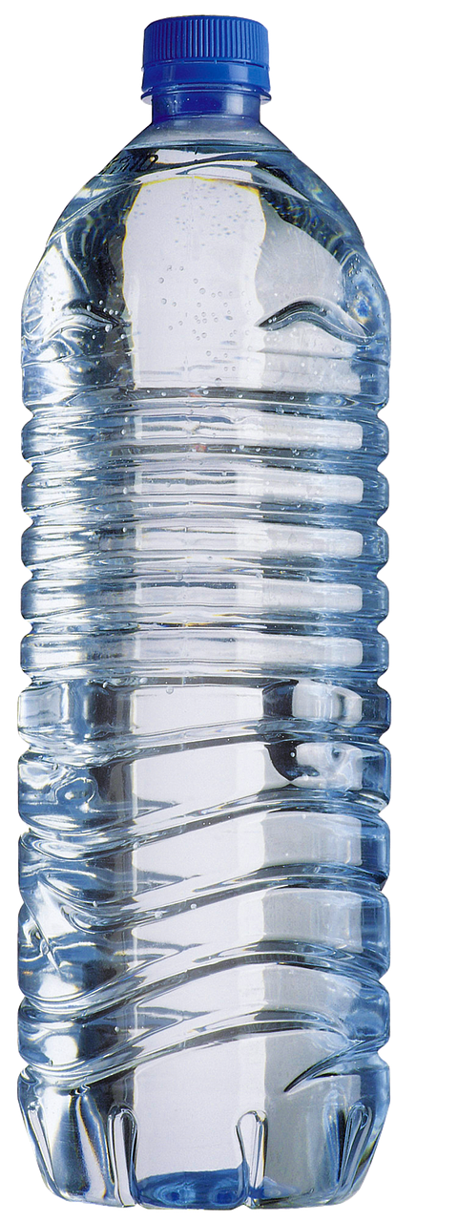
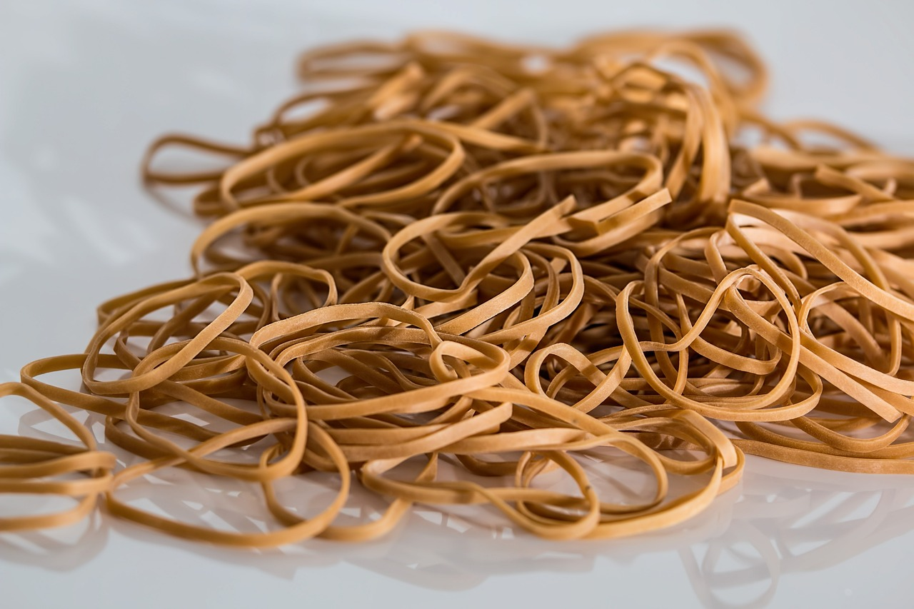
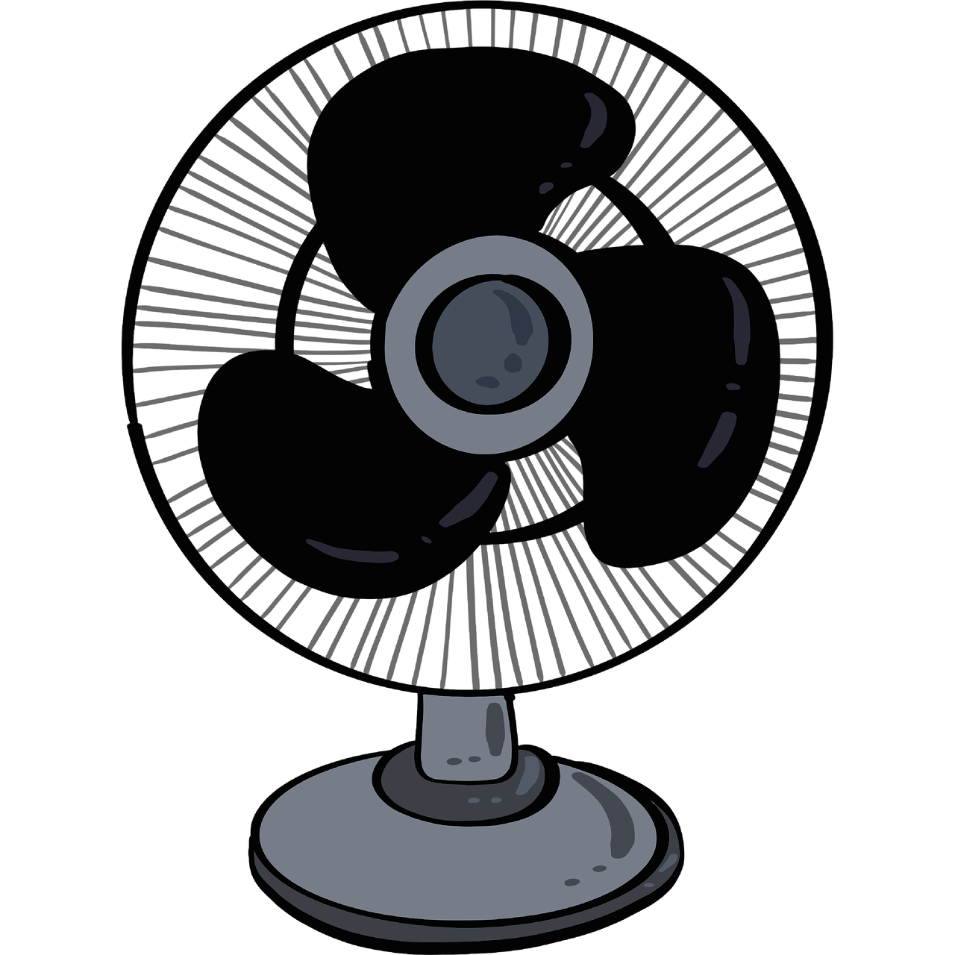
Cooling Effect Of Evaporation
Aim
Simple experiment to demonstrate that evaporation causes
cooling using a laboratory thermometer and a wet cloth.
A laboratory thermometer
A small piece of cloth or cotton
Materials
Needed
Water
String or rubber band
Fan or open-air environment
Notes:
Notes for Teacher – NA
Suggestions: < NA
Source of Multimedia used in this slide - <Please provide source URL where we find the image and the license agreement>
Thermometer : https://pixabay.com/vectors/thermometer-degree-hot-summer-159652/ (OpenClipart-Vectors)
Cloth : https://pixabay.com/photos/cloth-plaid-red-pattern-towel-2729146/ ( Engin_Akyurt)
Water : https://pixabay.com/illustrations/water-cup-water-bottle-transparent-4998513/ (AlLes)
Rubber bands : https://pixabay.com/photos/rubber-bands-elastic-bands-503028/ (stevepb)
Fan : https://pixabay.com/illustrations/fan-summer-ventilation-breeze-ac-5389133/ (Katillustrationlondon)

Slide 5
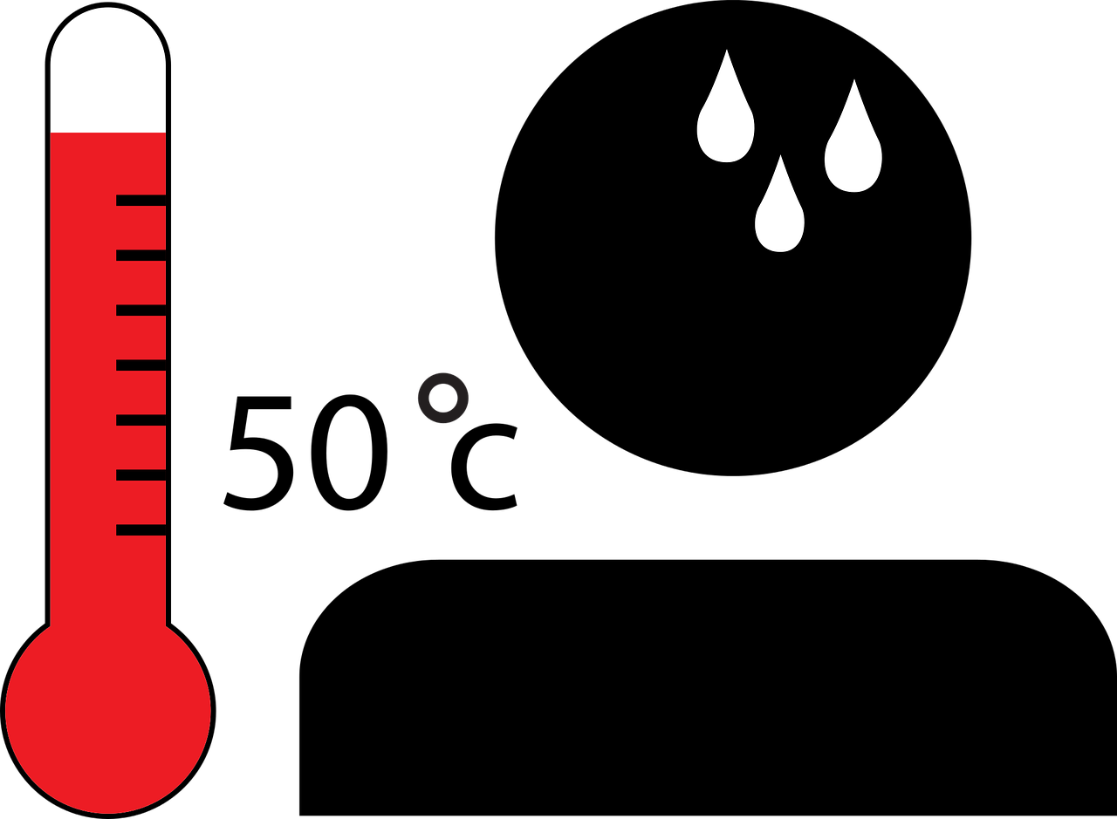

Cooling Effect Of Evaporation
Measure the Initial Temperature:
Wrap the Bulb with Wet Cloth
Procedure
Record the temperature
To enhance Evaporation
Note the temperature again
Notes:
Notes for Teacher - NA
Suggestions: < NA
Source of Multimedia used in this slide - <Please provide source URL where we find the image and the license agreement>
Boy : https://pixabay.com/vectors/boy-business-cartoon-comic-1300226/ (OpenClipart-Vectors)

Slide 6
Analysing the Experience
Reflection Questions
1
What temperature does the thermometer record in the beginning?
Compare the initial and final readings of thermometer.
Give reasons for the differences in the readings.
2
3
What did you notice when the thermometer was brought under the fan?
Notes:
Notes for Teacher - < NA
Suggestions: < NA
Source of Multimedia used in this slide - NA

Slide 7
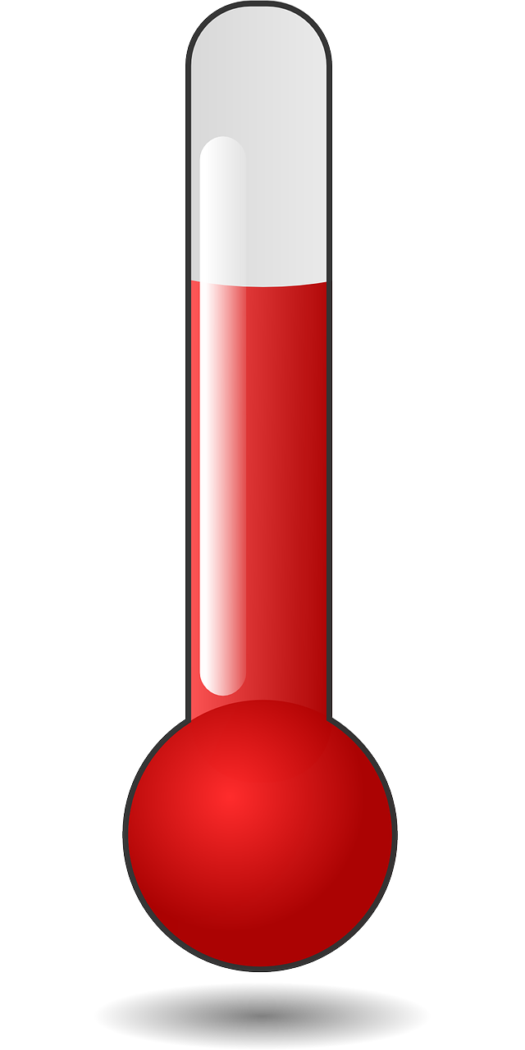
Cooling Effect Of Evaporation: Experiment
Dry Bulb Temperature
Wet Bulb Temperature
Wet
Air flow
Notes:
Notes for Teacher - NA
Suggestions: NA
Source of Multimedia used in this slide - <Please provide source URL where we find the image and the license agreement>
Thermometer : https://pixabay.com/vectors/hot-temperature-thermometer-weather-159386/ (OpenClipart-Vectors)
Thermometer 2 : https://pixabay.com/vectors/icon-human-rights-2071969/ (craigclark)

Slide 8
Effect of Heat Energy On State Of Matter
ADD ENERGY
Solid
Liquid
Gas
REMOVE ENERGY
Notes:
Notes for Teacher - The suggested images can be drawn on the Blackboard. The teacher can get students to participate to fill in the labeling and then extend the learning to exchange of heat energy during change of state.
Suggestions: NA
Source of Multimedia used in this slide - <Please provide source URL where we find the image and the license agreement>
PPT shapes

Slide 9
Try this out…
Wet one hand with the water from their water bottles and stretch both hands towards the fan (in summer) or swing their hands in the air.
Observe the difference in temperature in both hands
Explain with reason, the cooling effect.
Mention two other ways through which you can dry your hands. Which way will be faster and Why?
Notes:
Notes for Teacher - NA
Suggestions: NA
Source of Multimedia used in this slide - NA

Slide 10

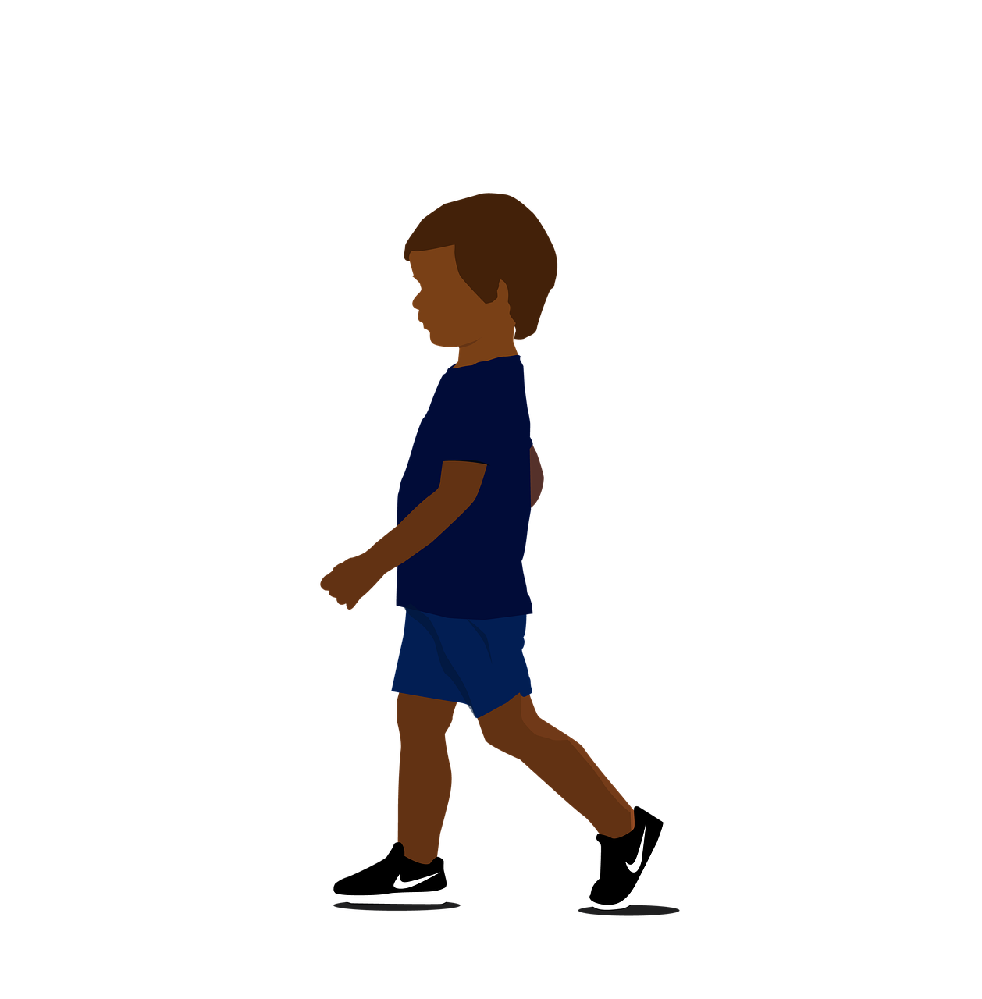
Think further..
In hot weather, we feel hot as heat energy is entering our body. Can the same explanation apply here when our wet hand is feeling cold? Explain.
Notes:
Notes for Teacher - < Discuss these Question in the class
Suggestions: <Ideas/ Images/ Animations / Others – To make better representation of the content >
Source of Multimedia used in this slide - <Please provide source URL where we find the image and the license agreement>
Hot : https://pixabay.com/vectors/landscape-summer-tree-nature-297237/ (Clker-Free –Vector-Images)
Boy : https://pixabay.com/illustrations/child-boy-cartoon-walking-cute-7482359/ (PNGFREE)

Slide 11
Attribution / Citation
Slide # | Thumbnail | Source link | Author
4 & 6 |  | Thermometer : https://pixabay.com/vectors/thermometer-degree-hot-summer-159652/ Cloth : https://pixabay.com/photos/cloth-plaid-red-pattern-towel-2729146/ Water : https://pixabay.com/illustrations/water-cup-water-bottle-transparent-4998513/ Rubber bands : https://pixabay.com/photos/rubber-bands-elastic-bands-503028/ Fan : https://pixabay.com/illustrations/fan-summer-ventilation-breeze-ac-5389133/ | OpenClipart-Vectors Engin_Akyurt AlLes Stevepb Katillustrationlondo
5 |  | Boy : https://pixabay.com/vectors/boy-business-cartoon-comic-1300226/ | OpenClipart-Vectors
5 & 6 |  | Thermometer : https://pixabay.com/vectors/hot-temperature-thermometer-weather-159386/ Thermometer 2 : https://pixabay.com/vectors/icon-human-rights-2071969/ | OpenClipart-Vectors craigclark
10 |  | Hot : https://pixabay.com/vectors/landscape-summer-tree-nature-297237/ Boy : https://pixabay.com/illustrations/child-boy-cartoon-walking-cute-7482359/ | Clker-Free –Vector-Images PNGFREE

