Slide 1
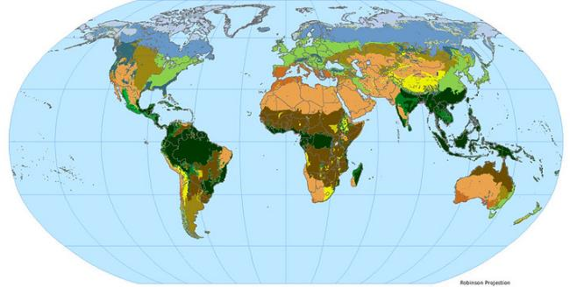
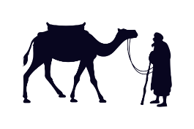
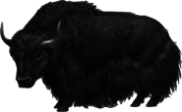
Hot and Cold Deserts
Notes:
Notes for Teacher –The teacher can begin the session with the following statement: “Let us now explore what a desert is, and how many kinds of deserts there are.”

Slide 2
CG: 1 Comprehends and interprets sources related to different aspects of human life and makes meaningful interpretations
C-1.2 Represents and analyses data related to various aspects of human life given in the form of text, table, charts, diagrams and maps.
Students will be able to
apply their knowledge to identify the landform.
analyse the features of hot and cold deserts.

Slide 3
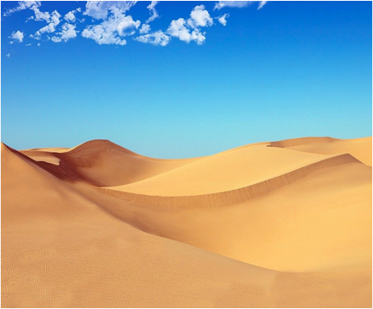
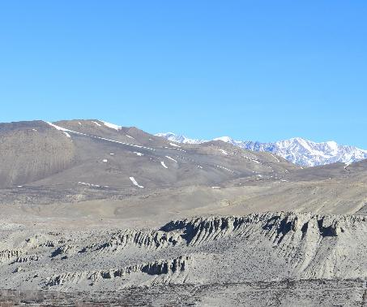
Think and Answer
1. Identify the landforms shown in the pictures.
Notes:
Notes for Teacher – Ask the 3 inquisitive questions. This is to set the context of the topic

Slide 4
Think and Answer
2. Mention a few features of a desert.
Less flora and fauna
Little vegetation
Scanty rainfall
Sparse population
Notes:
Notes for Teacher - Ask the 3 inquisitive questions. This is to set the context of the topic

Slide 5

Think and Answer
3. Do you think this can be a desert based on the characteristics of a desert? Why or why not?
Notes:
Notes for Teacher - Ask the 3 inquisitive questions. This is to set the context of the topic

Slide 6
Hot and Cold Deserts
Feature | Hot Desert (Thar Desert) | Cold Desert (Ladakh)
Location | Chiefly in Rajasthan, extending into Gujarat and Haryana. | Located in the Great Himalayas, on the eastern side of Jammu & Kashmir.
Climate | Extreme heat; high evaporation; very low rainfall. | Extreme cold and dryness; thin air; receives heavy snowfall.
Temperature | Can exceed 50°C in summer; it drops significantly at night. | Summer days are just above 0°C; winter nights can drop below -40°C.
Vegetation | Scanty - Cacti, thorny bushes. | Scanty - grass, willows, and poplars in valleys.
Wildlife | Camels, Great Indian bustard, blackbucks, and lizards. | Yak, wild sheep, goats, Tibetan antelope (Chiru), and snow leopards.
Clothing | Light, loose cotton clothes to stay cool; turbans to protect the head from the sun and sand. | Heavy woollens, robes made of sheepskin or yak wool, and fur hats to combat freezing winds.
Landscape | Vast rolling sand dunes, occasional salt marshes (Rann). | Rocky terrain, deep valleys and lakes
Occupations | Animal rearing (sheep, goats), handicraft work, and tourism (camel safaris). | Tourism (trekking/monasteries), seasonal farming (barley/peas), animal rearing (sheep, yaks)
Notes:
Notes for Teacher – N/A

Slide 7

Attribution / Citation
Slide | Thumbnail | Source link | Attribution
1 |  | Deserts Map: https://www.flickr.com/photos/54545503@N04/5485516989 Old Man and Camel: https://pixabay.com/illustrations/old-man-camel-desert-travel-3469819/ Yak: https://pixabay.com/vectors/animal-hairy-horned-horns-1293769/ | SEDACMaps kreatikar OpenClipart-Vectors
3 |  | Hot desert: https://pixabay.com/photos/desert-dune-sand-dry-hot-sahara-4306805/ | nicolagiordano
3, 5 |  | Cold Desert: https://pixabay.com/photos/mountains-dry-rock-bare-lifeless-95865/ | Sanam Maharjan

