Slide 1
Follow the Rule

Slide 2
CG-3 Develops the ability to describe simple and compound sentence structures to express understanding and experiences.
C-3.1 Uses appropriate structure and grammar in their writing.
Students will be able to:
to categorise the adjectives for positioning them in the right place in the right order in a sentence

Slide 3
Follow the rule
When we have more than one adjective in a sentence, we must place them in the right order according to the category to which they belong.
Order
1
Number or Determiner adjectives
2
Opinion adjectives
3
Fact adjectives
Notes:
Note to the teacher: Begin the class with a recap exercise on adjectives. Ask the students to read out these sentences and then answer the questions that follow.
1. She carried two, lovely, small leather handbags.
In the above sentence, can you identify the adjectives?
two → Determiner/Quantity
lovely → Opinion
small → Size
leather → Material
2. If I say, “a red big ball” and “a big red ball,” which one sounds more natural to you? Why do you think so?
Expected answer: “A big red ball,” sounds more natural. That’s because in English, adjectives usually follow a fixed sequence. Size (big) comes before colour (red). So our ears expect ‘big’ first, then ‘red’.
From the sentences we just read, you noticed that adjectives don’t appear randomly before a noun. For example, in the sentence mentioning two lovely small leather handbags, each adjective has its place: lovely (opinion) comes first, then small (size), and finally leather (material). Similarly, in a big red ball, big (size) comes before red (colour).
This shows us that English follows a natural order of adjectives. To make our sentences sound smooth and correct, we need to follow this sequence:
Opinion → Size → Age → Shape → Colour → Origin → Material → Purpose → Noun
Now, let’s look at the teaching aid MS_TA_Follow the Rule.pptx, that is provided as an attachment. It has the details for the order of adjectives with examples. Taking the cue from our recap, we’ll explore how to apply this rule whenever we use two or more adjectives together.

Slide 4
Determiners/ Numbers
Articles
Possessives
a, an, the
my, your, their
Demonstratives
this, that
Quantifiers
Numbers
many, few, some, any
one, two, five
Notes:
Notes for Teacher – NA

Slide 5
Opinion adjectives
Beautiful
Terrible
Wonderful
Delicious
Ugly
Tasty
Horrible
Cold
Hot
Lovely
Chilling
Steaming
Notes:
Notes for Teacher NA

Slide 6
Fact adjectives
big, small, minute, colossal, large, tiny
Size
Age
old, new, recent, ancient
square, round, flat, triangular
Colour
Shape
pink, blue, green, white
Indian, Chinese, Japanese, American, German
wooden, rubber, silken, golden
Origin
Material
Purpose
fishing, mining, musical, farming
Notes:
Notes for Teacher – NA

Slide 7
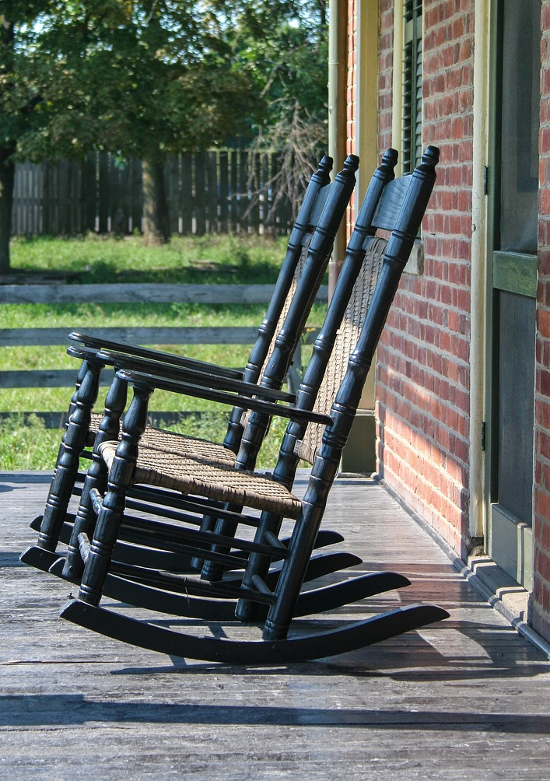
Example -1
I love that comfortable, old, wooden rocking chair.
that
determiner
comfortable
opinion
?
old
age
wooden
material
rocking
purpose
chair
noun
Notes:
Notes for Teacher – NA

Slide 8
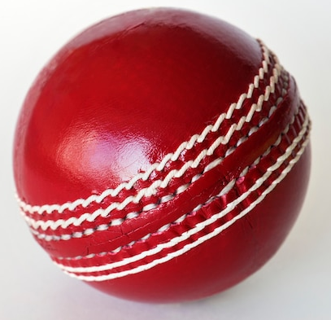
Example 2
A small new red Indian rubber, bouncing ball
A
?
Determiner
Small
Size
Red
Colour
Indian
Origin
Rubber
Material
Bouncing
Purpose
Ball
Noun
Notes:
Notes for Teacher – NA

Slide 9
Order of Adjectives
The rule for the Order of adjectives can be easily remembered with the help of an acronym:- NOSASCOMP, where
N
Number/ Determiner
C
Colour
O
Opinion
O
Origin
S
Size
M
Material
A
Age
P
Purpose
S
Shape
Notes:
Notes for Teacher – NA

Slide 10
This table will help classify the adjectives.
Classification of adjectives
Determiner | Opinion | Size | Age | Shape | Colour | Origin | Material | Purpose
a | delicious | huge | old | oval | white | French | golden | race
that | lovely | tiny | modern | triangular | orange | Indian | metallic | musical
Points to remember:-
Identify the adjectives to which category they belong.
Place them in order with the help of the acronym NOSASCOMP.
Notes:
Notes for Teacher – NA

Slide 11
Attribution / Citation
Slide # | Thumbnail | Source link | Author
6 |  | https://pixabay.com/photos/rocking-chair-wooden-rocking-chairs-2683875/ | Chapay
7 |  | https://www.magnific.com/free-photo/cricket-ball-isolated_2807389.htm | rawpixel.com
Notes:
Notes for Teacher - NA

