Slide 1

કલ્યાણકારી પહેલોમાં લોકોની ભાગીદારી
Notes:
Notes for Teacher - < Information for further reference or explanation >
Suggestions: <Ideas/ Images/ Animations / Others – To make better representation of the content >
Source of Multimedia Objects (Image/audio/ Video/Animation) used in this slide -
Hands- https://pixabay.com/illustrations/hand-shake-connect-reach-out-unite-4027365/

Slide 2
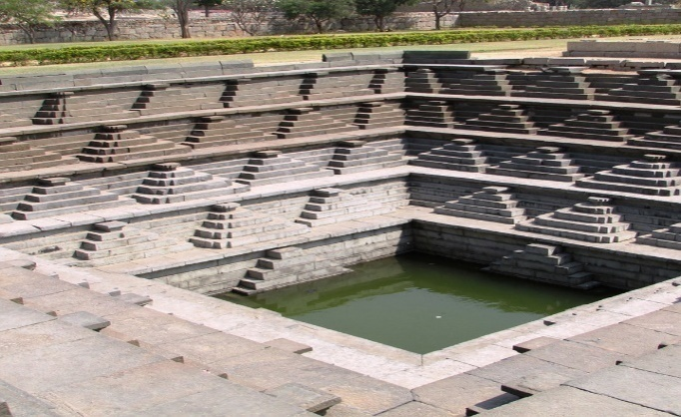
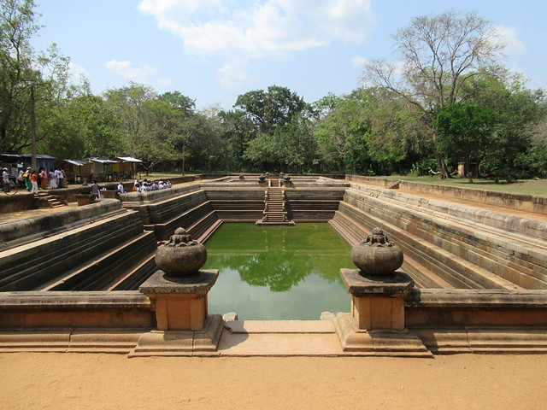
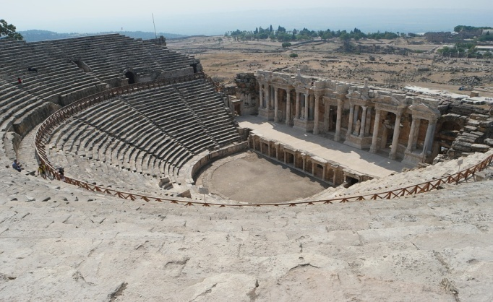
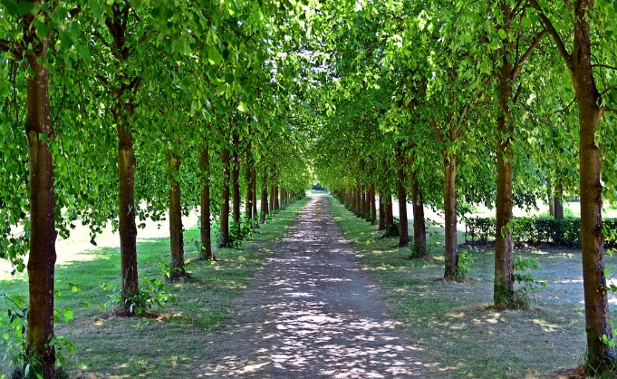
શાસકની સાચી ચિંતા
ભૂતકાળના શાસકોએ તેમના નાગરિકોના કલ્યાણ માટે કામ કર્યું અને લોકો સાથે મૈત્રીપૂર્ણ સંબંધો અપનાવ્યા.
નાગરિકોએ પણ આ યોજનાઓમાં સક્રિય ભાગ લીધો હતો.
સ્નાન કૂંડો બાંધ્યા
કૂવાઓ બાંધ્યા
જાહેર અખાડા બાંધ્યા
વૃક્ષો રોપ્યાં
Notes:
Image source-
Ancient well- https://pixabay.com/photos/step-well-unesco-heritage-site-hampi-286572/
Stadium- https://pixabay.com/photos/in-ancient-times-the-ancient-stadium-1063321/
Ponds- https://www.flickr.com/photos/davidstanleytravel/43143309230 (Author : David Stanley)
Planted trees- https://www.maxpixel.net/Trail-Tree-Lined-Avenue-Spring-Trees-Away-Avenue-3433474

Slide 3
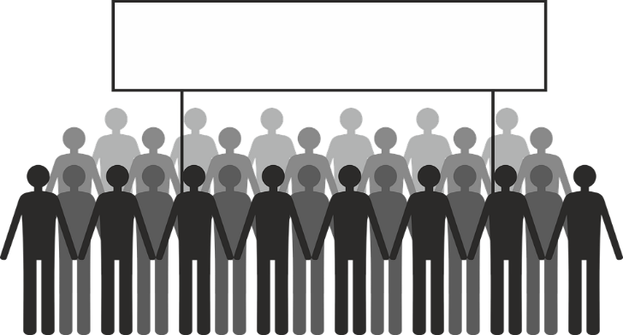
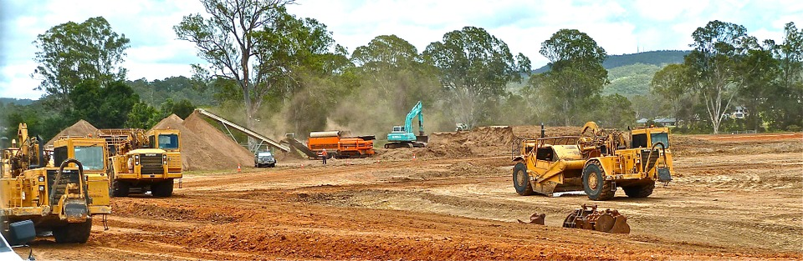
વર્તમાન પરિસ્થિતિ
તમે આપણા દેશમાં થયેલા તાજેતરના કોઈ નાગરિક આંદોલનનું નામ આપી શકો છો જેના કારણે લોકોની આકાંક્ષાઓ પર નેતાઓ ધ્યાન કેન્દ્રિત કરી શક્યા?
વૃક્ષો બચાવો
પુલ બનાવવા માટે કપાતાં વૃક્ષો બચાવા માટે નાગરિકો કૂચ કરી રહ્યા છે.
સંવેદનશીલ વન્યજીવન વન વિસ્તારોમાં રસ્તાઓનું બાંધકામ અટકાવવું
Notes:
Image source-
Protest - https://pixabay.com/vectors/demonstration-show-me-demonstrate-2137450/
Road in forest area - https://pixabay.com/photos/bulldozer-crawler-earth-moving-410119/

Slide 4
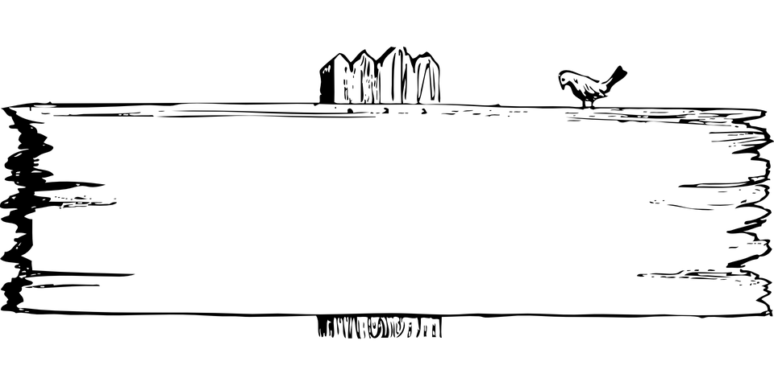





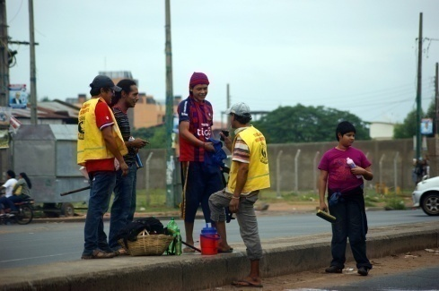
આ વિશે સાંભળ્યું
ચિપકો આંદોલન
અગ્લી ઈન્ડિયન
Notes:
Notes to the teacher-
Tree huggers – Chipko movement where people hug trees and prevent them from being cut
Ugly Indians- a group of people who beautify flyovers and public spaces in Bengaluru
Image source-
Banner- https://pixabay.com/vectors/signposts-directions-directional-40322/
Children- https://pixabay.com/vectors/three-children-kids-male-female-2747268/
Tree- https://pixabay.com/vectors/tree-forest-trunk-nature-leaves-576847/
Cleaning road- https://pixabay.com/photos/children-young-people-clean-road-184729/

Slide 5

આપણે શું કરી શકીએ છીએ?
જો તમારા વિસ્તારમાં કોઈ તક હોય, તો શું તમે…
આવા નાગરિકના આંદોલનોમાં જોડાવો?
રાષ્ટ્ર નિર્માણમાં મદદ કરો?
તમે કઈ પહેલ સૂચવો છો?
Notes:
Notes to the teacher
The children can give their ideas.
Teacher to initiate discussion. She can give lead ideas
Collect old newspapers from housing societies, sell them and support a local orphanage
Clean water bodies and lakes in your area
Plant trees
Maintain local parks and playgrounds
Image source-
Boy- https://pixabay.com/illustrations/boy-smart-idea-light-bulb-smiling-1454054/

Slide 6
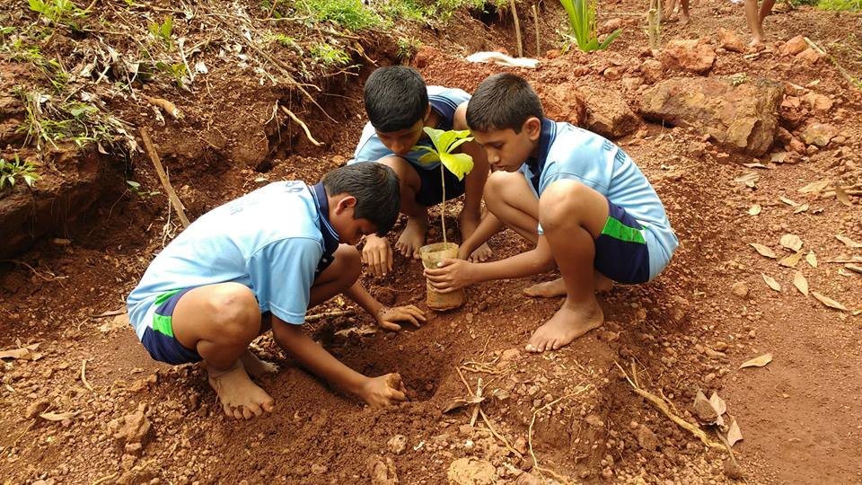
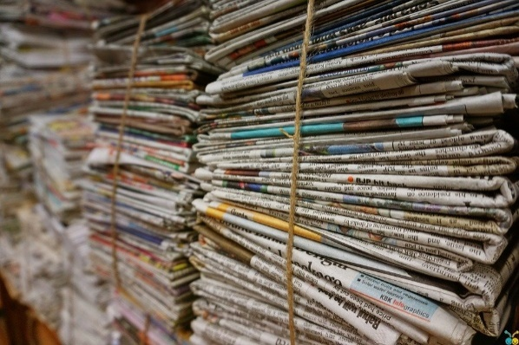
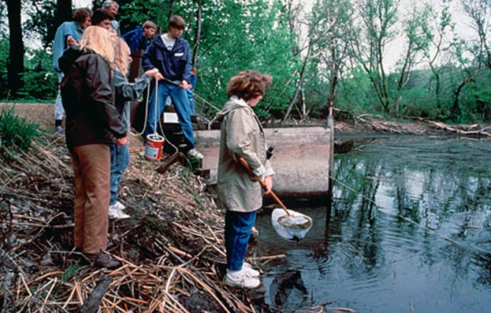
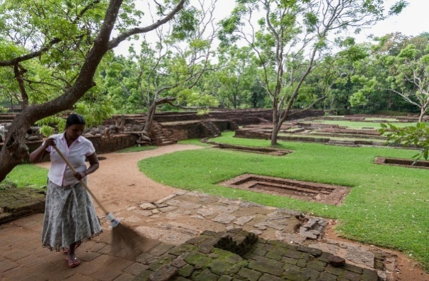
ચર્ચા
શું આપણે આમાંની કોઈપણ પ્રવૃત્તિમાં આપણા પ્રયત્નો લગાવવાનું વિચારી શકીએ છીએ...
વૃક્ષારોપણ
અખબારનું વેચાણ
તળાવોની સફાઇ
ઉદ્યાનોની સફાઇ
Notes:
Notes to the teacher
The children can give their ideas.
Teacher to initiate discussion. She can give lead ideas
Collect old newspapers from housing societies, sell them and support a local orphanage
Clean water bodies and lakes in your area
Plant trees
Maintain local parks and playgrounds
Image source-
Newspaper - https://pixabay.com/photos/bundle-jute-rope-newspaper-1853667/
Planting paper- SSSVV Gallery (Keyword- Planting)
Cleaning lakes- https://commons.wikimedia.org/wiki/File:People_cleaning_river.jpg (by US Fish and Wildlife Service)
Park cleaning- https://pixabay.com/photos/work-cleaning-park-640699/

Slide 7










Attribution / Citation
Slide# | Thumbnail | Source and Attribution | Author
2 |  | Ancient well- https://pixabay.com/photos/step-well-unesco-heritage-site-hampi-286572/
2 |  | Stadium- https://pixabay.com/photos/in-ancient-times-the-ancient-stadium-1063321/
2 |  | Ponds- https://www.flickr.com/photos/davidstanleytravel/43143309230 (Author : David Stanley)
2 |  | Planted trees- https://www.maxpixel.net/Trail-Tree-Lined-Avenue-Spring-Trees-Away-Avenue-3433474
3 |  | Protest - https://pixabay.com/vectors/demonstration-show-me-demonstrate-2137450/
3 |  | Road in forest area - https://pixabay.com/photos/bulldozer-crawler-earth-moving-410119/
4 |  | Children- https://pixabay.com/vectors/three-children-kids-male-female-2747268/ Tree- https://pixabay.com/vectors/tree-forest-trunk-nature-leaves-576847/
4 |  | Cleaning road- https://pixabay.com/photos/children-young-people-clean-road-184729/
5 |  | Boy- https://pixabay.com/illustrations/boy-smart-idea-light-bulb-smiling-1454054/
4 |  | Banner- https://pixabay.com/vectors/signposts-directions-directional-40322/

Slide 8




Attribution / Citation
Slide# | Thumbnail | Source and Attribution | Author
6 |  | Newspaper - https://pixabay.com/photos/bundle-jute-rope-newspaper-1853667/
6 |  | Planting paper- SSSVV Gallery (Keyword- Planting)
6 |  | Cleaning lakes- https://commons.wikimedia.org/wiki/File:People_cleaning_river.jpg (by US Fish and Wildlife Service)
6 |  | Park cleaning- https://pixabay.com/photos/work-cleaning-park-640699/
This digital material has been developed by the Sri Sathya Sai Vidya Vahini, a unit of Sri Sathya Sai Central Trust, Prasanthi Nilayam, as a collaborative offering in the service of our nation.

